Slide 1
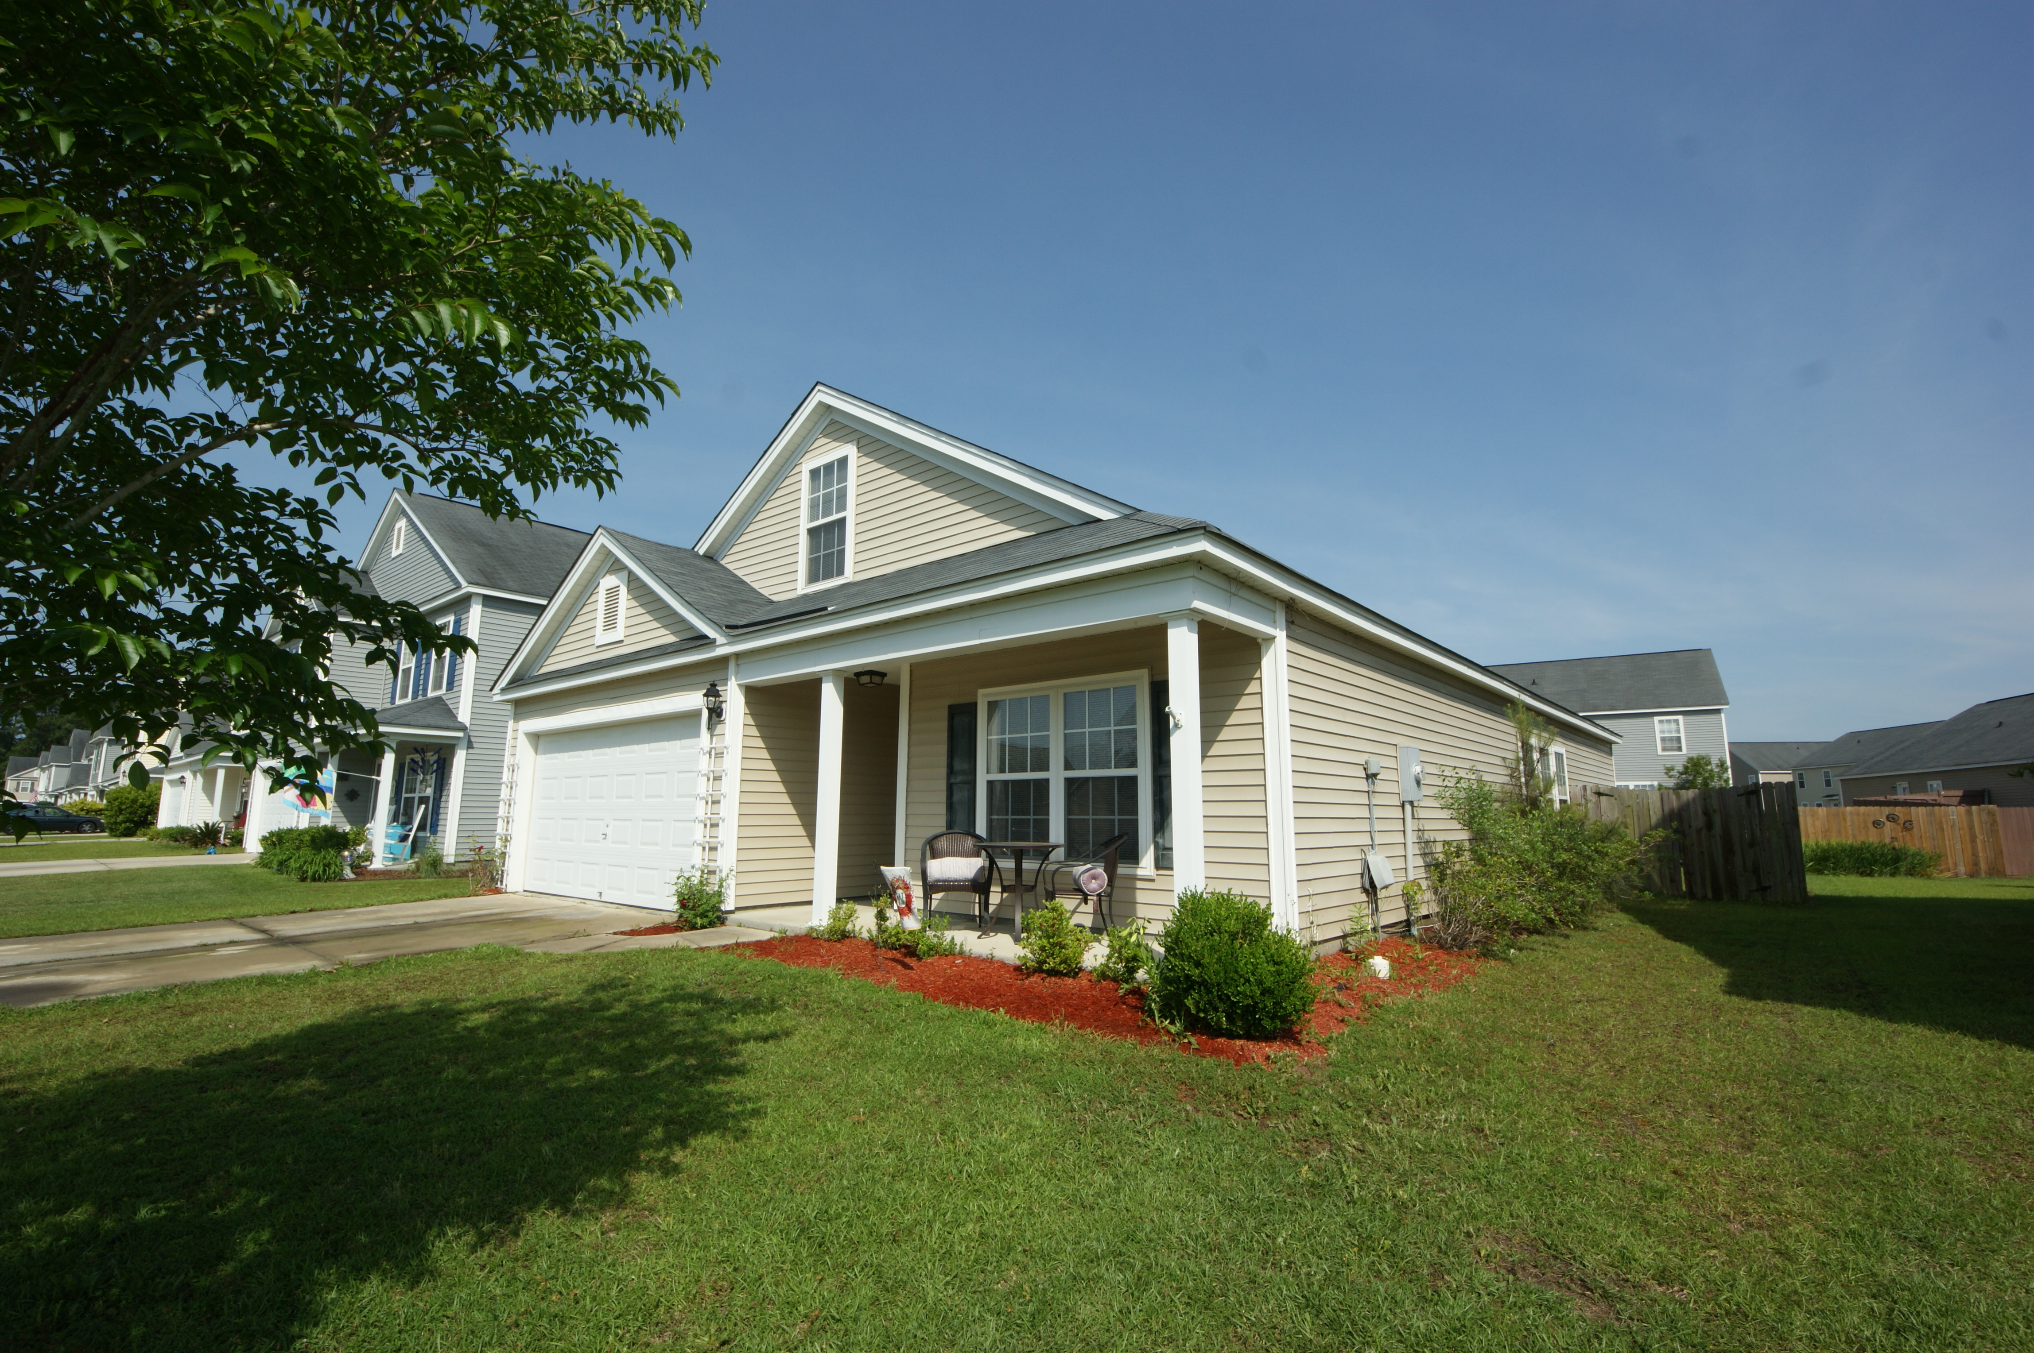
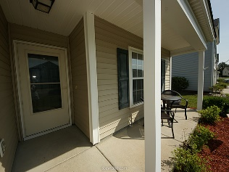
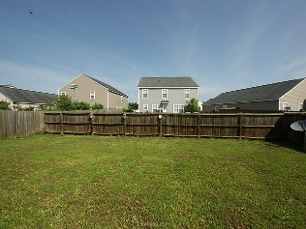
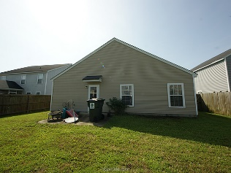
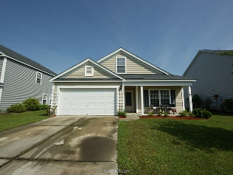


3010 Crusades Street
Hunters Bend ~ Ladson ~ MLS# 15013208 ~ $175,000
Back on the Market &
Newly Painted Throughout!
BACK ON MARKET! NEWLY PAINTED INTERIOR WALLS & TRIM, AND PROFESSIONALLY CLEANED CARPETS! Move in ready in desirable Hunter’s Bend! This 4 bedroom, 2 bath home is located within walking distance of 3 schools. There is a large kitchen which is open to the family room. The master suite has walk-in closets and a deluxe master bath. The secondary bedrooms are separated for maximum privacy, including one finished bedroom over the garage perfect for guest room, office, or a teenager’s bedroom! Enjoy the lovely front porch to relax or chat with friendly neighbors, or retreat to the fully fenced and private backyard.
Kristin Schatmeyer
Cell - (843) 697-7370
kristin.schatmeyer@carolinaone.com
www.KristinSchatmeyer.com
Carolina One Real Estate
2713 Highway 17 North
Mt. Pleasant, SC 29466

