Slide 1
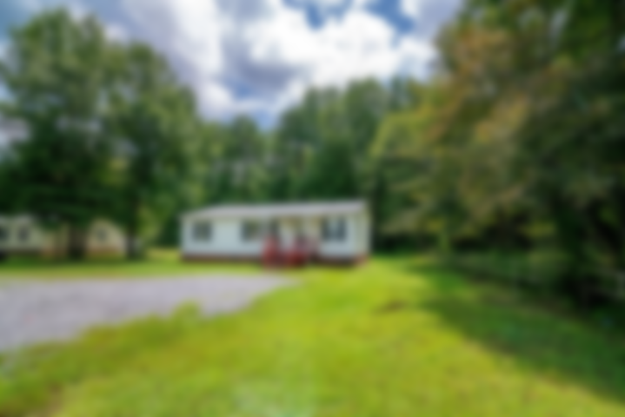
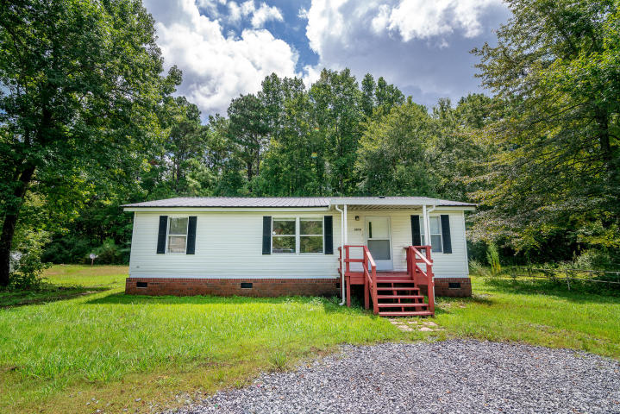
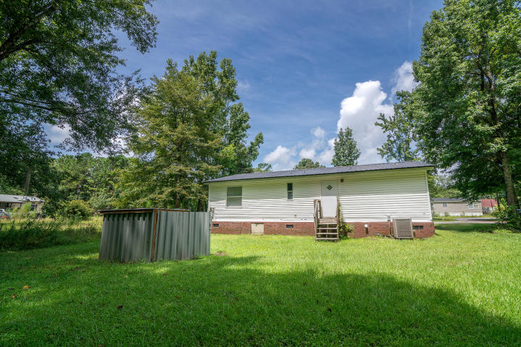
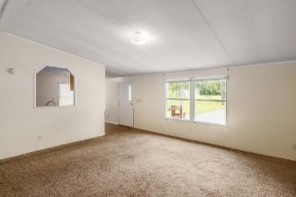
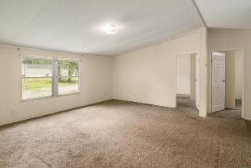
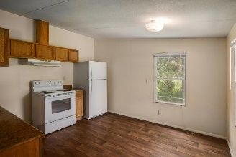
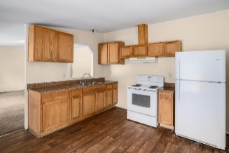
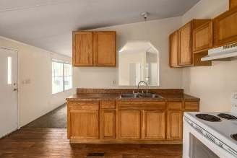
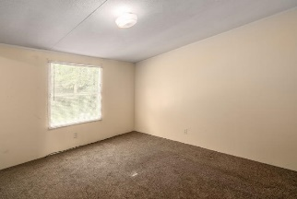
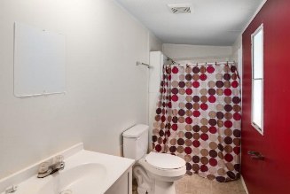
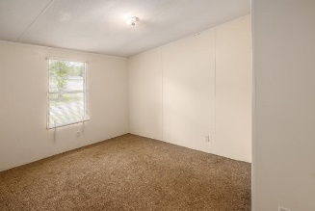
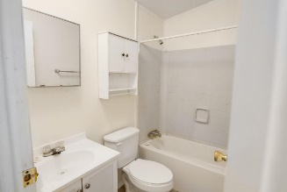
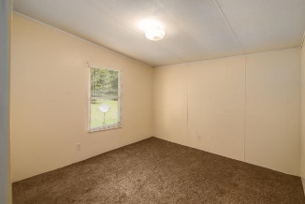


3010 December Lane
Summerville, SC 29485 ~ MLS# 19001687
Just Listed!
3 bd 2 bath on .35 acre lot now at $115,000!
Welcome home to this move in ready 3 bedroom 2bath sitting on a spacious .35 .acre This doublewide manufactured home is on a permanent foundation. It features a large eat in kitchen with plenty of cabinets and counter space. Living room , Master bedroom has a walk in closet w/ attached bathroom, the two secondary bedrooms are split from the master for added privacy. Roof was replaced about 3 years ago, Sewer lines were replaced 8/29/18, newer carpet and freshly painted, just waiting for you to move in and make it your own .Conveniently located near shopping, restaurants and Downtown Summerville. A truly unique property, schedule your appointment today!
Asking $1,200,000
MLS# 17023051
3,692 SqFt
4 Bed/3½ Baths
Short Drive to Historic Downtown Charleston & Beaches
Jacqui Swain
(843) 295-9484
jacqui.swain@carolinaone.com
www.jacquisellscharleston.com
Carolina One Real Estate
1530 Old Trolley Road
Summerville, SC 29485

