Slide 1
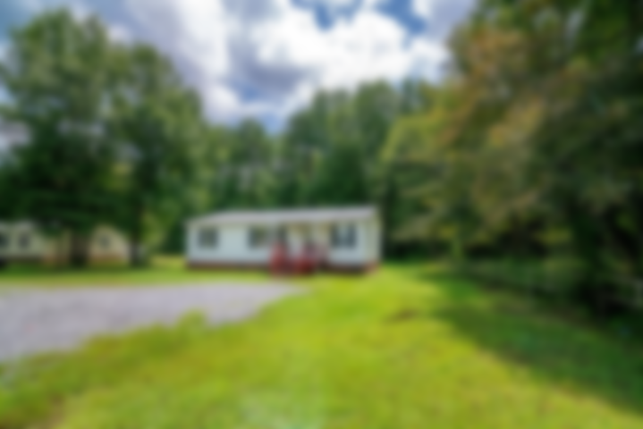
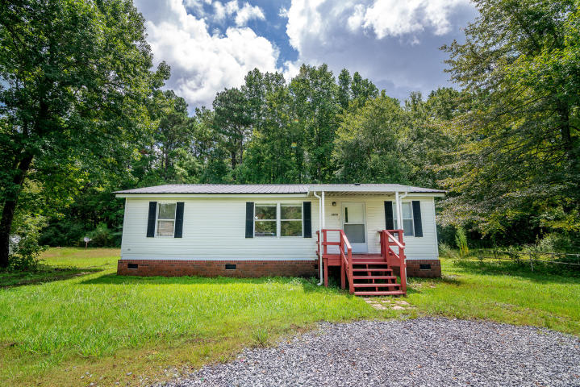
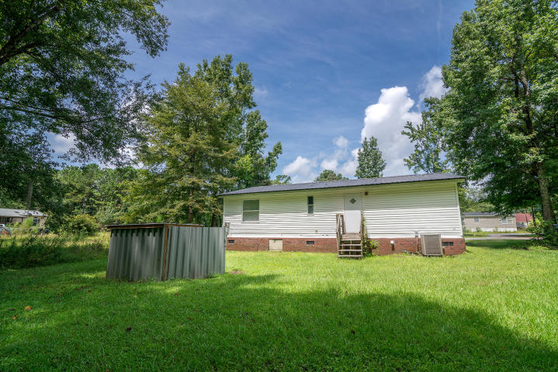
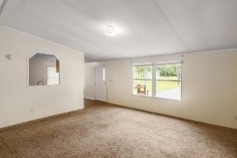
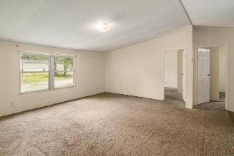
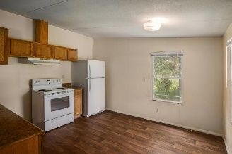
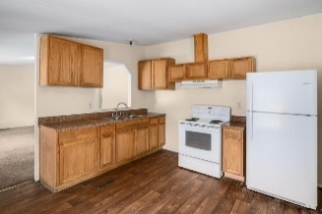
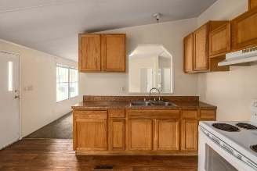
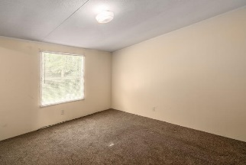
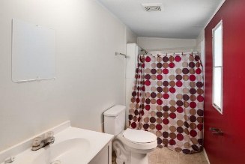
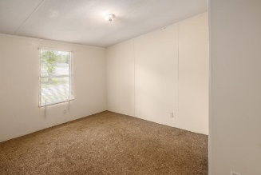
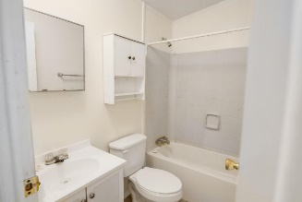
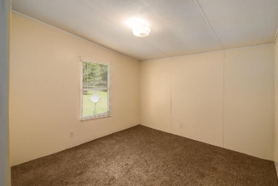


3010 December Lane Summerville, SC 29485 ~ MLS# 18021588 ~ $125,800
Just Listed!
3 Bedroom 2 Bath on oversized lot for only $125,800!
Asking $1,200,000
MLS# 17023051
3,692 SqFt
4 Bed/3½ Baths
Short Drive to Historic Downtown Charleston & Beaches
Welcome home to this move in ready 3 bedroom 2bath sitting on a spacious .35 .acre This doublewide manufactured home is on a permanent foundation. It features a large eat in kitchen with plenty of cabinets and counter space. Living room , spacious bedrooms. Master bedroom has a walk in closet w/ attached bathroom. . Roof was replaced about 2 years ago, newer carpet, freshly painted, waiting for you to move in and make it your own. Conveniently located near shopping, restaurants and Downtown Summerville A truly unique property, schedule your appointment today!
Jacqui Swain (843) 295-9484 jacquiswainc21@gmail.com www.JacquiSwain.c21.com
Century 21 Expert Advisors
100 Seven Oaks Lane
Summerville, SC 29485

