Slide 1
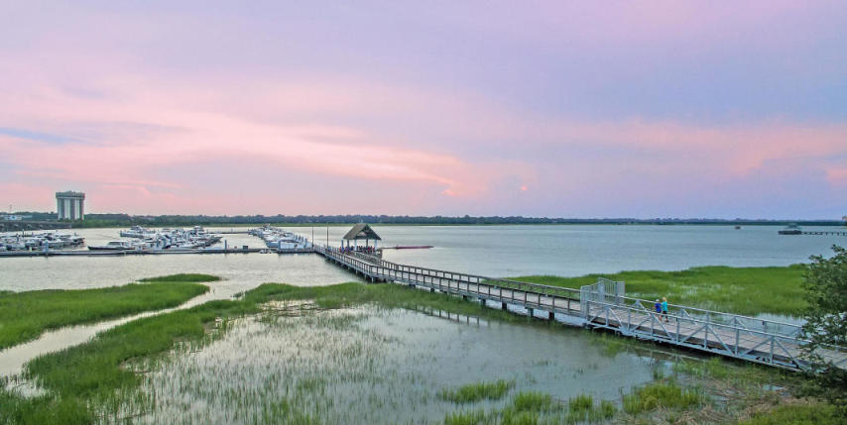

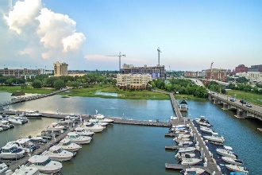
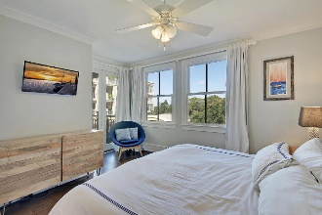
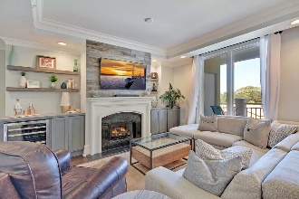
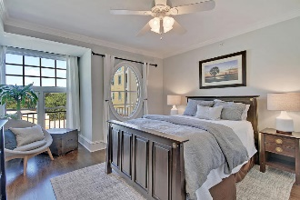
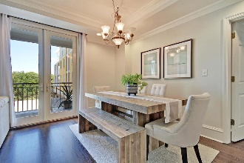
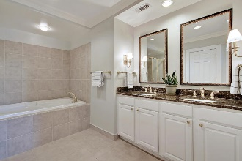
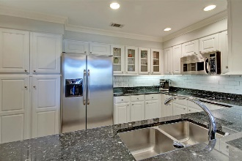
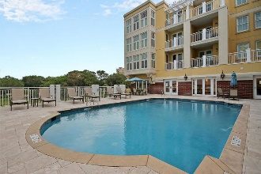
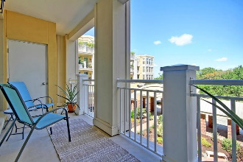
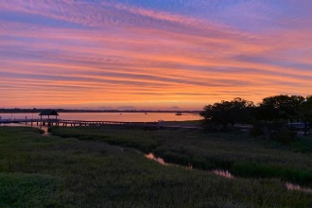

Parkshore Marshfront
$599k in The Bristol!
3010 Old Bridgeview Lane
The Bristol ~ Charleston, SC 29403 ~ MLS# 19025188 ~ AMAZING PRICE! $599,000
This luxurious and beautifully renovated 2 bed, 2bath condo on the Ashley River offers a true Charleston lifestyle to the discriminating buyer. Two deeded, covered garage parking spaces, golf cart, kayak and bike storage, along with a "state of the art" exercise facility, pool, sauna, clubroom and kitchen are some of the amenities to enjoy at the The Bristol. This private, gated community is located riverfront at the Bristol Marina, with private dock access, giving homeowners the perfect location to enjoy all that Charleston offers. Watch fireworks at Joe Riley Stadium from your private balcony, walk thru Brittlebank and local parks, restaurants and Publix grocery, golf cart down King St, take the boat for a ride, or simply relax at home or by the pool.
Dual masters are separated by an open floor plan, including custom built ins, fireplace, wine cooler, kitchen with stainless appliances, granite and tile backsplash. Lots of cabinet and closet storage; guest parking. No transfer fee; flood insurance, cable and water included.
Additional features include:
New hardwood floors
New paint throughout
Crown molding
Great storage
Private access to Bristol Marina
Community room available for rent
Walking distance to new West Edge development (with Publix), MUSC and Roper
Next door to Brittlebank Park
Custom furnishings, washer & dryer, window treatments are negotiable.
Recycling Available
Monthly/yearly dues include cable, water, full-time maintenance on-site property manager, ground maintenance, swimming pool, gym, flood insurance, building insurance, capital reserves, landscaping, two dedicated parking spots, ground level storage, bike/kayak storage, golf cart parking, 24/7 gated, and security cameras
Book your viewing today!
Missy Reid Missy@MattOneillTeam.com (864) 934-5447

