Slide 1
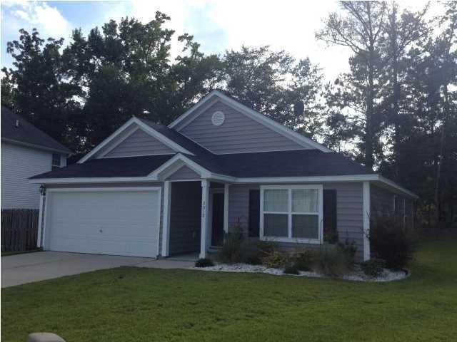
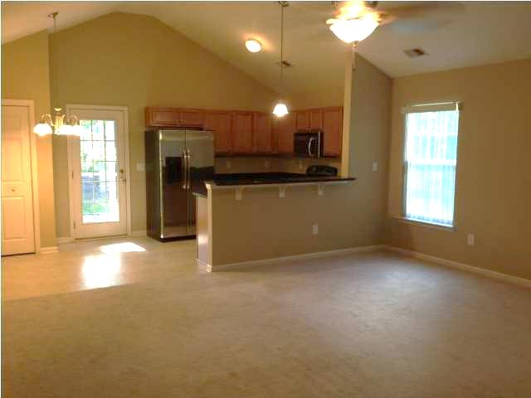
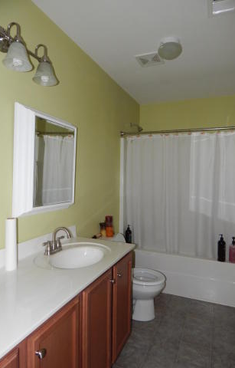
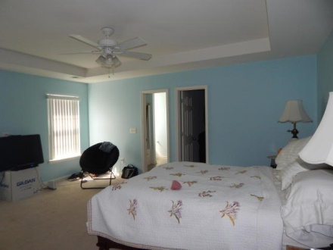
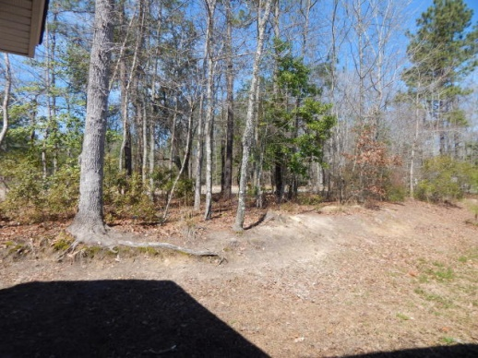
NEW LISTING! Lots of Upgrades!!
3012 Argyll Drive
Glen at Summerset
Summerville
MLS# 15006293
$158,000
ADORABLE ONE STORY HOME! This home offers a wide open floor plan with lots of upgrades. Walk into the large foyer with first bedroom to the right. Front bedroom has tray ceilings and lots of natural light. Hall bathroom is very spacious with plenty of counter space. Enter the living room with breathtaking vaulted ceilings making the room feel HUGE. Kitchen has lots of cabinet space, GE stainless steel appliances, and granite counter tops. Large master bedroom with dramatic tray ceilings. His and her closets offer plenty of storage space. Master bathroom has a deep garden tub for a nice relaxing soak after a hard days work. Third bedroom has vaulted ceilings and plenty of natural light. Large laundry room with cabinets installed for extra storage. Enjoy the private backyard on the beautiful oversized screened in porch - One of the largest in the neighborhood. Hunter ceilings fans are installed in the living room, master bedroom, and one of the secondary bedrooms. This home is a must see and won't last long.
Jennifer Laffey-Foster, MRP
Real Estate Agent
Miler Properties
Office: 843-821-1111
Cell: 843-708-1582
jlfoster86@gmail.com
www.milerproperties.com

