Slide 1

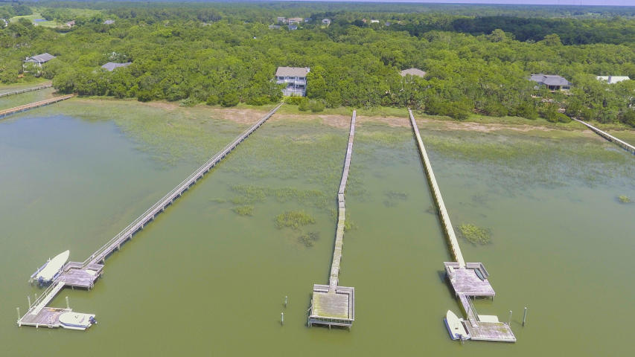
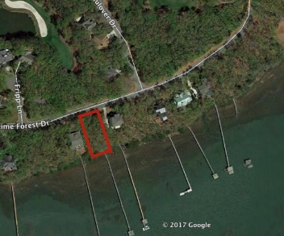
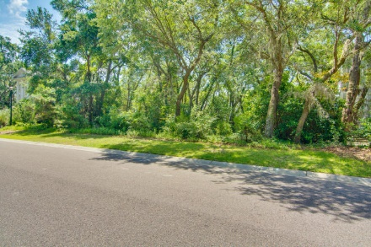
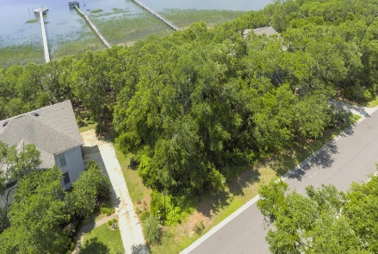
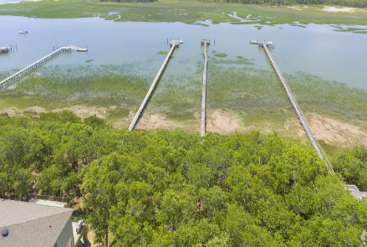
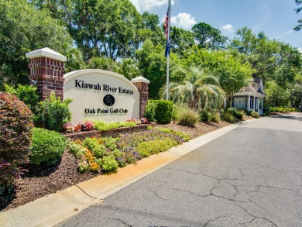
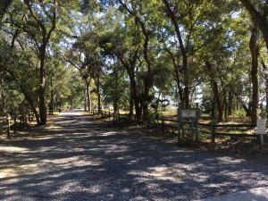
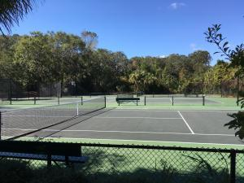



Only Waterfront Home Site For Sale in Kiawah River Estates!
3016 Maritime Forest Drive
Johns Island, SC 29455 · MLS# 17014127 · Just Reduced to $335,000
Build your dream home here in Kiawah River Estates on this fantastic lot with beautiful live oaks situated on Haulover Creek at the confluence of the Kiawah River. This gated community encompasses Oak Point Golf Course. Amenities include a clubhouse, pool, tennis courts, and dockside park with a crabbing, fishing, and kayak dock. Minutes from Bohicket marina/shops and Freshfields Village shopping center. Membership in the Kiawah Island Governor's Club can be purchased by the property owner. Pier head is in place but the dock walkway has been removed.
Lee Lindler
(843) 637-0803 | LeeL@NVRealtyGroup.com
Bob Bush
770-309-0711
bob.bush@nvrealtygroup.com
NV Realty Group | 1900 Seabrook Island Rd | Johns Island, SC 29455
www.NVRealtyGroup.com

