Slide 1
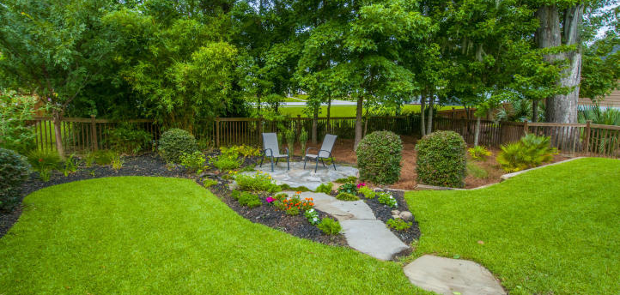
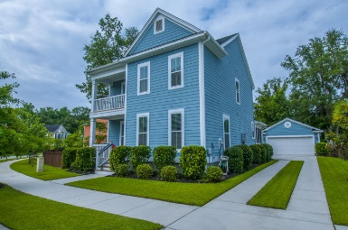
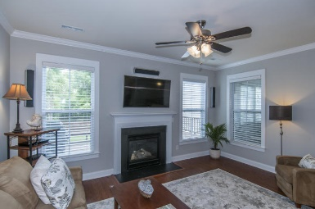
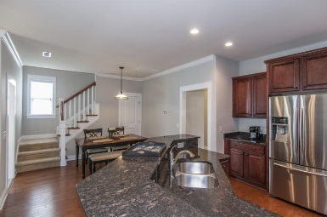
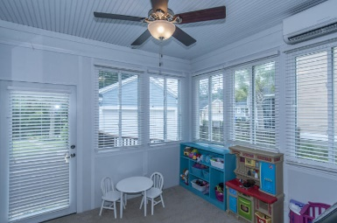
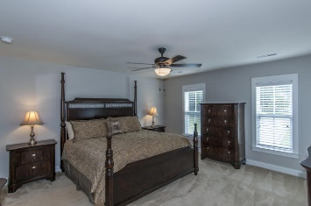
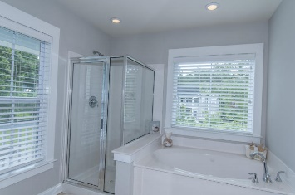
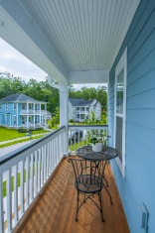
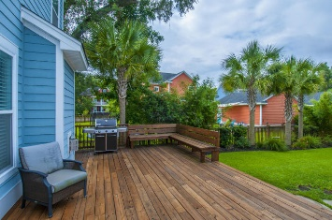
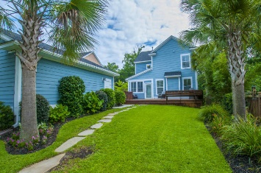


Price Reduced!
3017 Coopers Basin Circle
Carolina Bay ~ Charleston
MLS# 16017758 ~ $364,900
Move in ready home in Salt Grass section of Carolina Bay. Situated on a quiet street with double front porches that exude Charleston Charm. Freshly painted open floor plan with hardwood floors and tons of upgrades including crown molding and fireplace. 4 bedrooms (1 downstairs) and 3 full bathrooms. Kitchen has stainless appliances, multileveled cabinetry, breakfast bar and granite countertops. Eat in kitchen and separate dining room. Four season sun room is heated and cooled by separate Mitsubishi ductless HVAC. Spacious master suite offers access to top porch, ceiling fan, large walk in closet, jetted tub, walk in shower and marble vanity. Outside, you will find a massive deck along with custom landscape and hardscape. Bluestone pavers create walkway through backyard that leads to stone patio next to the beautiful garden area. A four foot wooden privacy fence surrounds the property. There is a 2 car, detached garage that features several steel enforced shelving and storage units. 5 zone in ground Rainbird Irrigation system.
Jennifer Frampton Pait
843-568-9509
jenniferfp@carolinaone.com

