Slide 1
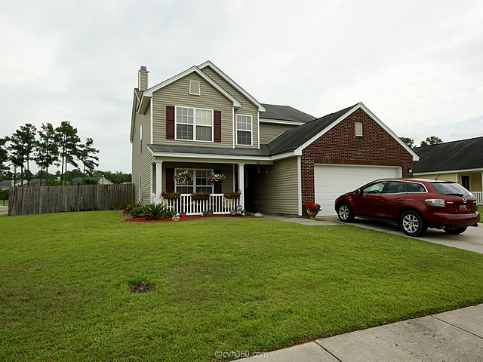
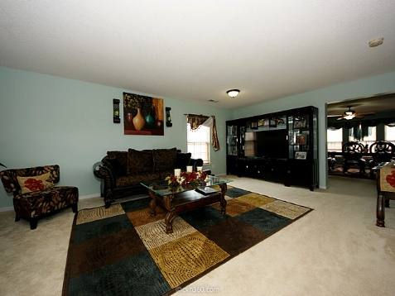
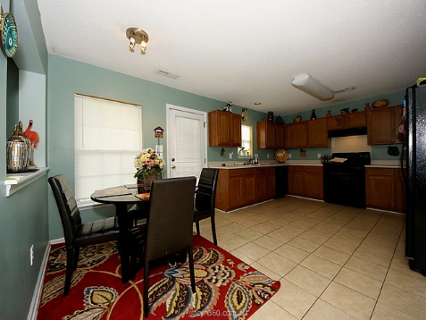
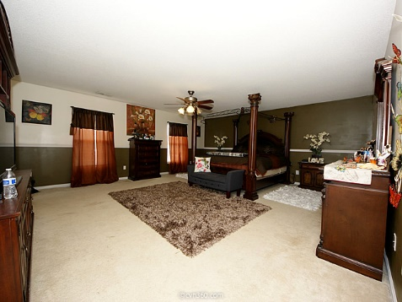
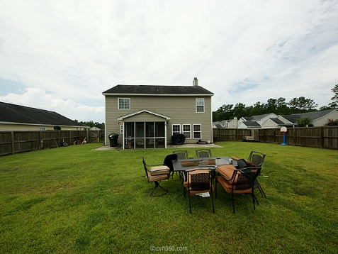
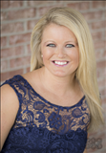

JUST REDUCED FOR QUICK SALE! 301 Edenton | Goose Creek, SC 29445 | MLS# 15017537 | $213,000
137 Beaufain Street
MLS# 15000837 - $1,150,000
Beautiful home on corner lot in sought after neighborhood of Liberty Hall Plantation! With 5 bedrooms & 3 full baths there is ample space for a growing family or conversion to bonus/office space. The family room, currently used as formal dining, boasts a wood-burning fireplace. There is also a eat-in kitchen and formal living room! The master bedroom is huge with a walk-in closet and separate shower & garden tub. Complete with screened-in porch, fully privacy fenced yard & 2 car garage! You don't want to miss this one!
Check out the virtual tour for more pix!
Melissa Britt Thierfelder, MRP melissabritt@remax.net
Office: 843-442-8787 | Cell: 843.725.8016
www.melissabritt.remax-carolina.com
RE/MAX Elite | 91 Broad St | Charleston, SC 29401

