Slide 1
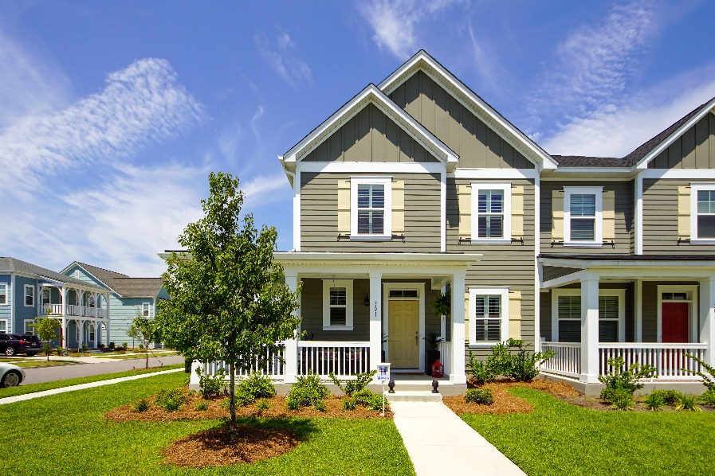
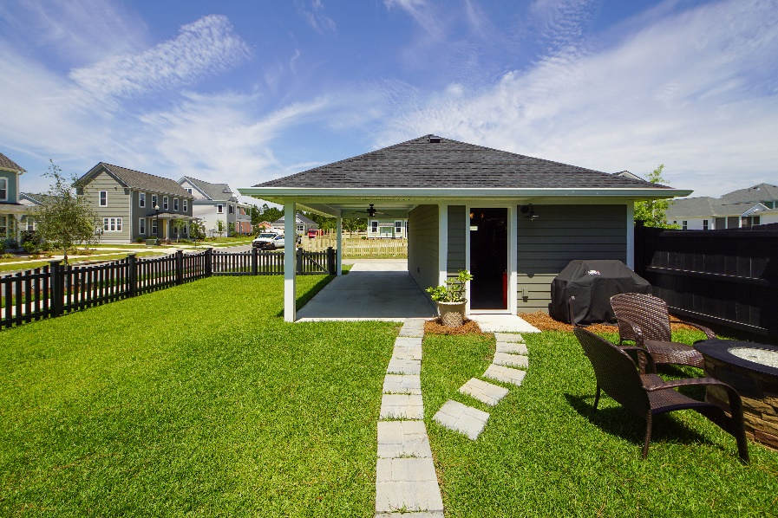
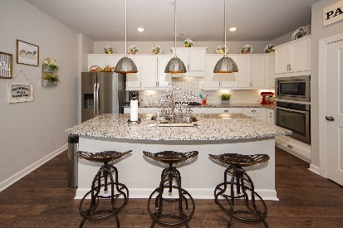
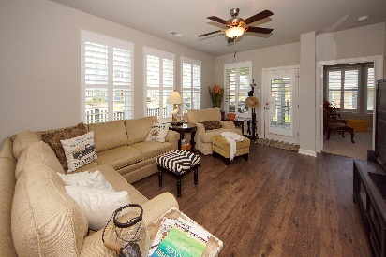
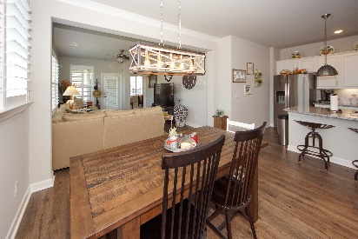
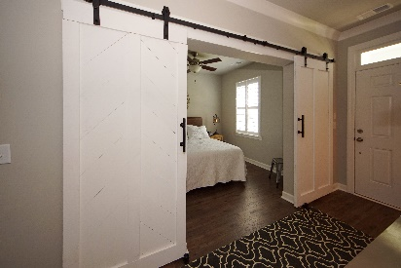
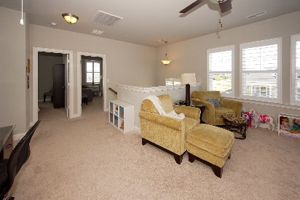
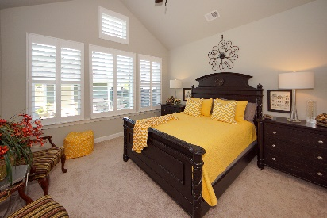
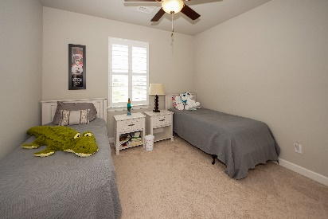
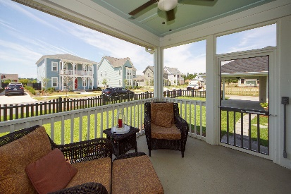


301 Garrison Street
Carnes Crossroads ~ Summerville, SC 29486
MLS# 19018473 ~ $326,000
New on the Market!
Awesome 2 story open concept corner lot townhouse with custom extended fence, detached carport and garage with parking for four vehicles. The master bedroom is downstairs with a walk-in shower, double vanities, and large walk in closet. There are 2 bedrooms, large retreat, full bath, large walk-in attic walk-in closet upstairs. Upgraded kitchen with granite counter-top, under-cabinet lighting, ceramic back-splash, sliding shelves, island, pendant lights, and stainless appliances. Study on first floor with custom barn doors. Hardwoods in family, foyer, study, dining, half bath, and kitchen. Ceramic tile in bathrooms. Crown molding in foyer and dining room. Custom plantation shutters throughout. Upgraded interior/exterior lighting. Laundry room down.
John H. Beckroge
ABR, EPRO, REALTOR
jbeckroge@gmail.com
(843) 367-3196
Brand Name Real Estate | 4 Carriage Lane Suite 106 | Charleston, SC 29407

