Slide 1
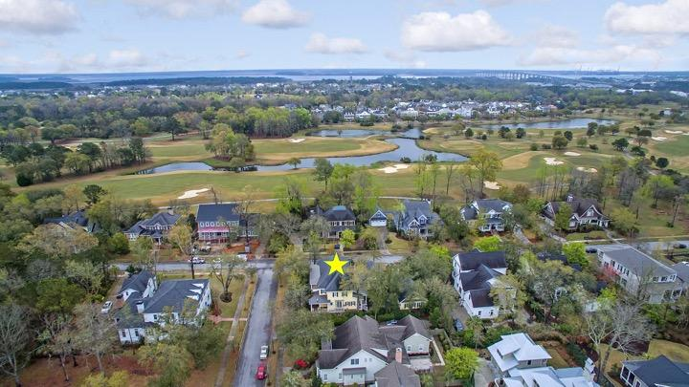
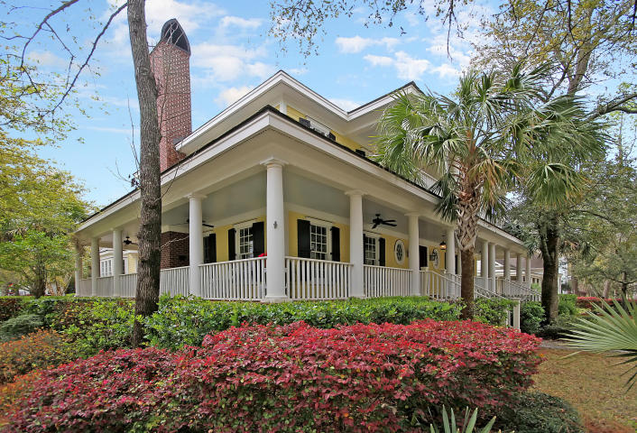
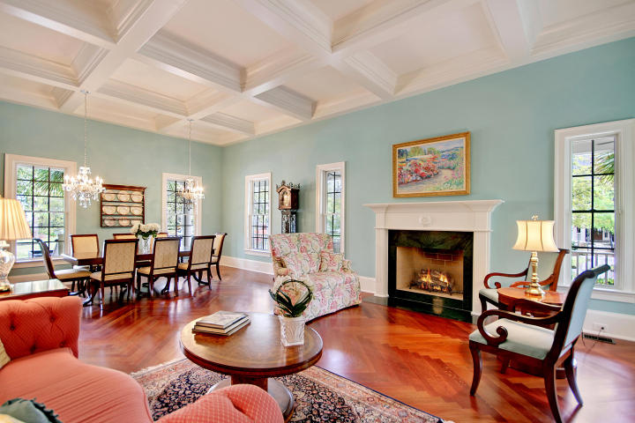
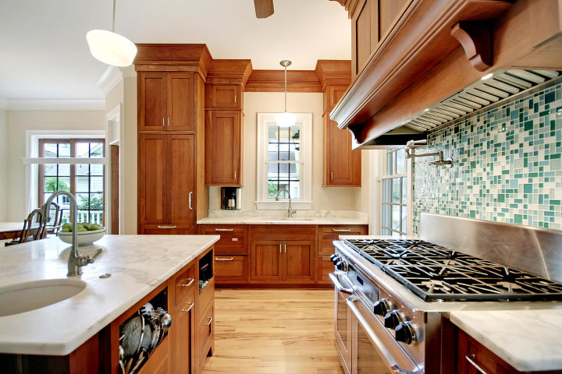
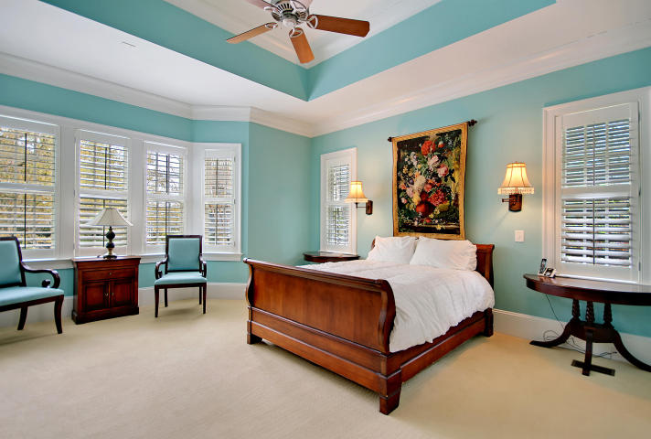
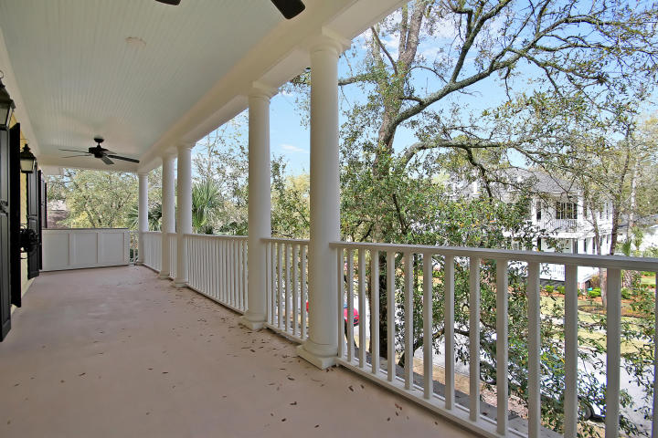
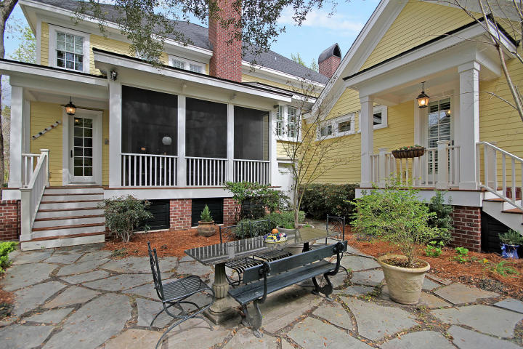
Great Downtown Investment Opportunity
Price Reduced in Daniel Island Park!
301 Hidden Bottom Lane Daniel Island, SC 29492 ~ MLS# 18007993 ~ $1,195,000
Let your island living lifestyle begin at this elegant custom home located in the desirable Daniel Island Park neighborhood just a short walk to the Club and community amenities. The attention to detail and quality of construction will become apparent the moment you step onto the property. Currently set up as a 4 bedroom 4 1/2 bath, with a 900 sqft, unfinished ''flex space'' on the second level that has plumbing in place for a full bath, this can easily become a 5 bedroom 5 1/2 bath residence - or a place to create your dream man cave, media room, or 2nd master suite. The outdoor living spaces are equally impressive with a backyard patio, a fireplace on the screened-in porch, a massive wrap around front porch and an upper level balcony. 12 foot ceilings, built in Murphy bed in the home office, chef's kitchen, and the relaxing master suite all come together to create DI oasis!
Additional features include:
All bedrooms have en-suite baths giving everyone comfortable accommodations
Living/dining room area has a coffered ceiling, fireplace and built-ins in the dining area
Owner's retreat has a sitting area, three walk-in closets, and a door that leads to the private patio out back
Great storage on two, ground level rooms
Beautiful cherry and maple wood flooring, carpet, tile, and cork flooring
Community amenities include - 2 resort style pools, state of the art fitness center and the convenience of being able to walk/bike to the both of DI's private golf courses
Book your viewing today!
Paige Rhodes 843-830-3281 paige@mattoneillteam.com
Ben Laaper 843-642-3546
ben@mattoneillteam.com

