Slide 1
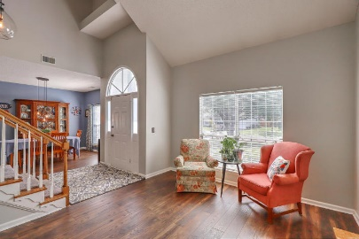
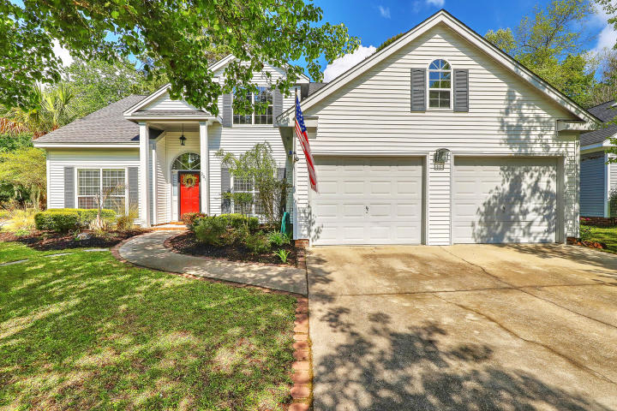
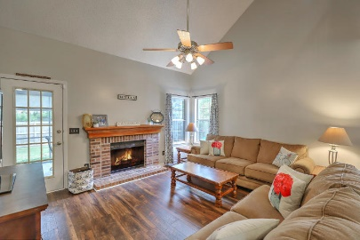
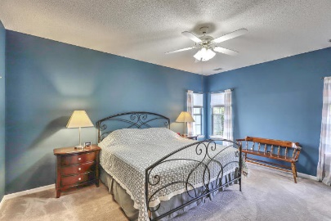
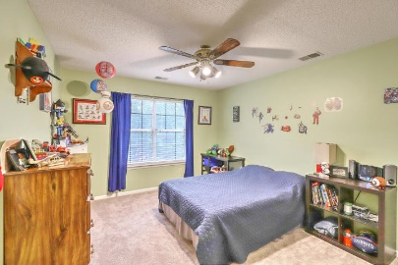
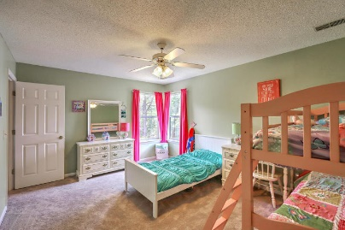
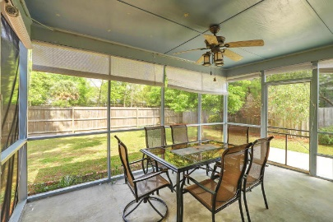
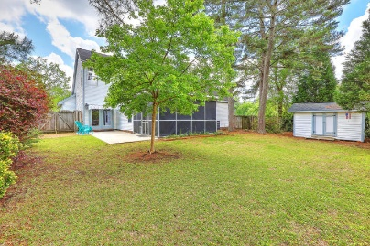


301 Thomaston Avenue
Brandymill | Summerville, SC 29485 | MLS# 19010571 | $274,900
Just Listed!
Open House April 14^{th ~} 1-4pm
This gracious two-story home with master bedroom on main level has so much to offer. Situated on a large corner lot with beautiful established landscaping, you will be greeted by a two-story foyer with both formal living room and dining room, high ceilings, lots of natural light. Owners have added new upgraded light and plumbing fixtures, carpet w/8lb. padding, fresh paint and new laminate flooring. Smart thermostat and newer HVAC unit for upstairs installed 2018. Eat-in kitchen offers plentiful counter space and cabinets. All appliances convey including fridge, washer and dryer. Gather around the wood-burning fireplace in the family room or step outside on the screened porch and relax while overlooking your spacious and fully fenced backyard. French doors in kitchen also lead out to a large patio, perfect for grilling or dining under the stars. Back inside, the master bedroom/bath, which overlooks the backyard, is large enough for a king bedroom suite, has his and hers walk-in closets and a separate garden tub/shower. Upstairs offers 3 bedrooms, 2 with walk-in closets, a full bathroom and extra storage in the walk-in attic. Seller has renewed termite bond(1/2019) with Terminix and is offering a one year home warranty through 2-10 Home Warranty.
Beth Mandell
M 803-463-7734 | O 843-871-2121
bmandell@century21properties.com
www.bestcarolinahomedeals.com
Century 21 Properties Plus of Summerville | 118 W Richardson Ave | Summerville, SC 29483

