Slide 1
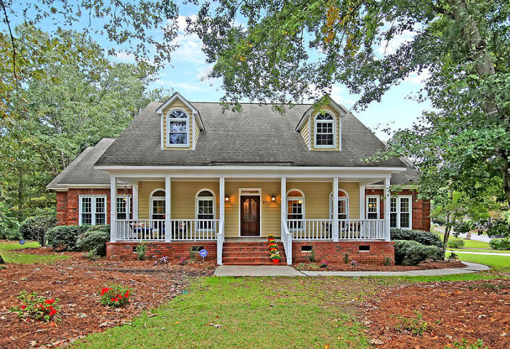
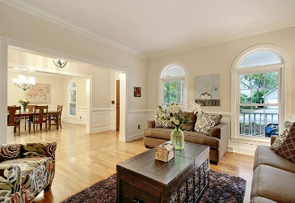
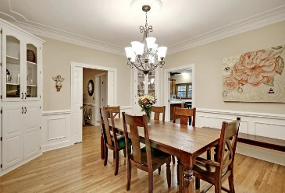
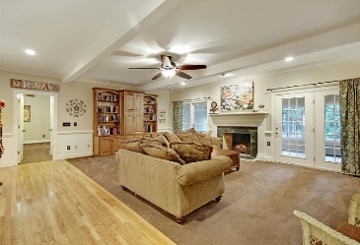
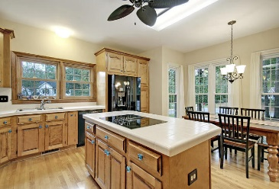
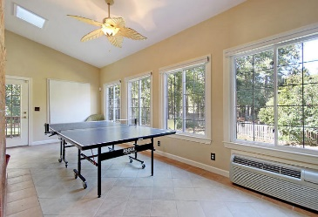
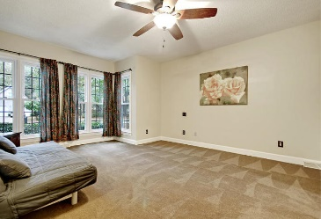
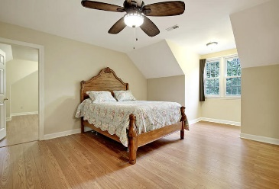
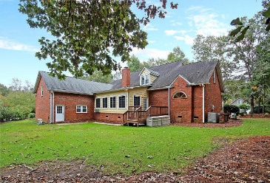

301 Upshur Court Ashborough East · Summerville, SC 29485 MLS# 18030091 · $475,000
Huge Home In Ashborough East
Best Home In Ashborough East
Gorgeous UPDATED 5 bedroom, 3.5 bath, executive home on large .5 acre wooded lot! THIS HOME HAS IT ALL! Full covered front porch leads beautiful wood front door that opens to handsome hardwood floors in foyer, living room, dining room and kitchen. To the left of the foyer is a living room that could also be an office, and to the right is a dining room large enough to entertain a big family or friend gathering. Straight ahead from the entry is an oversized family room with wood burning fireplace and adjoins the sunroom which can hold a sports table, or furniture and has an abundance of natural light. The kitchen has an island, tons of cabinet storage, lots of counter space, desk area, pantry, and an eat-in area with a wall of windows. There are dual master bedroom suites one up one down.
The first suite on the main level is large and has a relaxing ensuite spa-like master bath with updated magnificent tiled floors and fixtures, jetted tub, separate shower, dual vanities, and HUGE walk-in closet. Completing the first floor is the wonderful spacious mudroom/laundry room with sink, countertop, and storage area. The second floor master suite has a separate master get-away room attached to the bedroom for a private living area, workout room, or library, an ensuite bath and walk-in closet. This master bedroom suite would also work for a teen or mother-in law suite! There are three additional bedrooms upstairs and two that share a Jack-n-Jill bath with dual sinks. Completing the upstairs is a 600 sqft bonus room with own stairs, and large walk-in closet: this room could be a media room, office, or 6th bedroom. The home has a vast amount of closet space and an abundance of additional attic storage! Ashborough East in Summerville is a wonderfully landscaped community with a clubhouse, play park, tennis courts, boat storage, and community pool! The neighborhood is close to local shopping and grocery stores and is a short drive to downtown Charleston with 5-star restaurants, world class shopping and iconic history as well as a short drive to the beaches, the airport, Boeing and Daniel Island. Come take a look because you will not find another home that offers as much as this one.
Stan Huff
843-670-2835 stan.huff@agentowned.com
Jill Marcacci
843-297-5590 jill@agentowned.com
www.agentownedrealty.com
AgentOwned Realty Co. Preferred Group, Inc. | 824 Johnnie Dodds Blvd | Mt Pleasant, SC 29464

