Slide 1
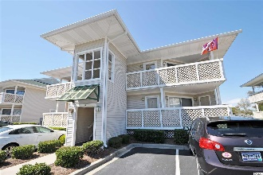
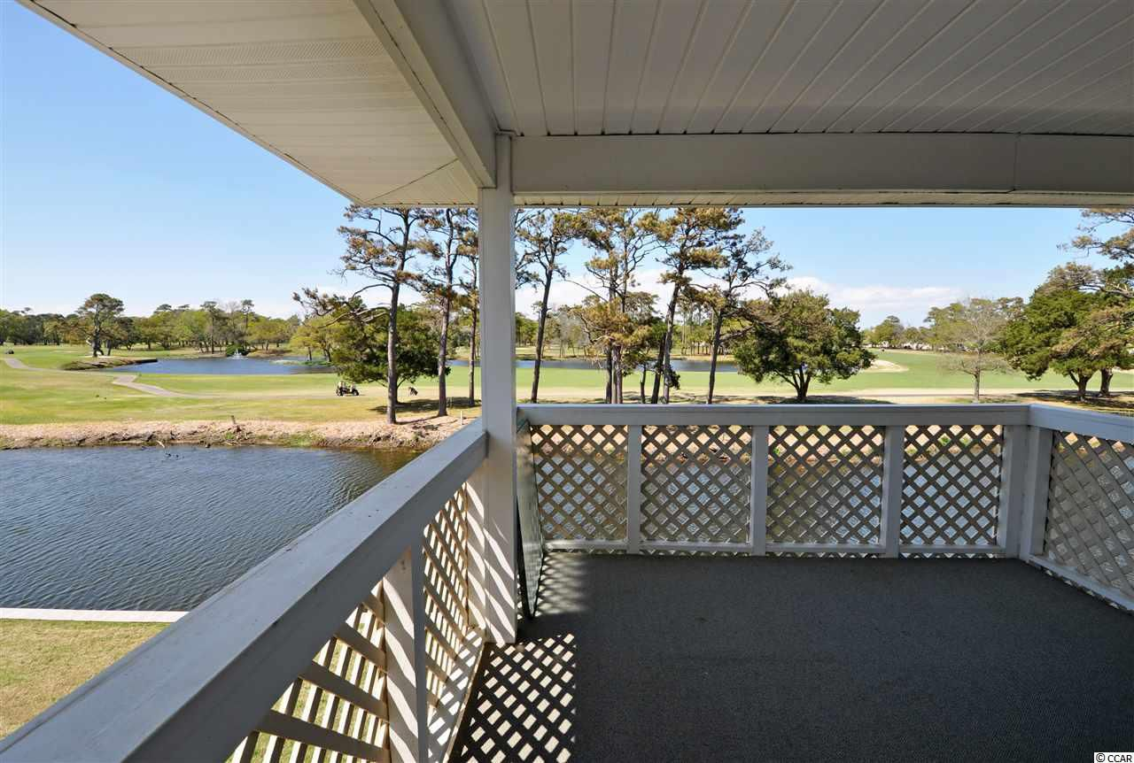
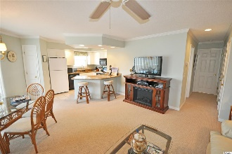
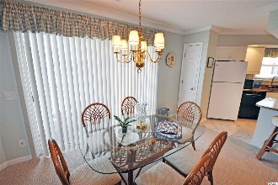
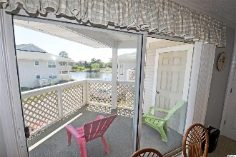
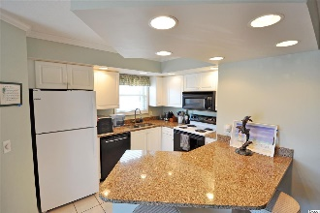
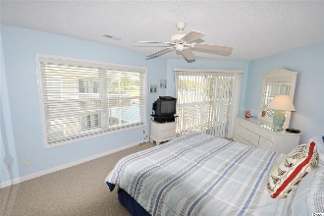
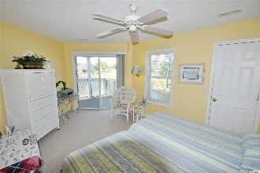
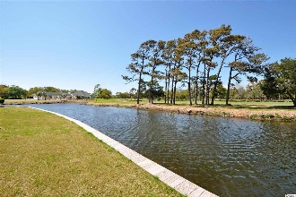
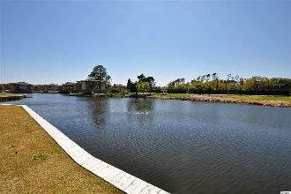
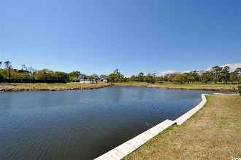


301 Shorehaven Dr #14C
Shorehaven 2 ~ North Myrtle Beach, SC 29582
MLS# 1908475 ~ $224,990
It is all about the Beach! Nestled in a quiet lakefront, golf-course-view location in the Cherry Grove Beach section of popular North Myrtle Beach, Shorehaven 2 is a well-known, proven-value home, second home or investment community. It is across the street from the beach, just named one of the nation's best; and a safe designated walkway provides direct access -- important for families. The wide, white sand beach is truly just a few minutes stroll from this lovely, well maintained 2-bedroom/2-bath treasure. Wonderful wrap-around balconies invite leisure time listening to the waves and watching the golfers, as the balconies also overlook the prestigious Surf Golf Club from the 10th hole as well as its tranquil meandering lakes. This small, private enclave of mid-rise thoughtfully designed condominiums has the Atlantic Ocean at its front entrance and the upscale amenities of a luxurious resort easily accessed within the complex -- a fabulous pool with hot tub & outdoor shower; grill; ample parking, only 4 units per quad; and a beautiful, peaceful environment. No motorcycles or trailers here. This spacious unit is perfect for a romantic getaway or a group, a family or a foursome. This particular building has no current rentals, and many residents are full-time. Its placement in the complex is preferred, too, for privacy and extraordinary views. It is on the second floor so has a grand expanse of those Surf Club vistas. It is well and tastefully furnished throughout, even an electric fireplace in the living room...Enter into the great room and an upgraded open kitchen with granite counter tops, new dishwasher and pantry, and roomy breakfast bar with overhead recessed lighting. The dining room seats six; and the living area is large, cozy and lives comfortably. New Berber carpet adds to the well-planned decor, featuring a nautical/beach theme. The unit is being sold furnished. The big bedrooms are particularly wonderful! There are two fabulous masters with en suites, and they both open to the hallway for guest use. The baths are uniquely functional with sinks separate from the main bathroom tub and showers at the entry to the bedroom. There is ample closet space, and an additional closet has been added to the first master, along with a double-sink vanity. The owners lockout is in the second master. The balcony is splendid and boasts breath-taking views, quiet enjoyment and complete relaxation, conveniently accessed from both bedrooms and off of the main living room. There is a washer/dryer, ceiling fans, and many other features, including an upgraded hot water heater tank for accommodating the company that is bound to visit when you live at the beach. So you may never want to leave. But, if you do, there is lots to do, much of the activities are walk-able -- restaurants, shopping, Shagging, parks and recreation, entertainment and main roads to major highways to experience all that the Grand Strand has to offer. But, ultimately, it is ALL ABOUT THE BEACH. OH, AND DON'T FORGET THAT MIDNIGHT WALK ON ONE OF THE NATION'S BEST BEACHES. THEN SHOREHAVEN 2 IS CALLING YOU BACK HOME...
Deborah Collins
843-424-9013
dctidewater@yahoo.com
Connie Ross-Karl
702-306-2643
conniesross@aol.com
NEW WAY PROPERTIES MYRTLE BEACH

