Slide 1
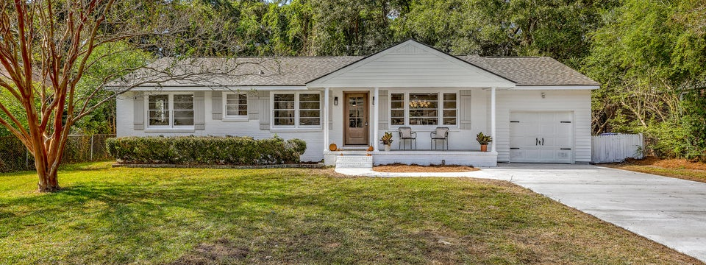
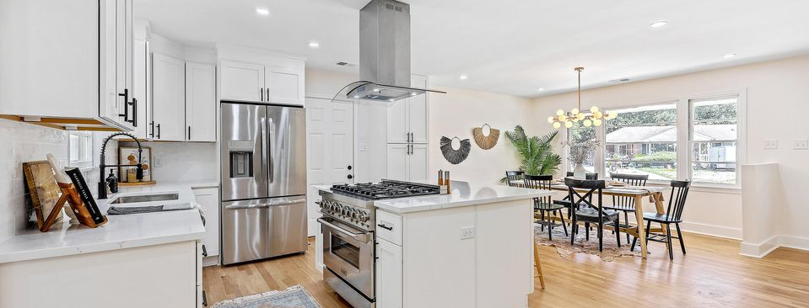
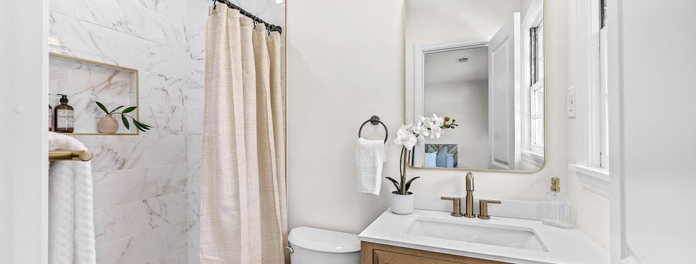
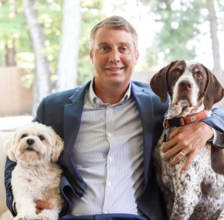
Improved Price & Open House Saturday from 12-2
JUS
9714 ROSEBERRY STREE
MOTIVATED SELLER!
/
7
1/
ii
Fully renovated. Priced to sell! Seller open to any concessions and commissions.
3/2/1 rate buy down? We’re open to it. Send it with an offer and let’s make a deal!
301 Culver Avenue
Air Harbor | Charleston, SC 29407 | MLS# 25028393
TAKE A VIDEO TOUR!
�
$619,900
3 BED
3 BATH
1,512 SQ_FT
0.22 ACRES
Fully reimagined and renovated, this stunning one-story 3-bedroom, 3-bath brick ranch blends timeless charm with modern luxury. Inside, you'll find refinished hardwood floors, all-new solid doors, recessed lighting, and a designer-inspired palette throughout. The chef's kitchen features new cabinetry, quartz countertops, tile backsplash, a 36" gas range, stainless appliances, and a stylish coffee bar area with wine fridge. Two ensuite bedrooms offer spa-quality tile baths, while the hall bath includes a tub for guests or family. The dining area has space for a large table and the den offers spacious seating options around the wood-burning fireplace. The open concept allows entertaining and flow throughout. The large laundry/mudroom bonus space adds versatility and convenience. Enjoy a new roof, new plumbing, fresh paint inside and out, new shutters, a brand-new double-wide driveway, one-car garage, and a large fenced backyard in a quiet, no-HOA neighborhood. Exceptional West Ashley location near the Greenway, I-526, grocery stores, restaurants, and only 10 minutes to downtown Charleston.
Just listed at $635,000. A true turnkey gem.
Scott Baskin
THE SCOTT BASKIN TEAM
843-324-4139
scott@explorecharlestonrealestate.com
SCOTT BASKIN TEAM

