Slide 1
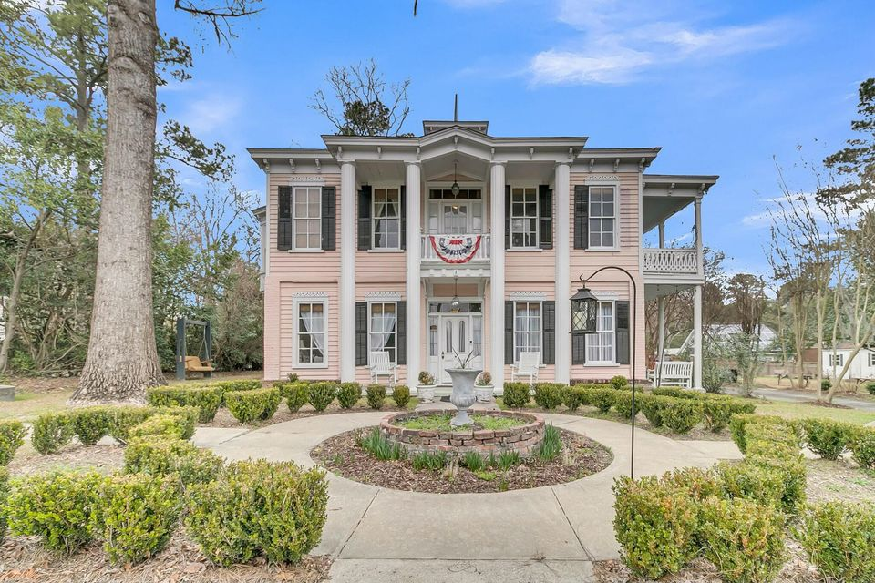
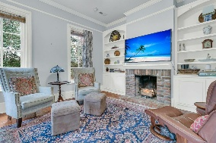
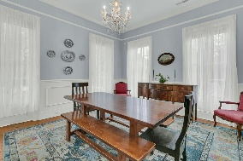
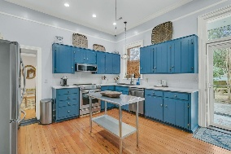
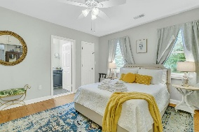
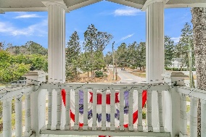
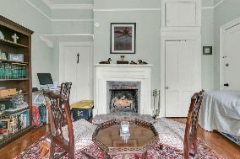
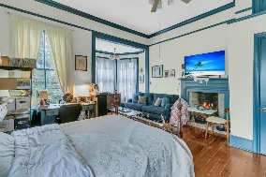
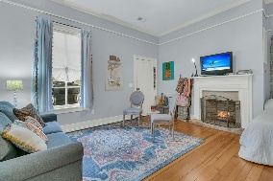
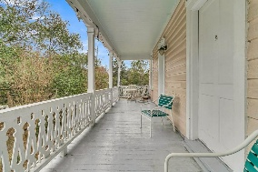
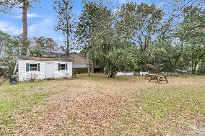
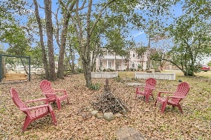
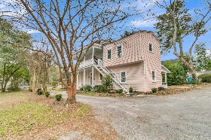
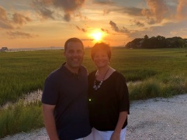

Historic Summerville Home!
Run Your Business Here And/Or Live Here!
301 E Richardson Avenue
Historic District
Summerville, SC 29483
MLS# 25003926
$1,470,000
6 Bedrooms | 5 Baths | 3,602 sf
Own a piece of Summerville history! This home, formerly known as the Pink Dolphin, is an opportunity to be within two blocks of Summerville town square and everything it has to offer as well as a home that can bring in supplemental income. There are two rental opportunities within this home, each with their own separate entrance. The possibilities for this home are endless! The current owners have done a lot of work to the home including, all new plumbing throughout, main kitchen renovation, tons of landscaping, painting, etc.. The home has heart of pine flooring, large windows, eight fireplaces, tons of historic touches that you would expect of a home built in 1881. Off the kitchen, with its own exterior entrance, is an Airbnb rental that is consistently rented.
It has its own small porch to sit and relax on, bedroom with kitchenette and full bathroom. The remainder of the first floor consists of the dining room, living room with built in shelving and the primary bedroom with its own full bath. Head upstairs and there are three more bedrooms, one that can also be a primary and the large rental that has an entrance from the side porch, a full kitchen, full bathroom, living area and bedroom. Up the second floor stairs is the access to the cupola. During the time this house was built, this cupola was more than likely used for ventilation. The location of this house is phenomenal. Walk down the street away from town and you are on the sawmill branch trail, which is heavily used by walkers, runners and bicyclists. This trail will take you right to the local grocery store. Walk a short two blocks in to town and have access to several amazing restaurants, the Ice House, Laura's, Sweetwater cafe, Bexley, Accent on Wine, Wine and Tapas, the Frothy Beard. Tons of shopping in walking distance as well, from clothing and shoes to home decor. Then within a two mile drive, you have tons of more stores and restaurants right at your fingertips! This home is a great opportunity for you to start your own business. It's also located within the Dorchester District 2 school district!
Larry & Kathy Mazalatis
Larry Cell 843-693-0529
Kathy Cell 843-693-0159
mazteamrealty@gmail.com
AGENTOWNED REALTY | 1800 TROLLEY RD | SUMMERVILLE, SC 29485

