Slide 1
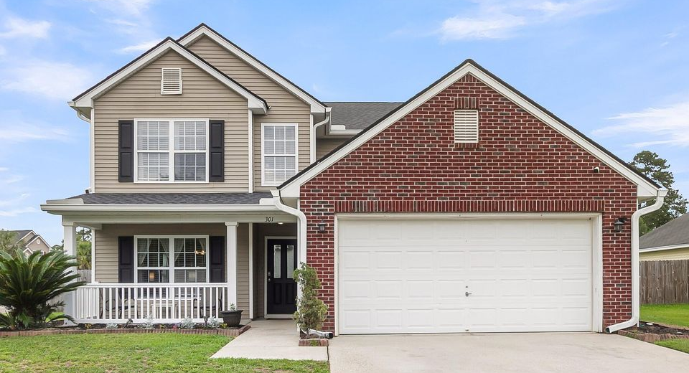
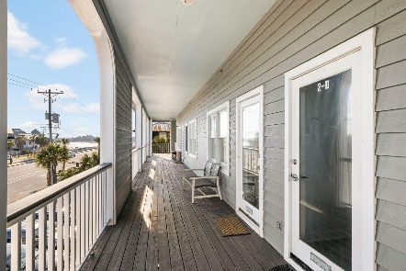
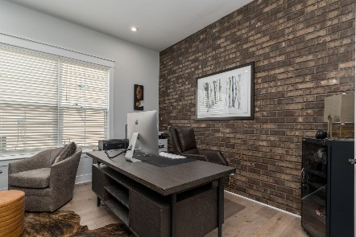
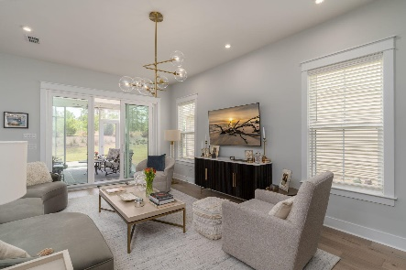

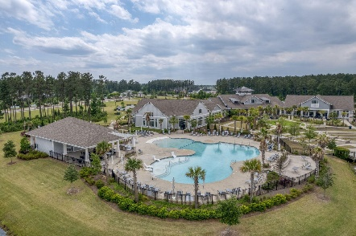
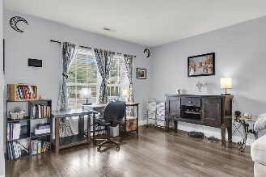
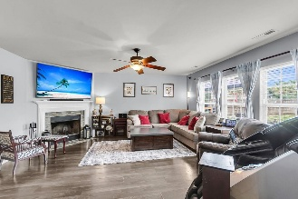
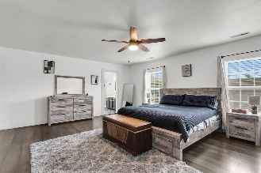
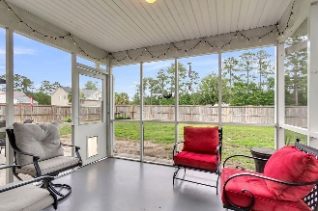
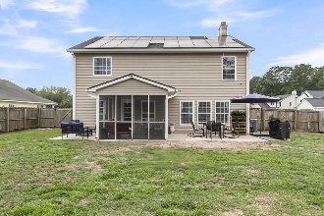
301 Edenton Road Liberty Hall Plantation | Goose Creek, SC 29445 | MLS# 25014358 | $423,959
Darrell Creek Elevated Home With Elevator & Salt Pool
Liberty Hall Corner Lot
Co-sponsored by
Sellers now offering $15,000 toward buyer concessions, closing costs or rate buy down.
Nestled on a desirable corner lot within the highly sought-after Liberty Hall Plantation, this five-bedroom, three-bath home offers an exceptional living experience. The downstairs living area boasts elegant laminate flooring, flowing seamlessly from the formal living and dining rooms into the inviting family room, complete with a cozy wood burning fireplace. The open kitchen is a chef's delight, featuring, tile floors, ample countertop space and tastefully painted cabinets. One bedroom and full bath is also on the lower floor, for ease of access or for a private guest room! Step outside to a fenced backyard and relax on the screened-in porch, perfect for enjoying the outdoors.
Upstairs, the enormous primary bedroom provides a private retreat, complemented by a very large walk-in closet. The primary bath is equally impressive, offering a garden tub, separate shower, and dual sinks for ultimate comfort. Three more spacious bedrooms round out this home's interior, as well as a dedicated laundry room!
Liberty Hall is an established neighborhood with amenities that include a pool, sand volleyball court, playground, soccer fields and baseball area, sidewalks throughout and ponds.
Solar panels on the home were purchased and installed in Aug of 2021. With an acceptable offer the seller is willing to pay off the balance for the new homeowner to enjoy the benefits of solar power without any of the cost. Seller is one to buyer concessions. Bring all offers!
Offering $3000
Lender Credit
Rochelle Rennert
843-847-9694 | rochellesellscharleston@gmail.com | www.RochelleSellsCharleston.com
AgentOwned Premiere Group, Inc. | 219 N Highway 52 Ste A | Moncks Corner, SC 29461-3926

