Slide 1
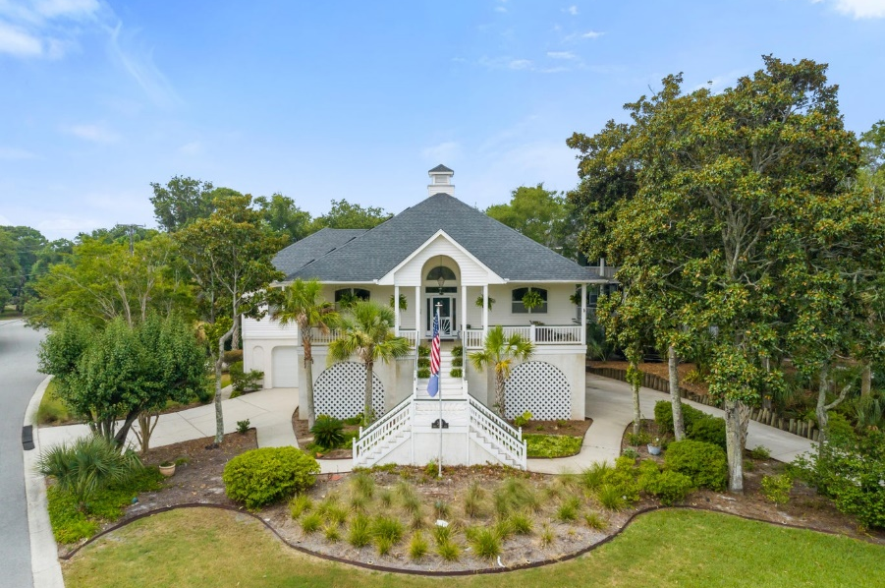
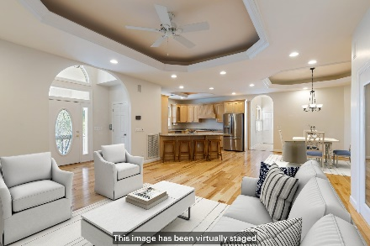
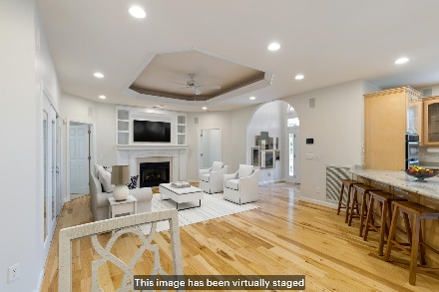
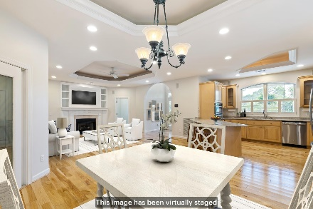
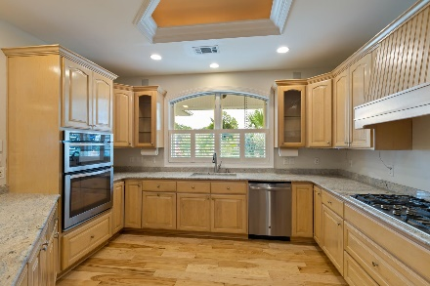
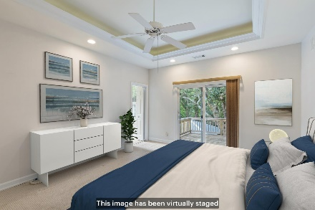
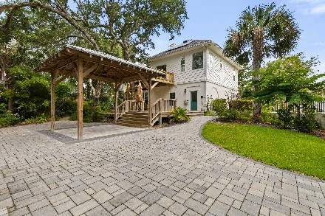
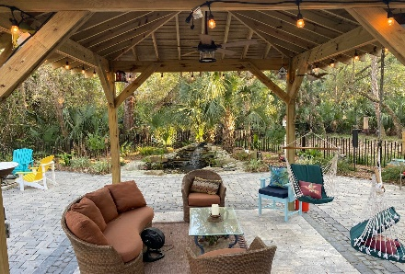
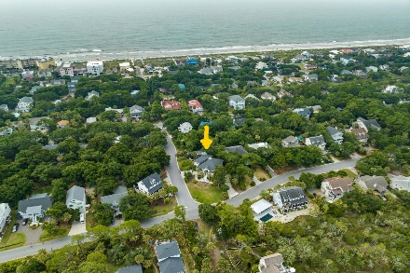



301 W Indian Avenue Sunset Point Folly Beach, SC 29439 MLS# 23016559 $1,725,000
Just Listed
Welcome to your dream coastal oasis in Sunset Point on Folly Beach. This exquisite residence offers an unrivaled coastal lifestyle that will truly captivate the discerning high-end buyer. Immerse yourself in the serene ambiance of this prestigious neighborhood and indulge in the luxury of a convenient stroll to the beach via the exclusive 3rd street access. Along with the proximity to the vibrant shops and restaurants on Center Street, you can fully embrace the coastal charm Folly Beach has to offer. Perched on an expansive lot approaching half an acre, this elevated home boasts one of the highest lots on the island. Inside, you'll discover an open floor plan adorned with gleaming wood floors, showcasing the perfect balance of elegance and comfort. This meticulously maintained residence offers three spacious bedrooms and three full bathrooms.
As you enter, the porch awaits, transformed into an ideal home office space, enveloped in natural light. The well-appointed kitchen acts as the heart of the home, featuring stunning wood cabinets, exquisite granite countertops, and stainless appliances. Retreat to the grand master suite, distinguished by a tray ceiling, private balcony access, and an ensuite bathroom. Indulge in relaxation within the expansive soaking tub or revitalize in the walk-in glass block shower, complete with a generously sized walk-in closet.
The additional bedrooms offer both spaciousness and ample closet space, with a shared "jack & jill" bathroom, perfect for accommodating guests or loved ones.
Step into the expansive backyard sanctuary, an idyllic setting for cherished moments spent gathering with friends and family. Here, you'll find a generous deck built around a beautiful Oak Tree, a beautifully paved patio with a covered gazebo, and a coy pond, ideal for entertaining and savoring the coastal breezes.
Parking is never a concern with this prestigious home, as it offers the convenience of three driveways along with a spacious climate-controlled garage, providing accommodation for up to four to five vehicles or room for a small boat. An enclosed room within the garage presents an exciting opportunity for a personalized bar or a delightful playroom for kids.
Discover the pinnacle of luxury beach living in this exquisite property at Sunset Point on Folly Beach. Embrace the tranquility, elegance, and sophistication of this extraordinary residence that truly embodies coastal living at its finest. Welcome home.
Stephen Kugelman
(843) 330-0403
steve@agentowned.com
www.kugelmanrealestate.com
Ashley Melton
(843) 670-2333
ashley.melton@agentowned.com
www.CharlestonPalmettoHomes.com
AgentOwned Preferred Group | 824 Johnnie Dodds Blvd | Mt Pleasant, SC 29464

