Slide 1
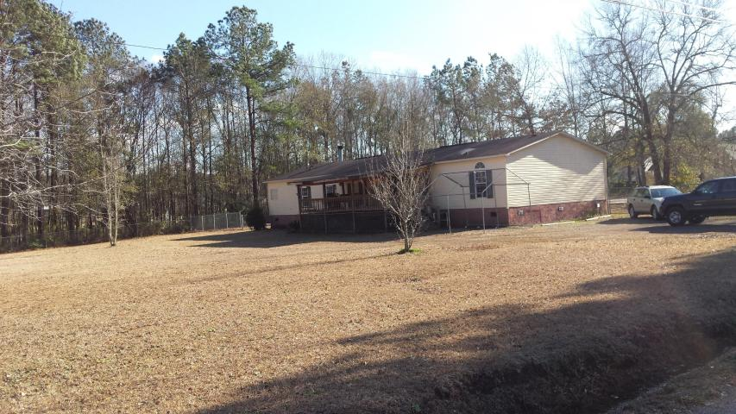
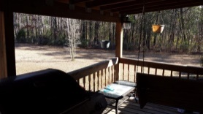
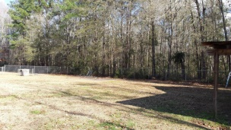
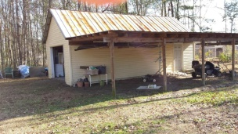
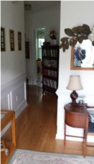
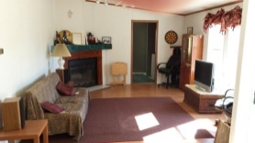
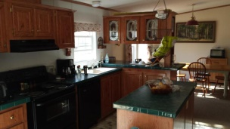
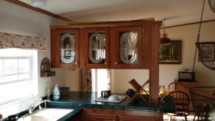
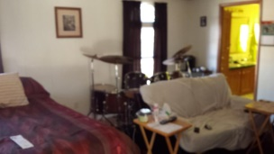
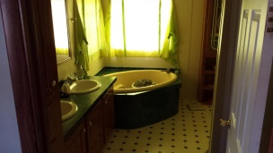


3020 December Lane Ladson, SC 29485 MLS# 15001456 $134,900
Country Living Close To The City ~ $134,900
1.86 acres of level land with lots of privacy!
4 BEDROOMS | 3½ BATHS | 3,600 SQ FT
A little country but close to the city! 4 bedroom 2 1/2 bath with an extra 5th room that can be used as an office or spare bedroom! Large kitchen with Island and eating area. Formal dining room and a family room with w/b fireplace. Large level lot with the back half fenced and the front half open. The large garage has a connected 2 car carport and has storage above. The home is in good condition but could use a touch of TLC. The front porch is covered and is approximately 10x22. There is also a new 8x10 deck on the rear of the home. If your looking for a quiet laid back kind of living this is truly for you. Not a short sale or foreclosure. If schools and square footage is important verify information.
Randy Spear
843-568-2800 M
rspear@carolinaone.com
Carolina One Real Estate
1530 Trolley Road
Summerville, SC 29485

