Slide 1
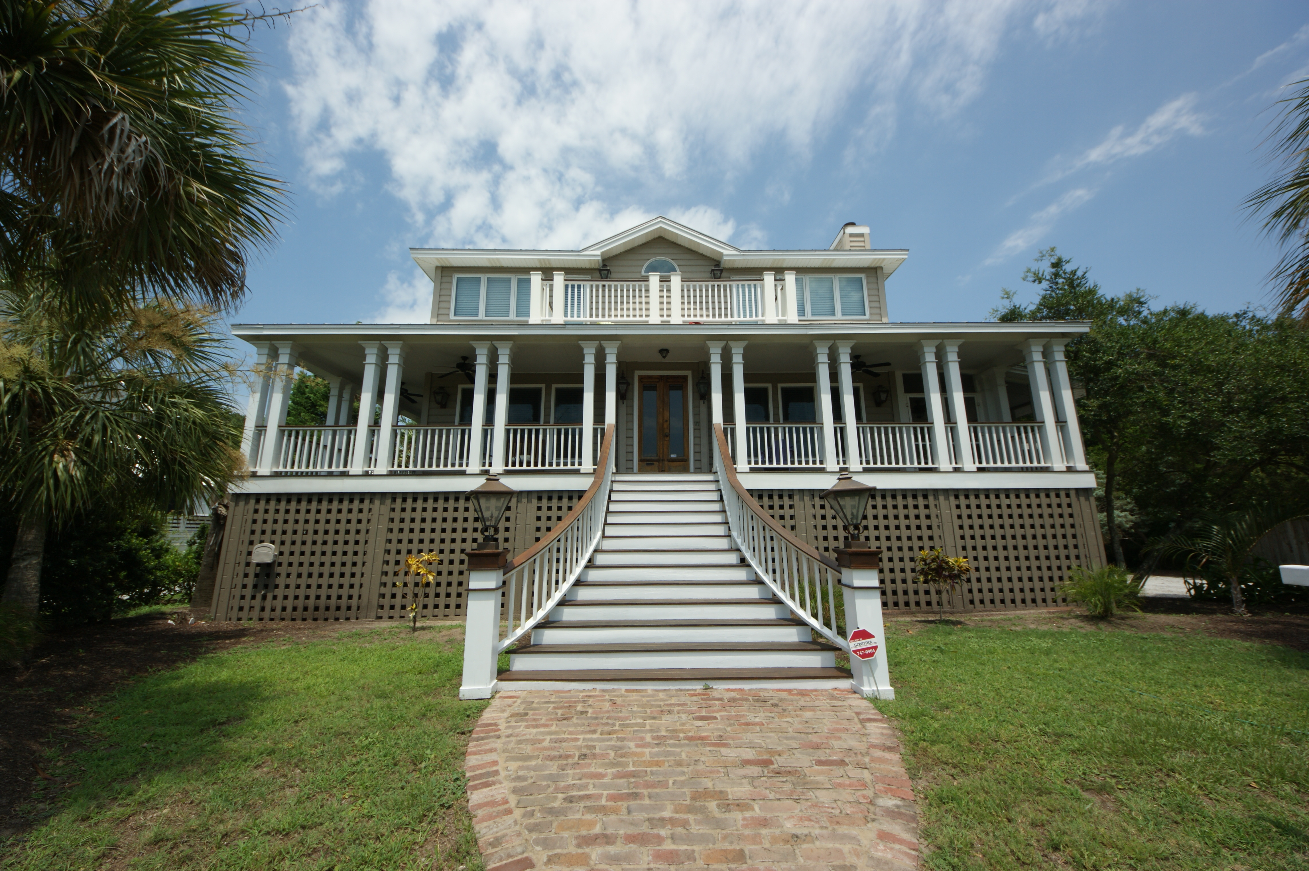
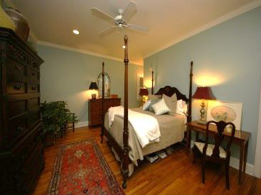
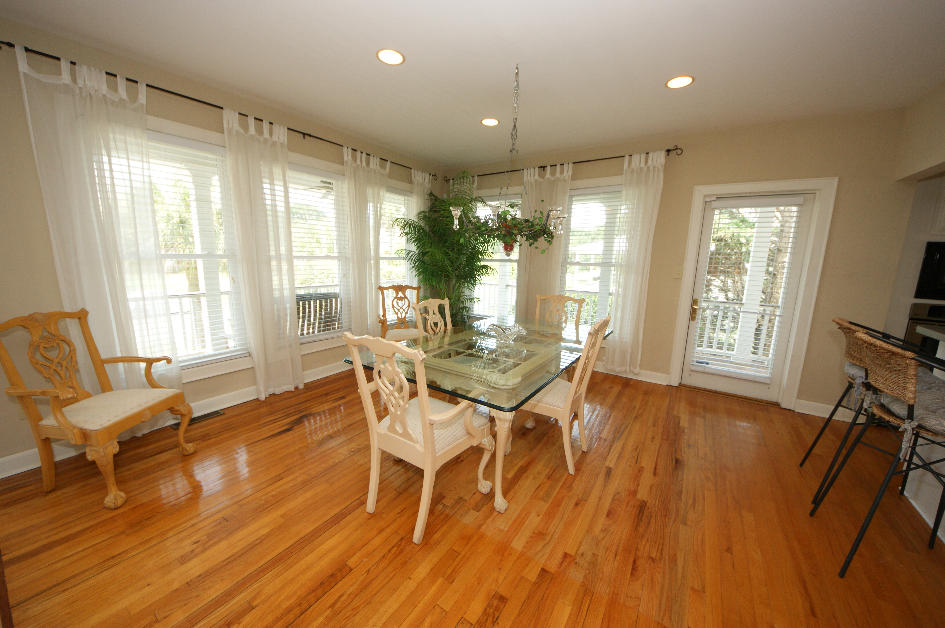
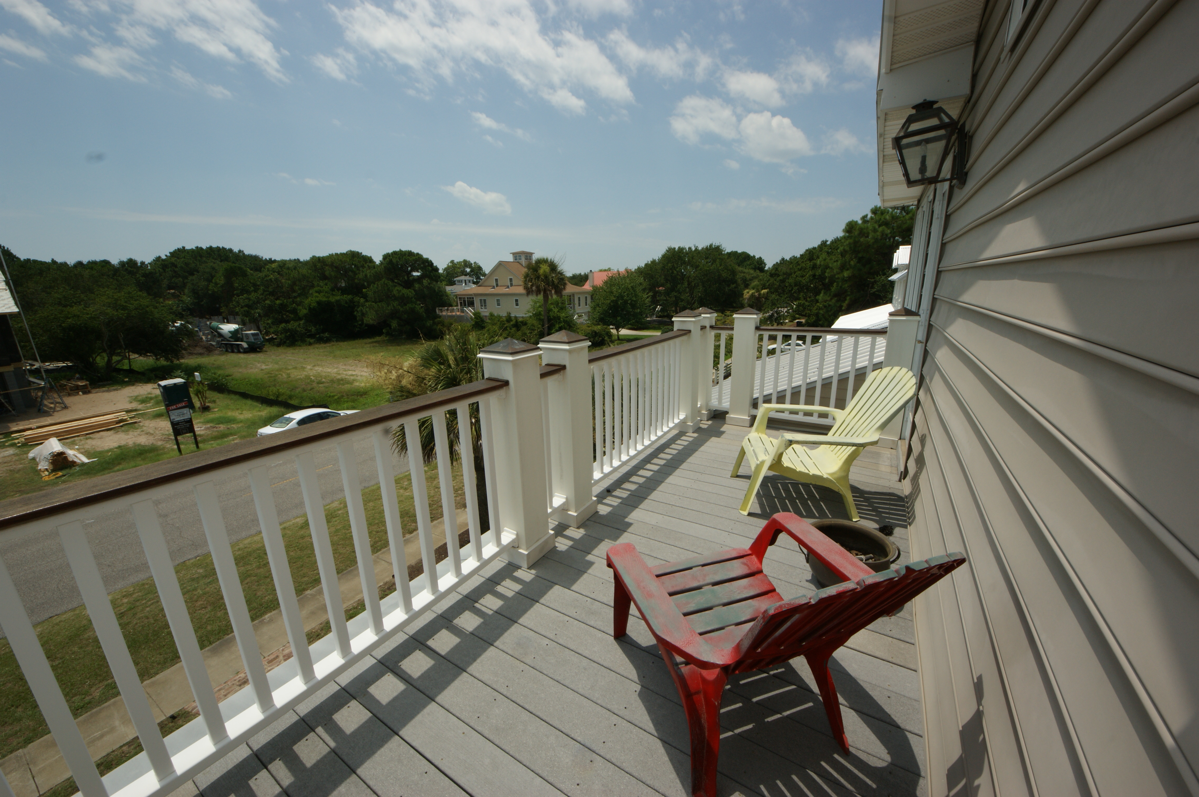
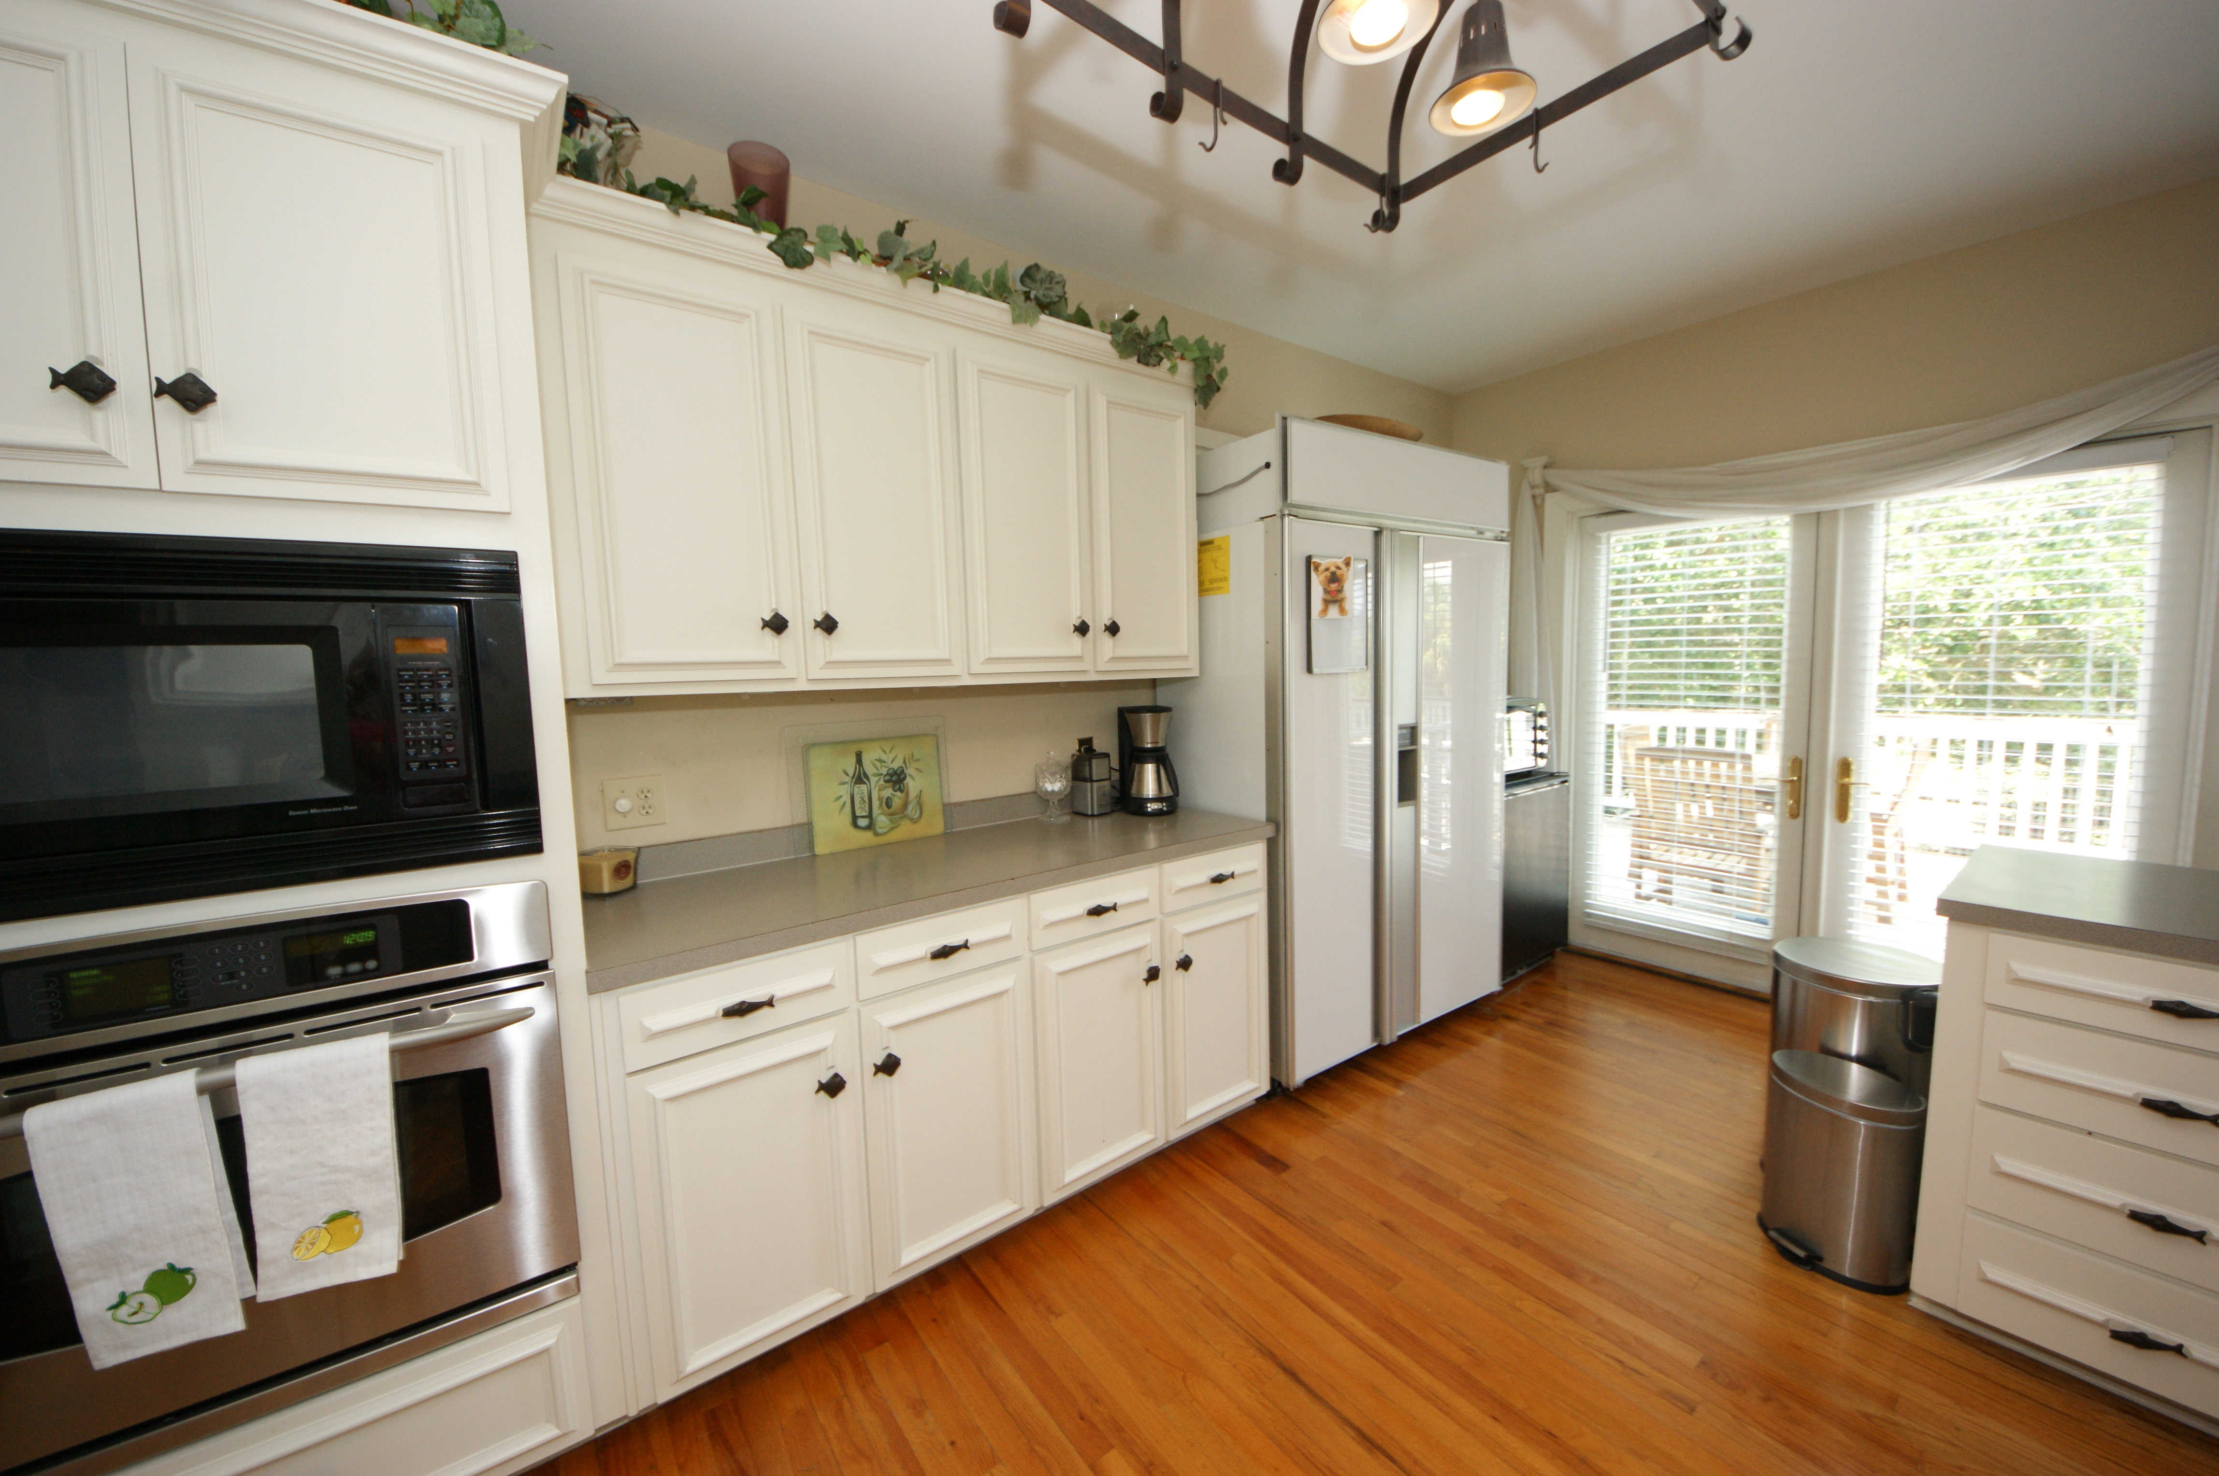
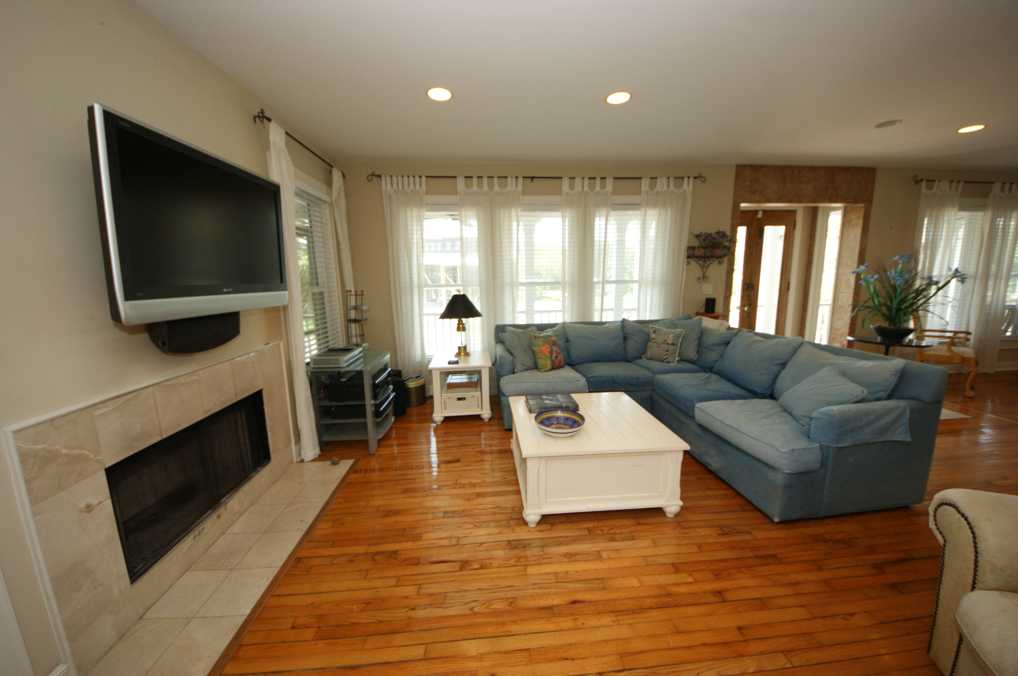
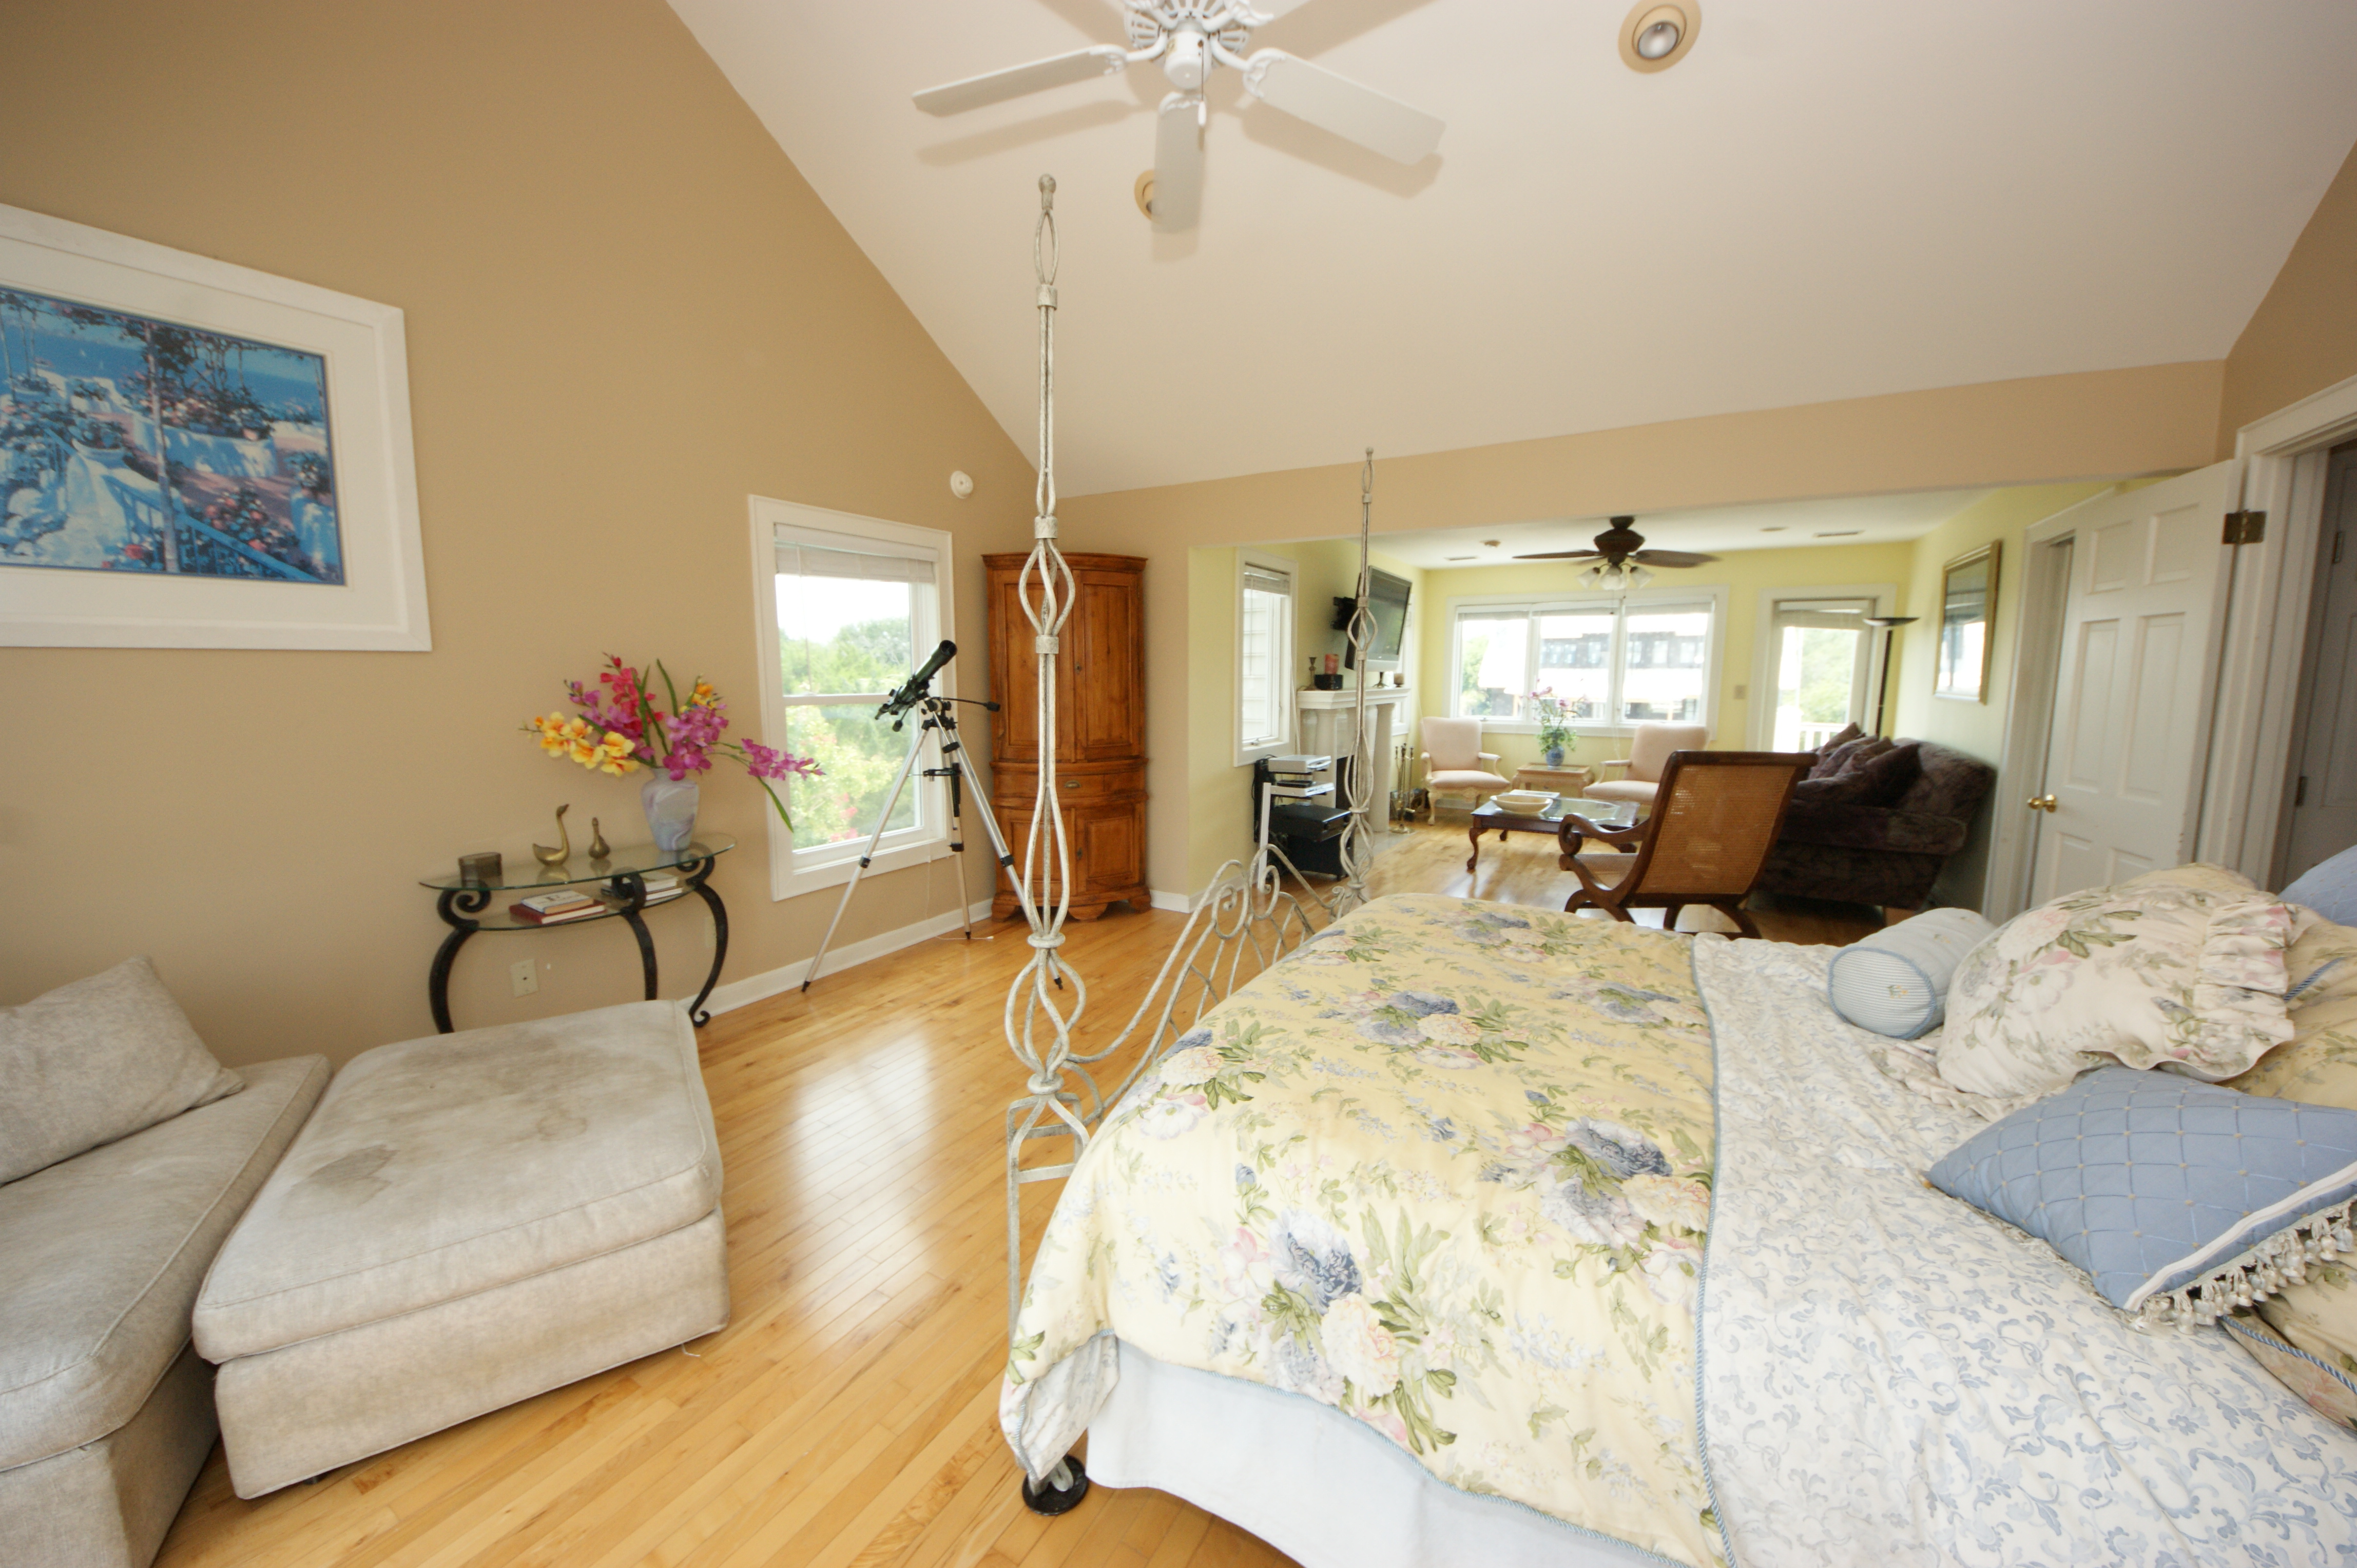


Potential Short Sale!
3024 Middle Street
Sullivans Island, SC 29482 ~ MLS# 15018593 ~ $1,289,000
4 Bedrooms :: 3½ Baths :: 2,855 sf :: Steps to the Beach
Chuck & Edy Mimms
Cell 843-224-9507
Office 843-530-8100 www.sanddollarsc.com
www.facebook.com/Sanddollarsc
Sand Dollar Real Estate Group | 2205 Middle Street | Suite 203, Mailbox 2 | Sullivans Island, SC 29482

