Slide 1
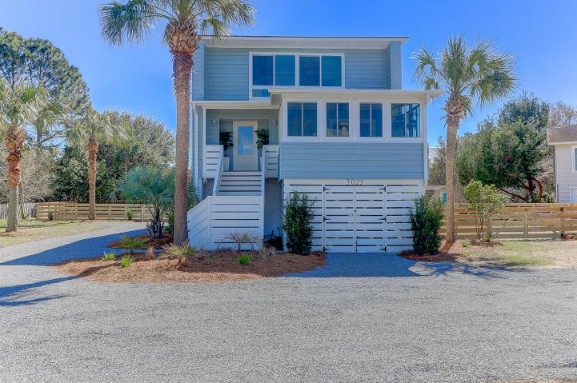
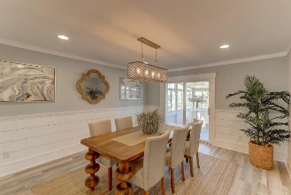
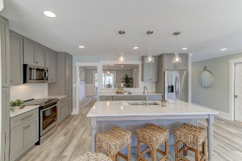
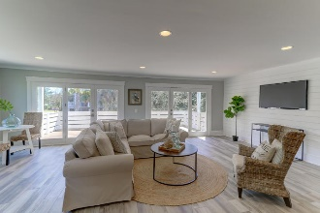
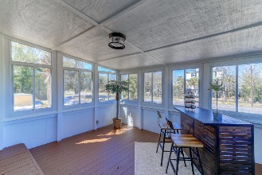
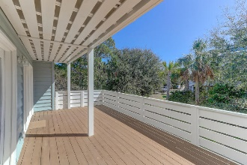
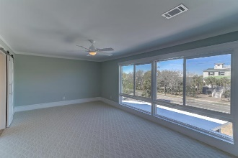
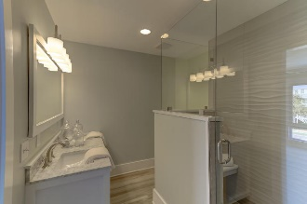
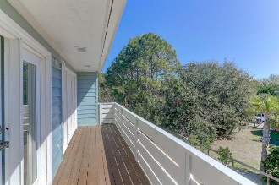
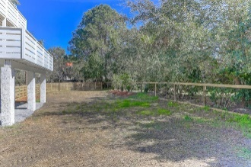
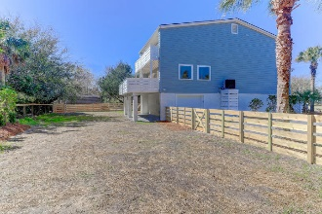


3025 Jasper Boulevard
Sullivans Island, SC 29482 :: MLS# 18004729 :: $1,299,000
Island Living
Just Reduced
Incredible transformation of this classic Sullivans Island cottage just a few short blocks to the beach . No details spared in this total renovation. Open floor plan with new kitchen with custom cabinets, quartz counter tops and stainless appliances that flows into bright and open living space .Separate dining room that opens to porch area to extend the entertaining outside . Master retreat with views of waterway , new bath with custom shower, and walk in closet. Two guest BR's with porch access and a updated hall bath and laundry area complete the upstairs. New roof, HVAC, flooring , custom wood work are just the start. Come see this recently polished gem and make island life a reality.
Clay Cunningham
O (843) 886-8110
M (843) 345-4647
clay@carolinaone.com
www.claysre.com
Carolina One Real Estate
1503 Palm Blvd Ste
Isle of Palms, SC 29451

