Slide 1
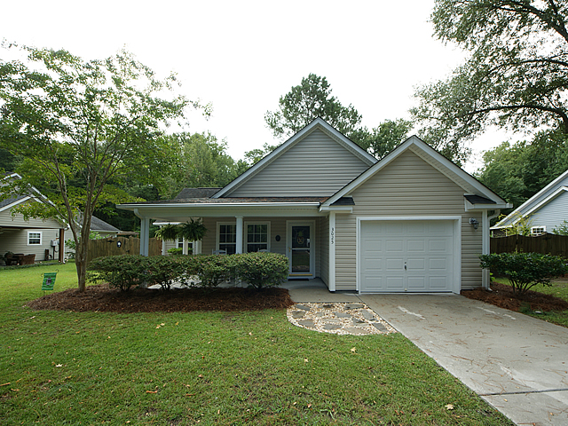
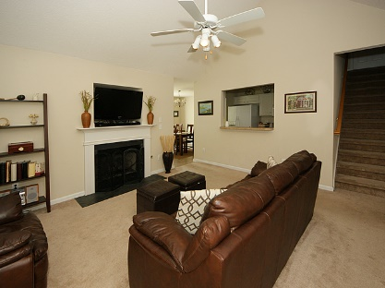
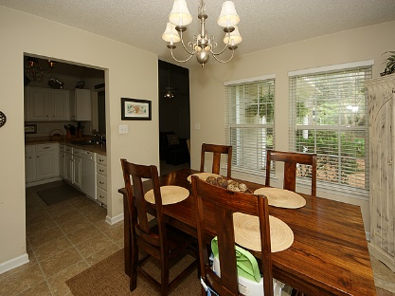
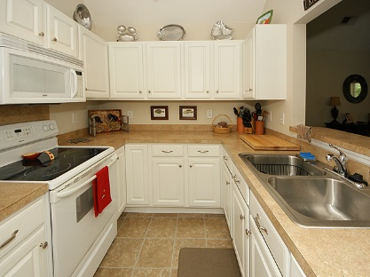
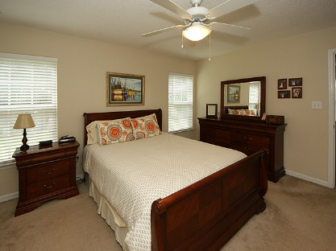
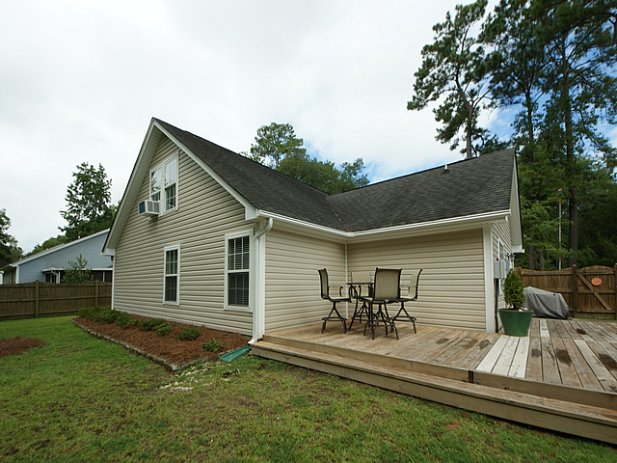
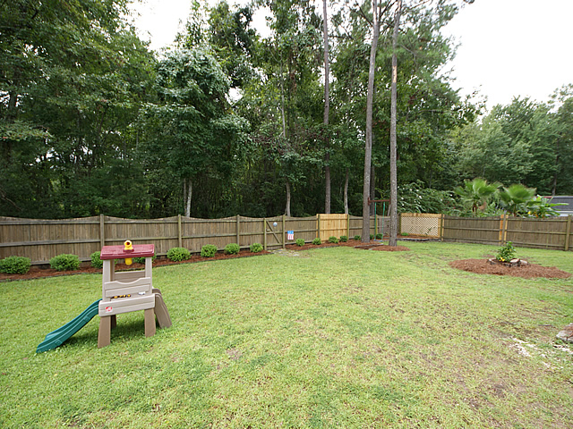


3025 Marlin Road
Tremont
Johns Island, SC 29455
MLS# 16023468 $264,900
1,608 Sq Ft - 3 Bedroom - 2 Bath
Open House Saturday
November 12th from 12pm-2pm
PRICE REDUCED!
Awesome home in the perfect Johns Island location! Enjoy Johns Island living at it's best while only being a few minutes to the Maybank Highway bridge, 15 minutes to downtown, and 15 minutes to Kiawah Island - easy access on and off the island and to everything the greater Charleston area has to offer! Johns Island offers fantastic restaurants, boutique shops, a farmers market, and so much more. This one owner home has been meticulously maintained and is in move in ready condition. The first floor features an open living room with fireplace, galley style kitchen and separate dining area. There are two nice sized guest bedrooms with a full bath with shower/tub combo off the hall. The downstairs also includes a spacious master suite with a stand-up shower, garden tub, and walk-in closet. Be sure to check out the bonus room upstairs that could be used for a kid's playroom, office, man cave, or extra living space. Bonus room also has it's own half bath. This home also includes a 1 car garage with ample storage space. Huge wooded backyard, with privacy fence, deck, and patio - great for kids to play and entertaining guests! Tremont is steps to Trophy Lakes and Whitney Lake and best of all - NO HOA! This home is NOT in a flood zone. Why wait for new construction when this home is ready now....come see it today!
Bottletree Properties, LLC
PO Box 1813
Mt. Pleasant, SC 29465
www.BottletreeProperties.com
Jeff Gallman
Realtor
(843) 729-5741
Jeff@BottletreeProperties.com

