Slide 1
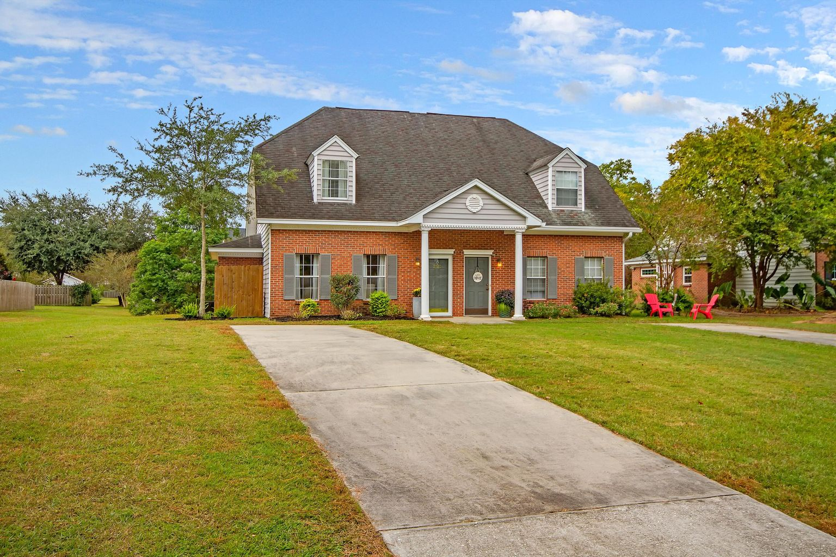
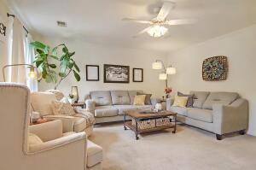
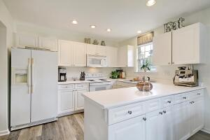
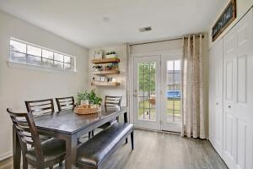
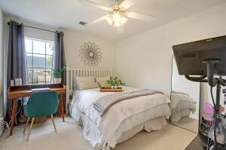
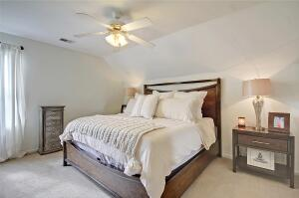
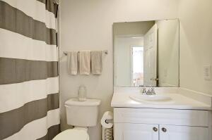
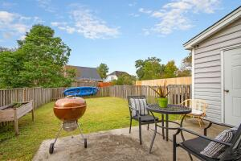
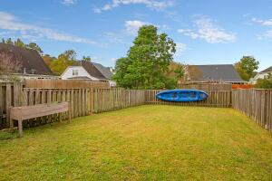

3025 Queensgate Way Park West · Mount Pleasant, SC 29466 MLS# 21029498 · $315,000
Cute Cute Duplex
Cute Cute Cute! Park West Duplex in move-in condition-smooth ceilings! Spacious living room. The kitchen has plenty of cabinets and countertop space and is open to the breakfast room. Fenced-in backyard and extra storage area off the rear of the unit. Bedroom and full bath w/tiled shower located on the first floor. There are two bedrooms on the second floor with a full bath including a garden tub/shower with a linen closet. Plenty of room for parking in the long driveway. Located on a pond lot with a common area that makes the yard feel huge. Park West amenities include pools, a play park, tennis courts, hiking & biking trails, and a clubhouse. Park West is convenient to schools, shopping, hospital, and the Beaches. This home is currently owner-occupied and well-loved.
Take a video tour: https://vimeo.com/642319722
Stan Huff
843-670-2835 stan.huff@agentowned.com
Jill Marcacci
843-297-5590 jill@agentowned.com
www.agentownedrealty.com
AgentOwned Realty Co. Preferred Group, Inc. | 824 Johnnie Dodds Blvd | Mt Pleasant, SC 29464

