Slide 1
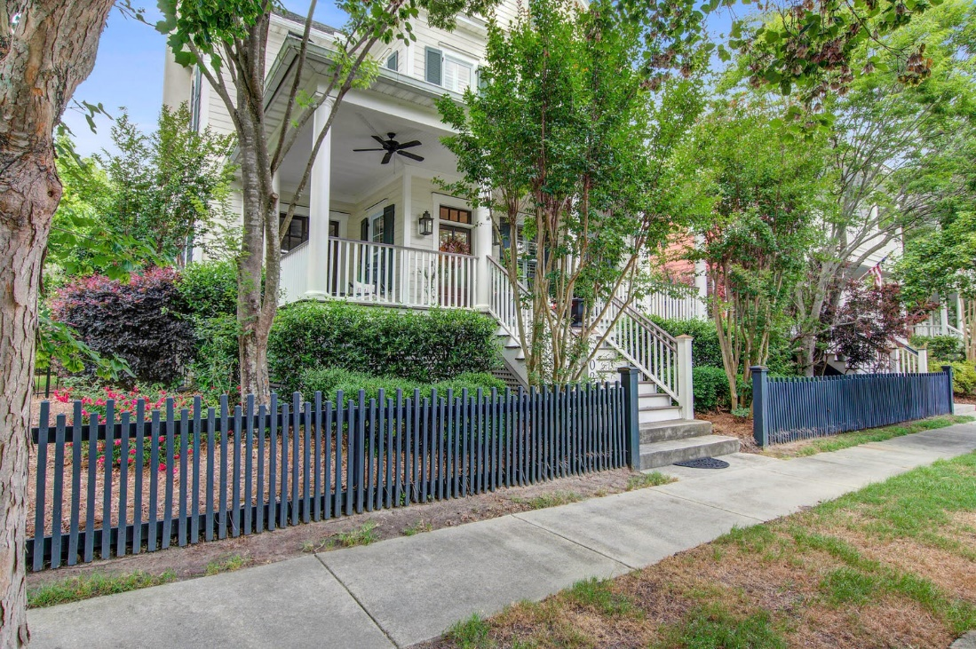
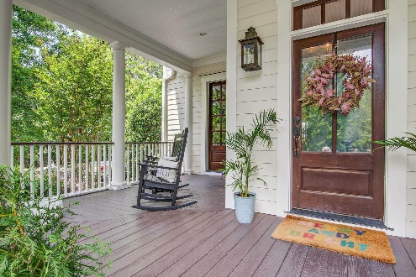
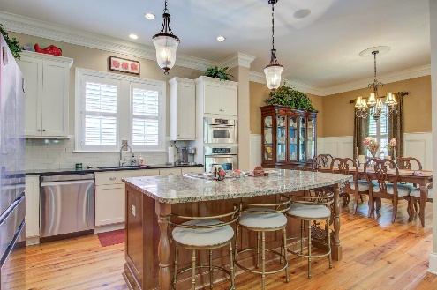
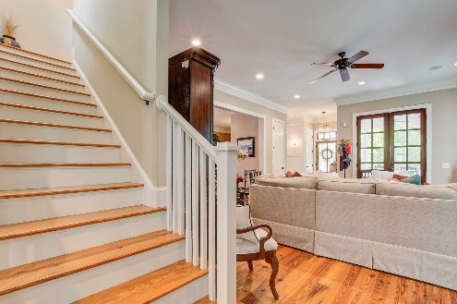
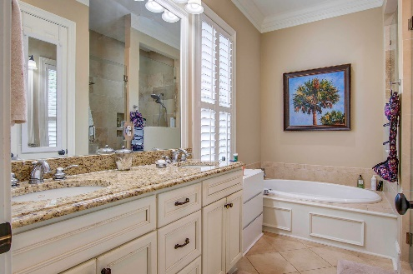


Open House Wednesday June 5th from 1-5
REDUCED
3027 Viscount Street
Daniel Island, SC 29492 · MLS# 24011799 · $1,600,000
Michael Dew
O 843-769-5100
M 843-870-7000
michaeledew@gmail.com
www.michaeldewrealestate.com
STUNNING CUSTOM BUILT SIMONINI 4 BEDROOM 3.5 BATH HOME TUCKED BACK IN DANIEL ISLANDS CENTER PARK NEIGHBORHOOD. THIS HOME IS SITUATED ON A CORNER LOT, ACROSS FROM 'TURTLE' POND. ENTER UPON THE INVITING LARGE FRONT PORCH. PERFECT FOR RELAXING AND ENJOYING THE POND VIEWS AND WILDLIFE. BEAUTIFUL HEART PINE FLOORS THROUGHOUT THE HOUSE AND PLANTATION SHUTTERS. THE LIVING ROOM FEATURES A GAS LOG FIREPLACE. THE DINING ROOM OPENS TO THE KITCHEN WHICH INCLUDES STAINLESS STEEL APPLIANCES, GRANITE COUNTERTOPS, AND TILE BACKSPLASH. THE GAS COOKTOP IS PERFECTLY SITUATED IN THE OVER SIZED ISLAND. THE DOWNSTAIRS INCLUDES A HALF BATH, MUD AREA AND UTILITY/LAUNDRY ROOM AS WELL AS THE MASTER SUITE. THE MASTER BEDROOM FEATURES A WALK IN CLOSET AND LARGE BATHROOM WITH DOUBLE SINKS, LARGE OVAL TUB AND WALK IN TILE SHOWER. THE SCREENED IN PORCHED WAS ENCLOSED AND IS PERFECT FOR AN OFFICE, PLAYROOM, OR FORMAL LIVING ROOM. THERE ARE 3 ADDITIONAL BEDROOMS UPSTAIRS. 2 BEDROOMS WITH A JACK AND JILL BATH AND ANOTHER WITH BATHROOM ATTACHED. THERE IS A SIGNIFICANT AMOUNT OF CLOSET STORAGE SPACE AND AN ATTIC ABOVE THE HOUSE AND ONE ABOVE THE GARAGE. THE PAVER PATIO IS A PERFECT ENTERTAINING SPACE WITH A NEW ALUMINUM FENCE ENCLOSED YARD. ADORABLE PLAYHOUSE/STORAGE IS ALSO INCLUDED. DETACHED 2 CAR GARAGE WITH ALLEY ACCESS AS WELL AS PLENTY OF OFF STREET PARKING IN FRONT AND ON THE SIDE OF HOME. THIS BEAUTIFUL HOME PUTS YOU IN THE PERFECT LOCATION TO SCHOOLS, PARKS, TRAILS, ACCESS TO 3 POOLS AND DOWNTOWN!
AgentOwned Charleston Group
902 Savannah Hwy
Charleston, SC 29407
Real Estate ● Mortgage
Insurance ● Business Brokerage

