Slide 1
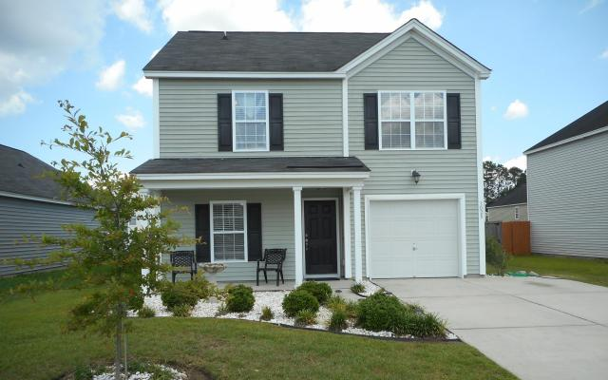
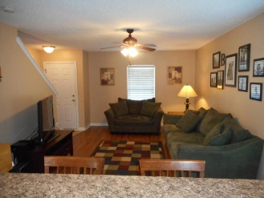
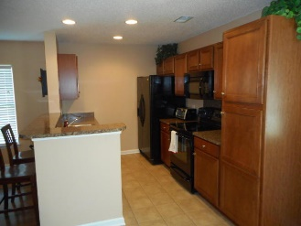
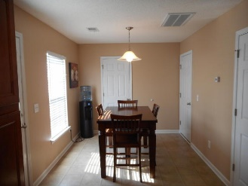
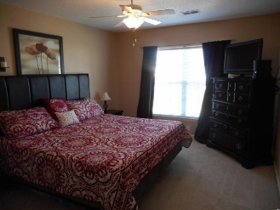
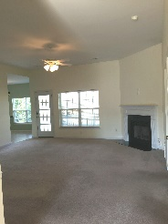
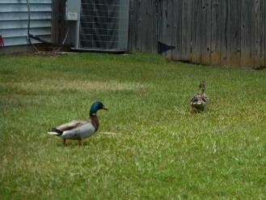


Open House
Saturday June 25th 10-12:30
3028 Kinswood Lane
Hunters Bend · Ladson, SC 29456 · MLS# 16014846· $156,900
Rodney Hancock
(843) 437-1347
rodneyhancock08@gmail.com mortgageprofessionalsonline.com
Beautifully maintained 3 bedroom 2.5 bath home. Great curb appeal. Freshly painted interior.Wood floors in main living areas. Downstairs includes a great room with a kitchen that flows great for entertaining guests with a eat in area looking out to the back yard. The garage has been made into a work out room and can easily be converted back to an original garage before closing if buyer desires. Upstairs has master bedroom and bath and 2 additional spacious bedrooms. Fenced in yard perfect for privacy. Real close to schools and Tom Conley Ball fields (Getting a facelift form Cal Ripken Jr.) Schedule a private showing today. This house can be eligible for 0.5% of the loan amount cash back toward closing costs. Ask me how!
AgentOwned Charleston Group
902 Savannah Hwy
Charleston, SC 29407
Real Estate ● Mortgage Insurance ● Business Brokerage

