Slide 1
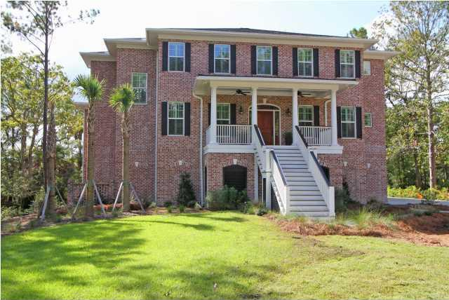


$10,000 Bonus to selling agent Agent Open House Luncheon
Wednesday 11am-1pm
Drawing for 2 - $50 gas cards
3028 Yachtsman Drive ~ Dunes West
$1,665,000 ~ MLS# 1424532
Gorgeous 6000 sq ft, custom built, deep water home with all the bells and whistles. The waterfront home on Wagner Creek is surrounded by 5 plus acres of marsh and woods and overlooks the 9th and 18th holes of the Dunes West Golf Course. Also included is your own private dock with a 14X14 ft pier head with water and electricity and a 8X20 ft floater with 6 to 7 feet of water at low tide.$10,000 bonus to selling agent with BIC approval and acceptable offer. Easy to show.
Bill Donovan
Office: 8438868110
Cell: 8439910146
www.BillDonovan.com
donovans@CarolinaOne.com
Carolina One Real Estate
1503 Palm Boulevard
Isle of Palms, SC 29451

