Slide 1
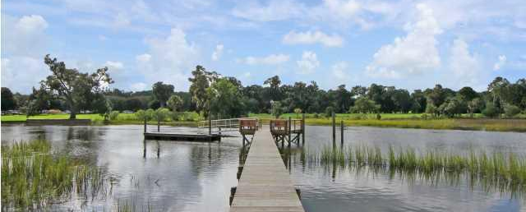
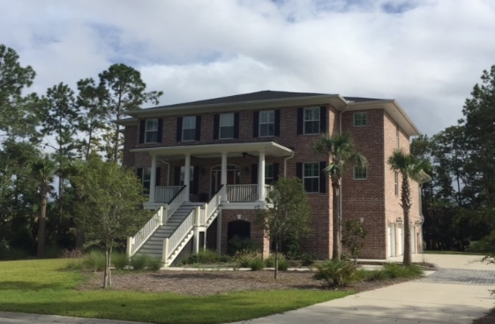
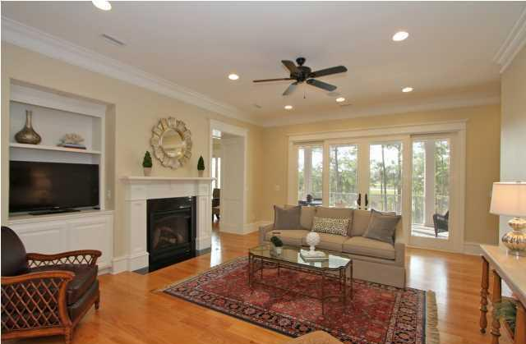
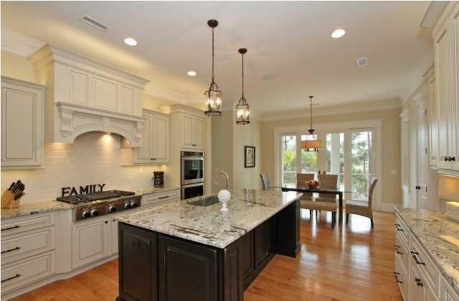
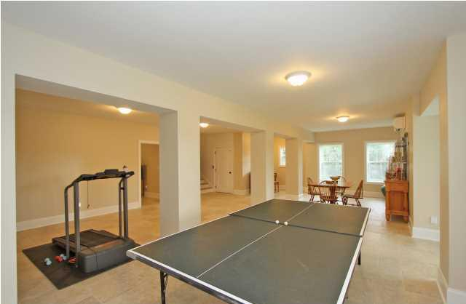
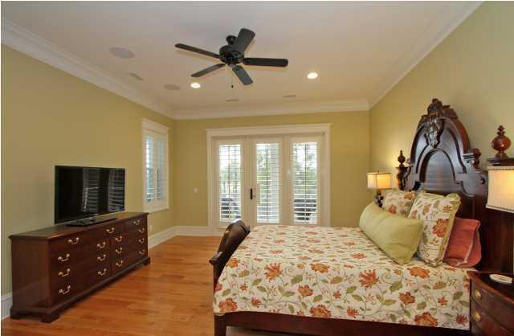
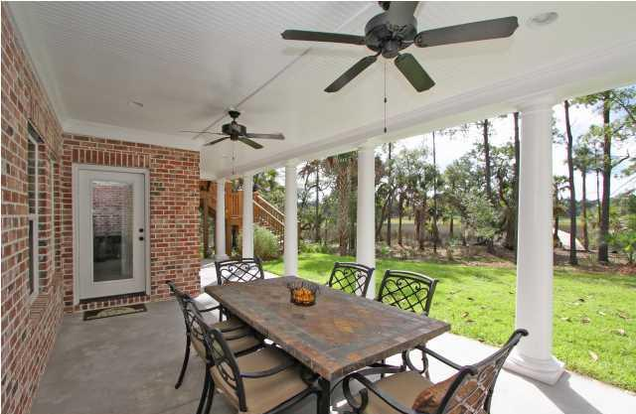

3028 Yachtsman Drive Mount Pleasant :: MLS# 1424532 :: $1,575,000
Dunes West Open House
Sunday October 4th, 2-5p
Gorgeous custom built, deep water home with all the bells and whistles that a discriminating buyer is searching for. The waterfront home on Wagner Creek is surrounded by 5 plus acres of marsh and woods and overlooks the 9th and 18th holes of the Dunes West Golf Course. Also included is your own private dock with a 14X14 ft pier head with water and electricity and a 8X20 ft floater with 6 to 7 feet of water at low tide. The first floor of this magnificent home includes a spacious entry hall, formal living room, separate formal dining room, great room with fireplace with gas logs, chef's kitchen, master bedroom and bath, powder room, large laundry room, office with built in desk and shelves and a huge screened porch which is accessible from the master bedroom, the great room and the kitchen. The second floor includes 3 large bedrooms and 3 full baths a library with built in shelves and a media room which opens onto a cozy private deck, great for relaxing and enjoying the sunsets. The ground level includes a huge recreation room, a guest room and full bath, covered porch and tons of storage as well as a three car garage. This lovely executive brick home includes so many special features that it is difficult to mention them all. Some of these include an elevator to take you to each floor, beautiful deep moldings throughout, hardwood floors on both first and second levels, central vacuum, surround sound, plantation shutters, double ovens, 2 dishwashers, gorgeous custom cabinets, stainless appliances, gas stove, ice maker, whole house dehumidifier, 2X6 exterior walls, cement board soffets and gutters, whirlpool tub and water filter system. This beautiful home has it all and is located in the exclusive Harbour section of the gated Dunes West neighborhood.
Listed by
Bill Donovan 843-991-0146 donovans@carolinaone.com
Hosted by
Renee Meyer 843-991-0007 - M
renee@carolinaoneplus.com
Carolina One Real Estate 1503 Palm Blvd Isle of Palms, SC 29451

