Slide 1
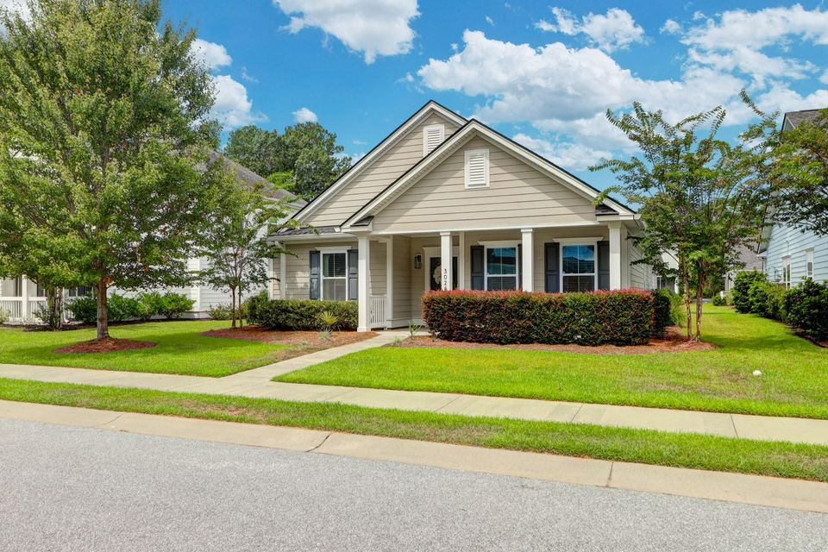
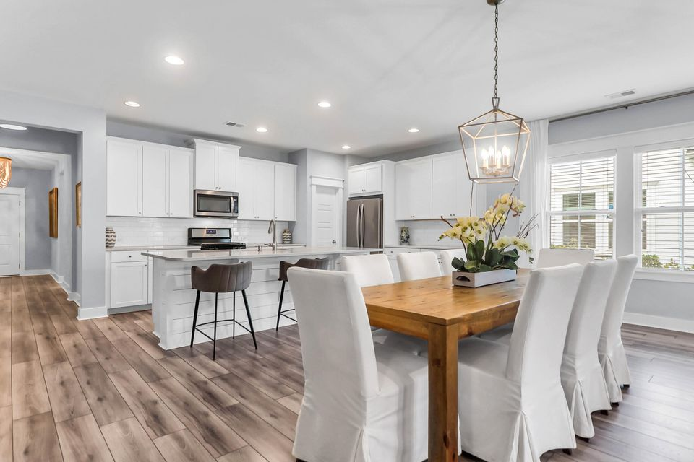
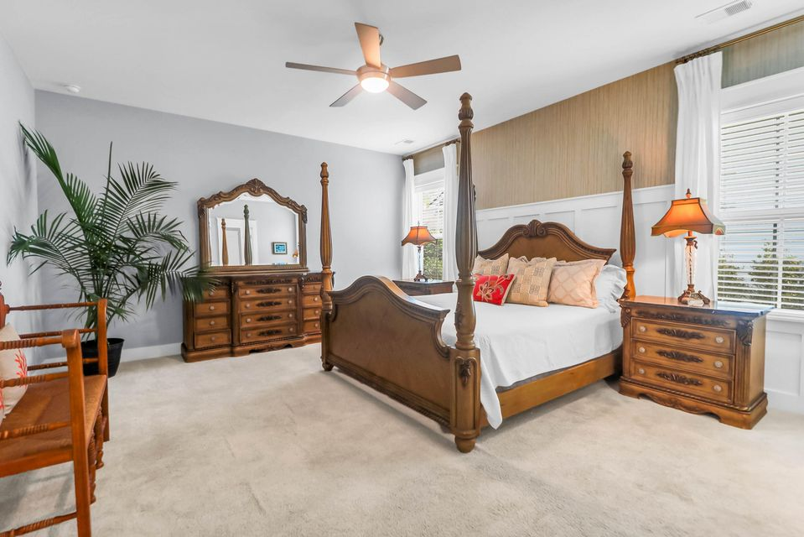
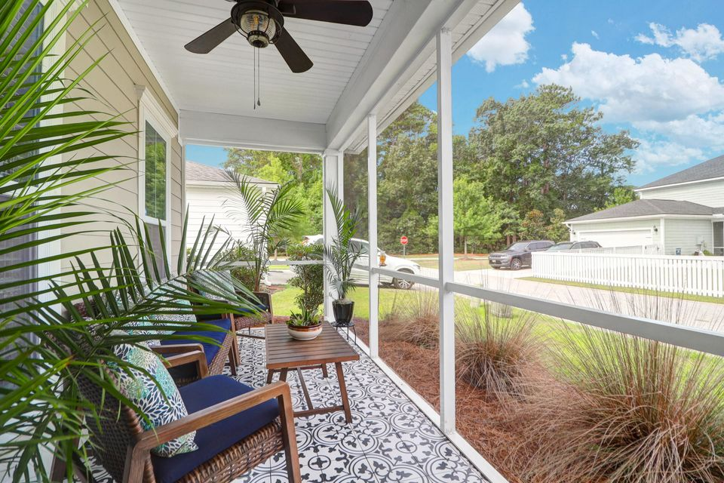

Beautifully Designed One Story!
3028 CASPIAN COURT
PARK WEST | MT PLEASANT | MLS# 25021554 | $737,700
3 BEDROOM | 2 BATH | 2,145SF
It's all here...a beautifully designed one-story residence featuring clean architectural lines, an open floor plan, and an abundance of natural light throughout. Priced below a July 2025 appraisal, with 3 bedrooms, 2 bathrooms, and a versatile flex room, this home offers both style and functionality in equal measure. Step inside to find durable luxury vinyl plank flooring flowing seamlessly through the main living areas, complemented by charming shiplap and judges paneling accents.

