Slide 1

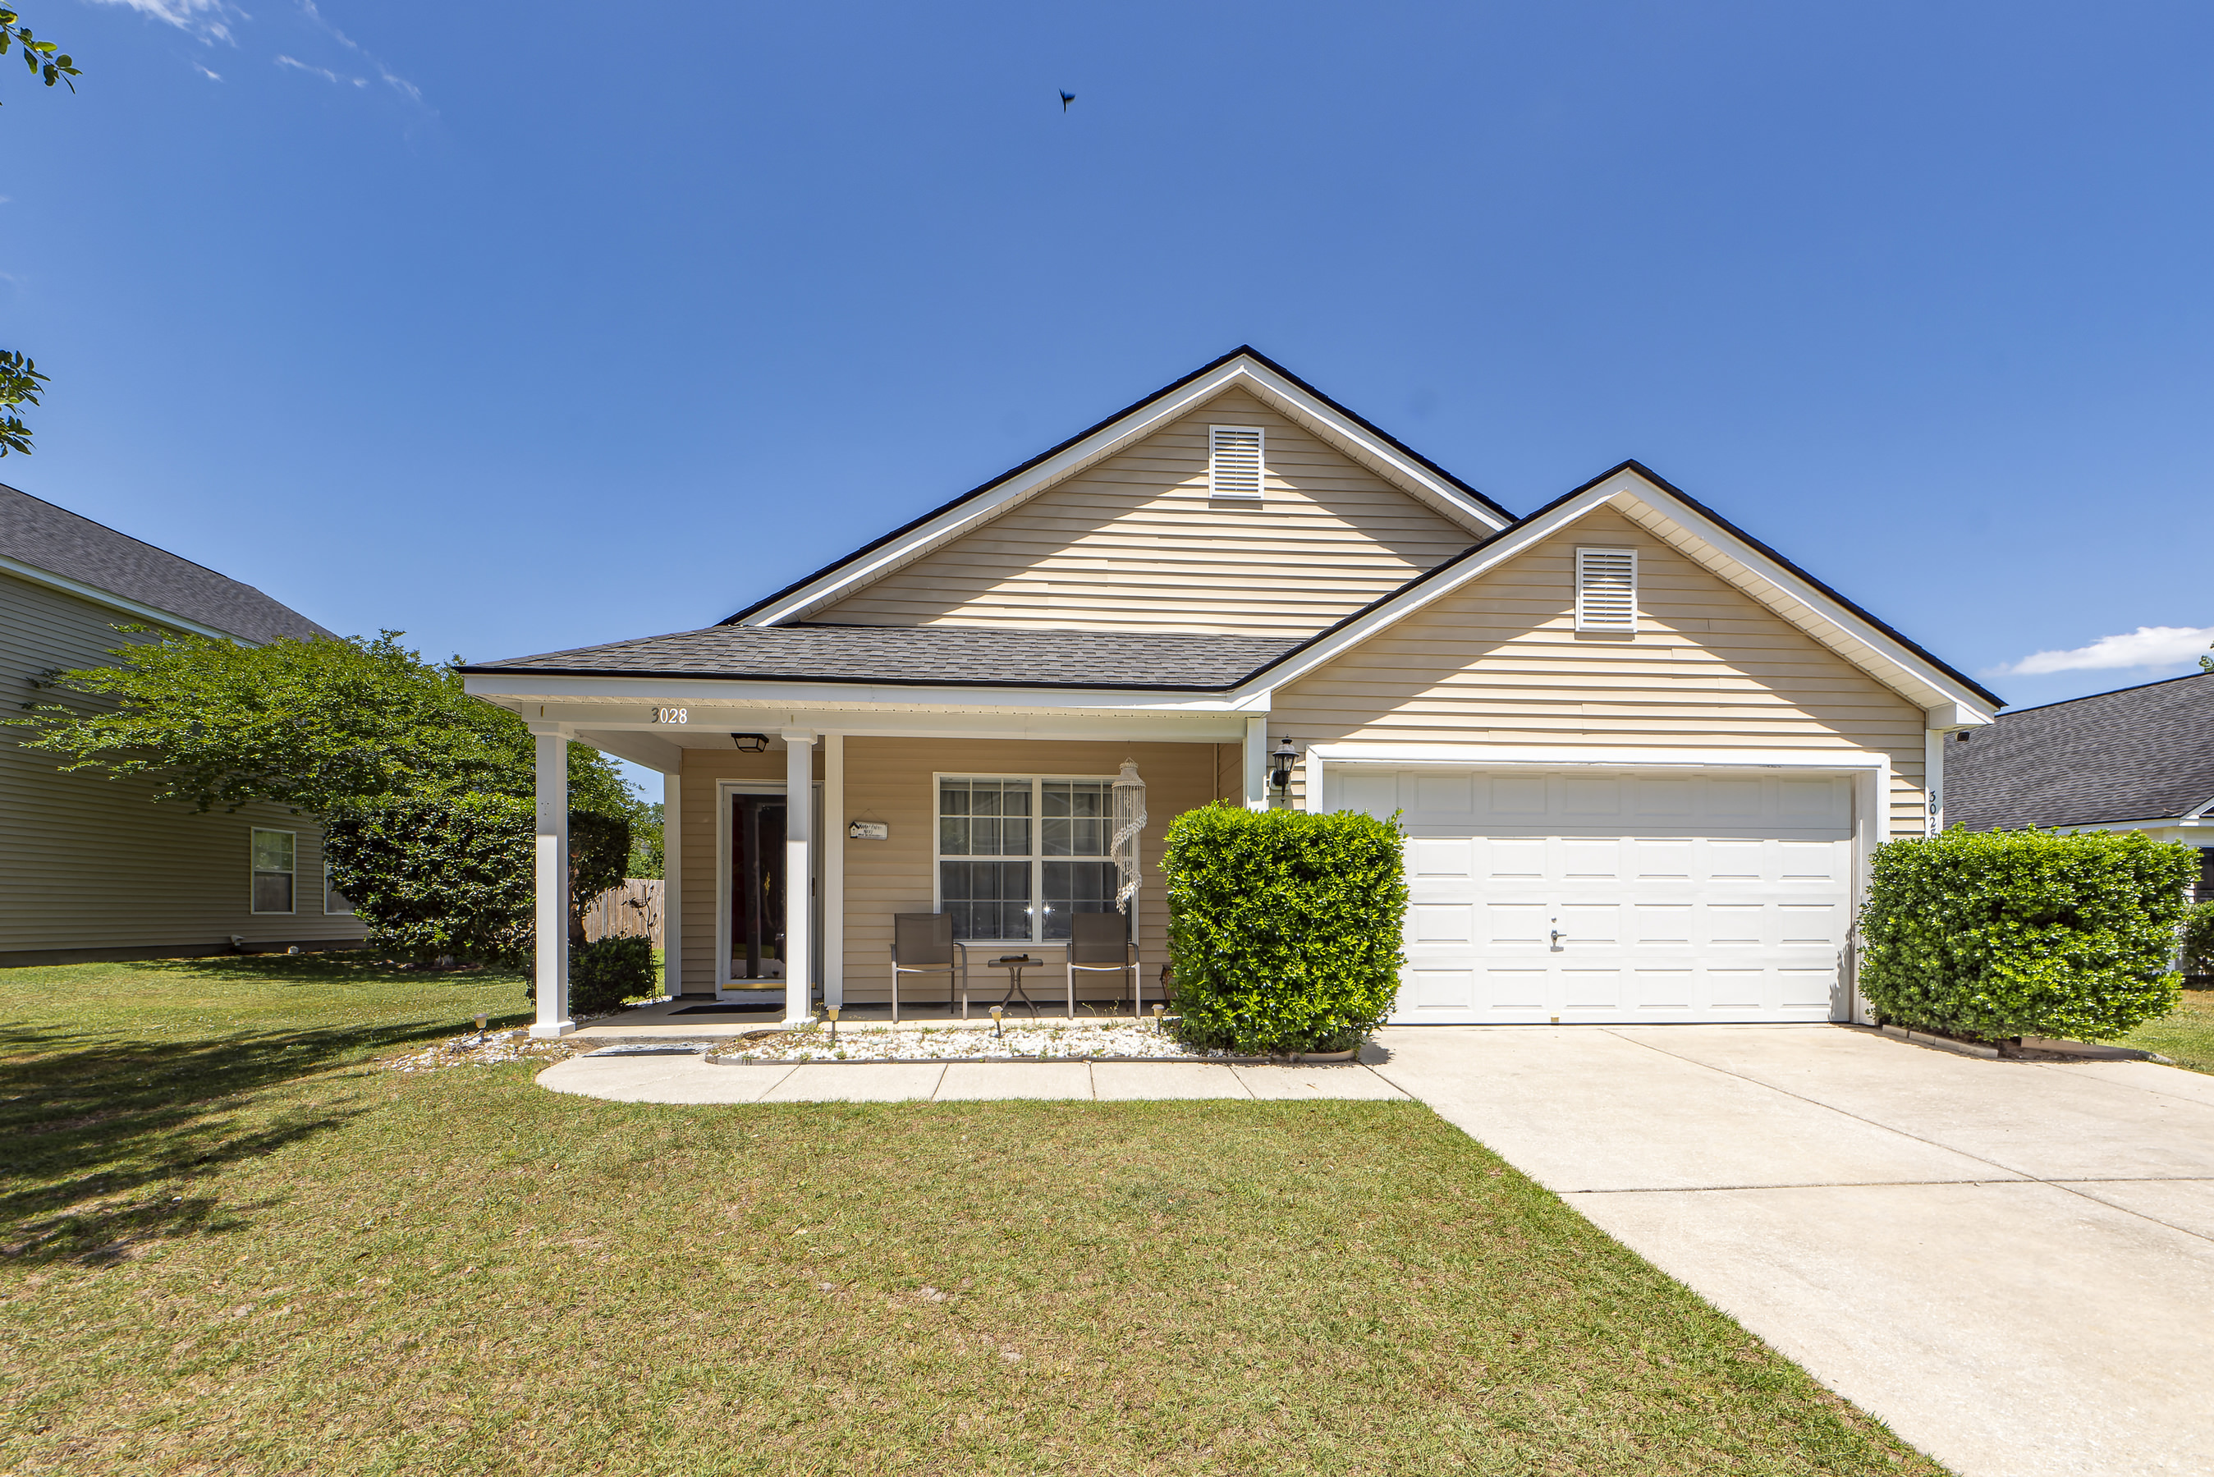
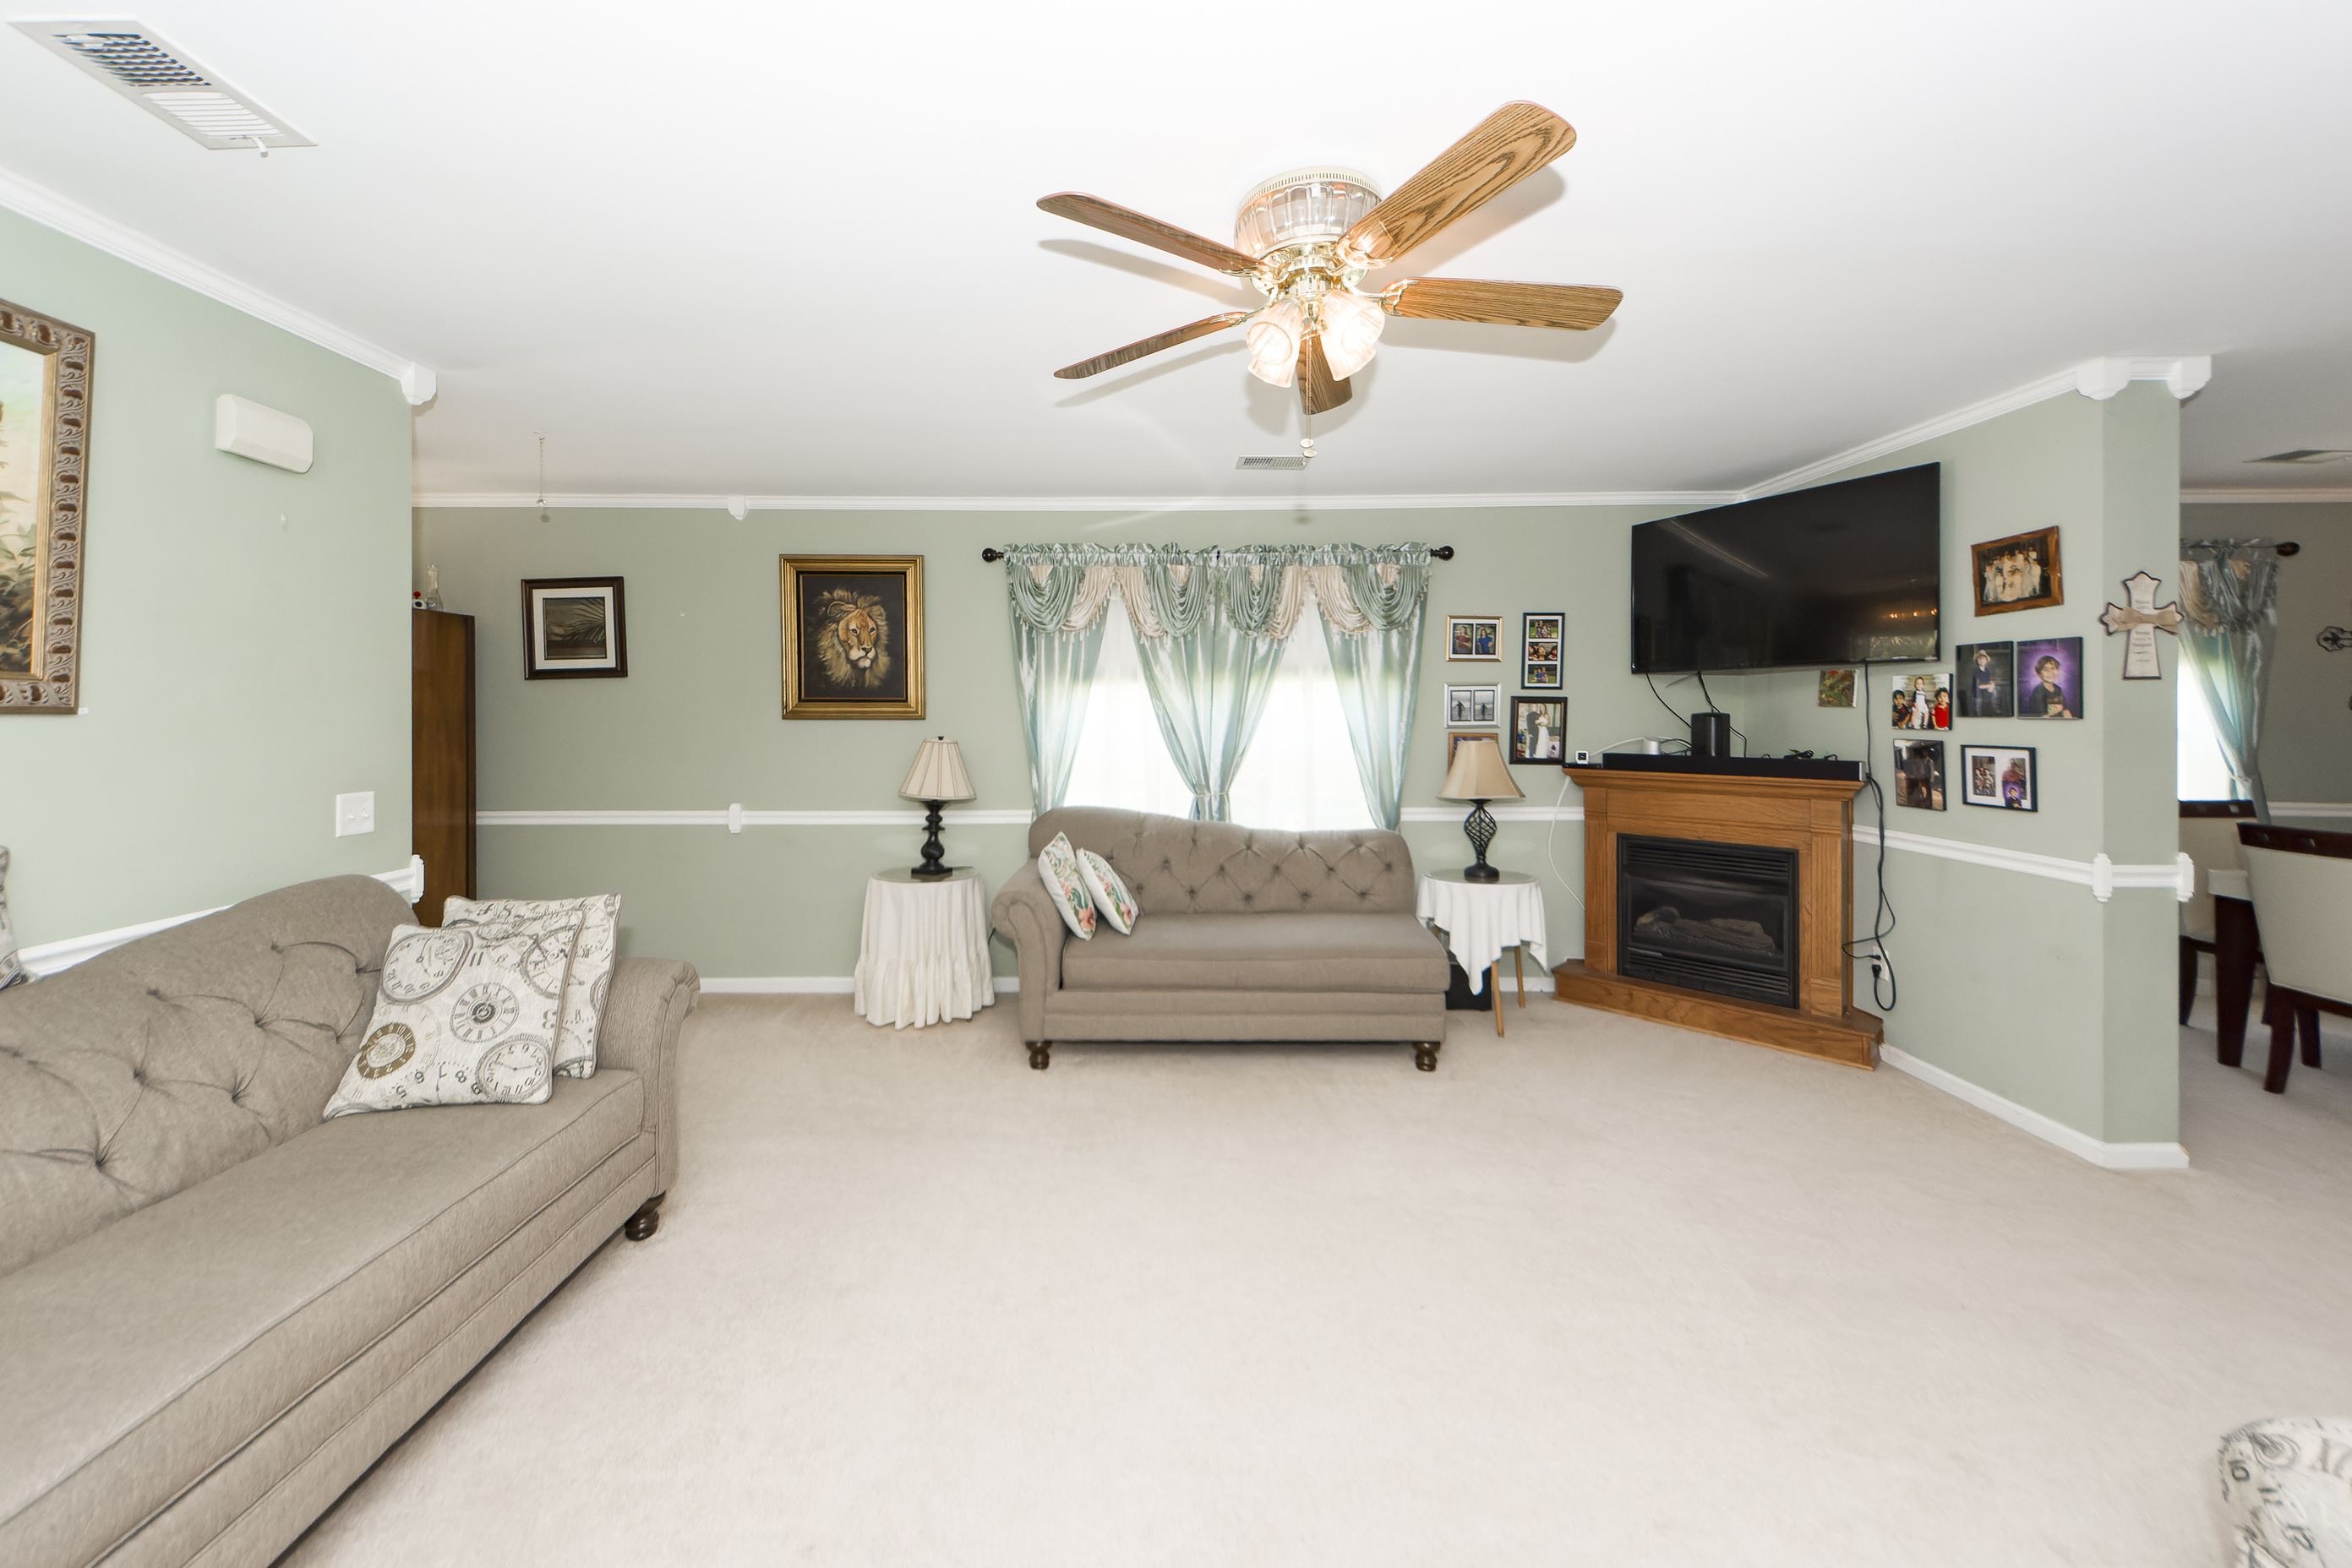
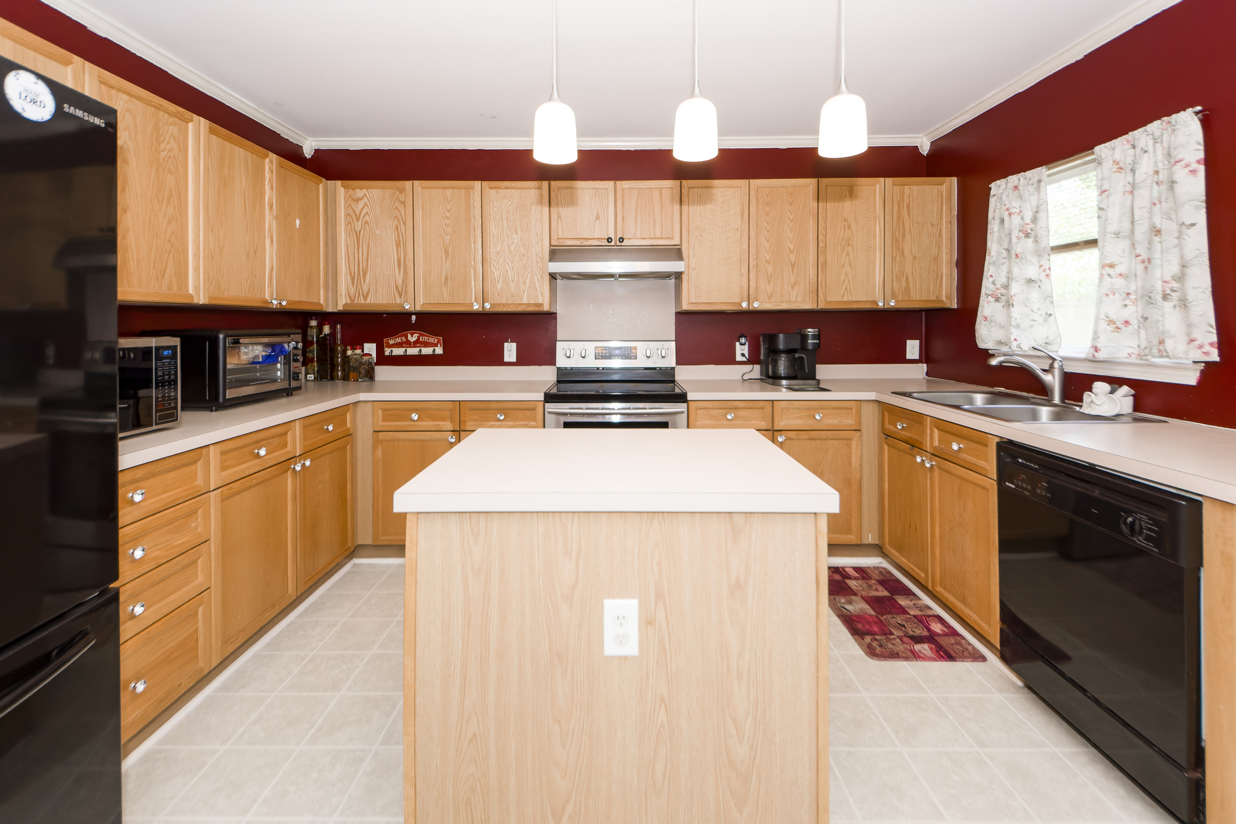


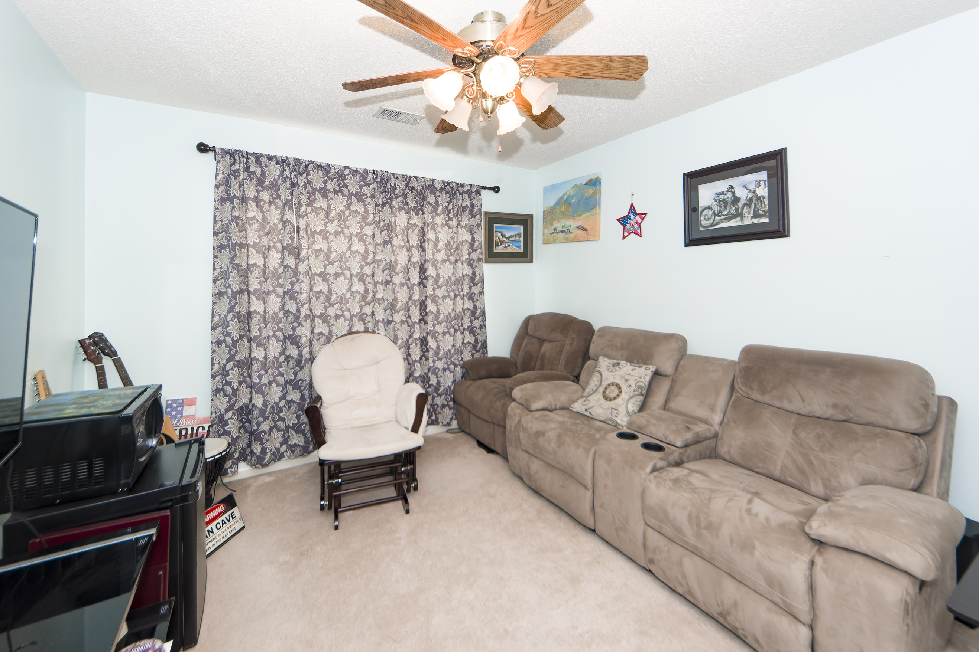
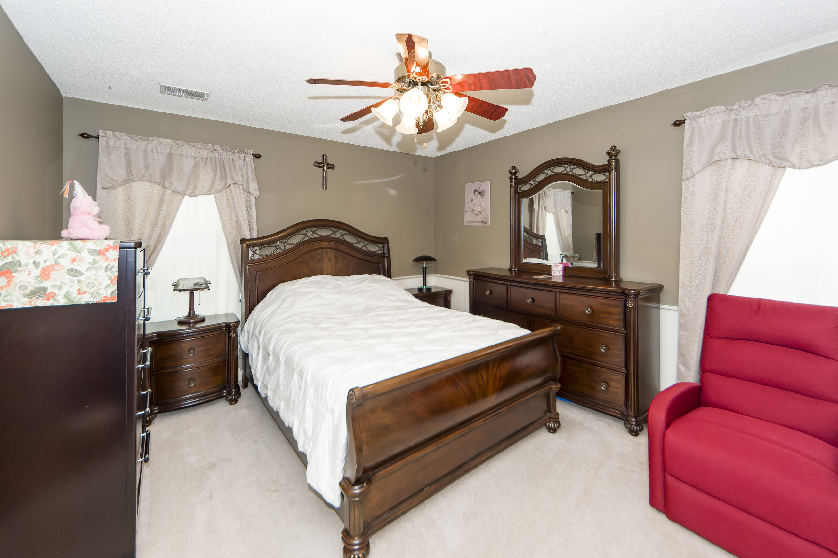



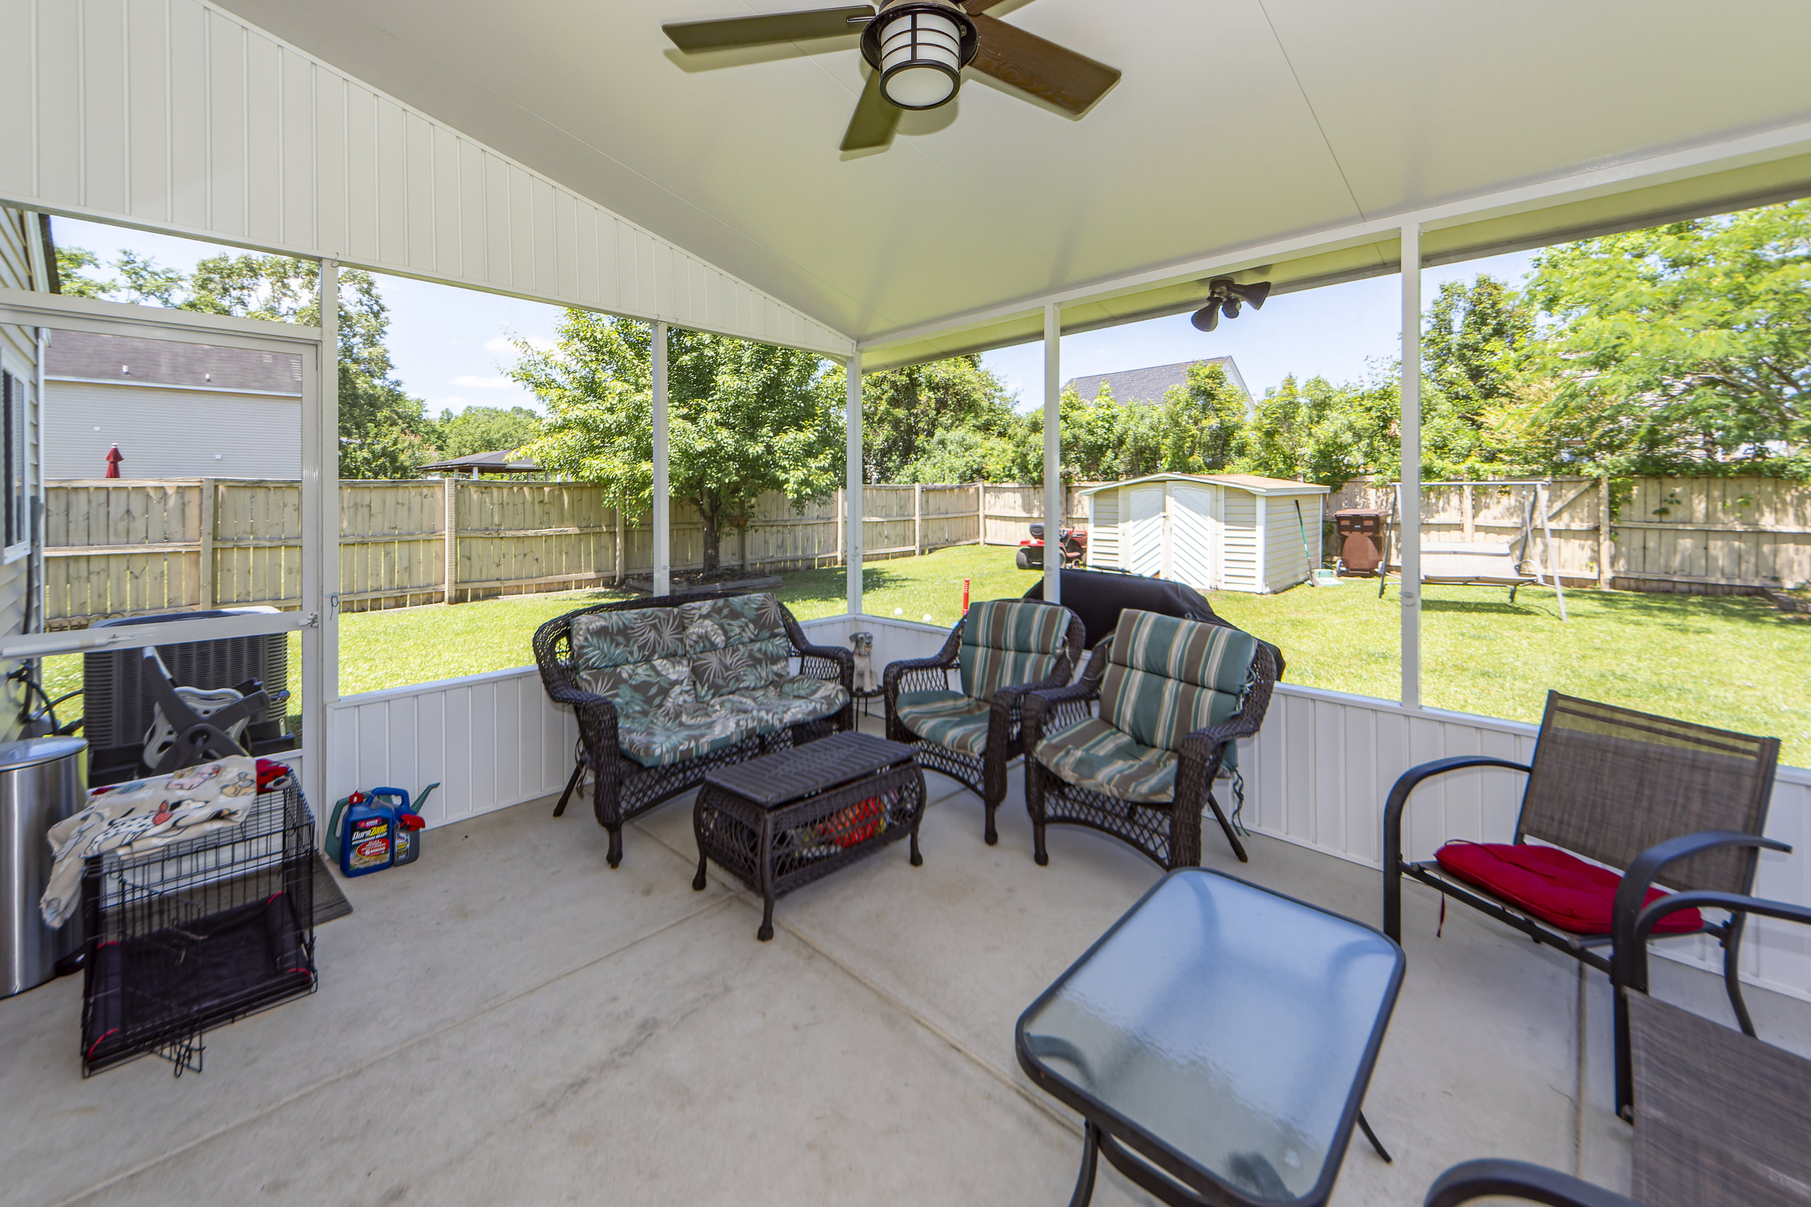
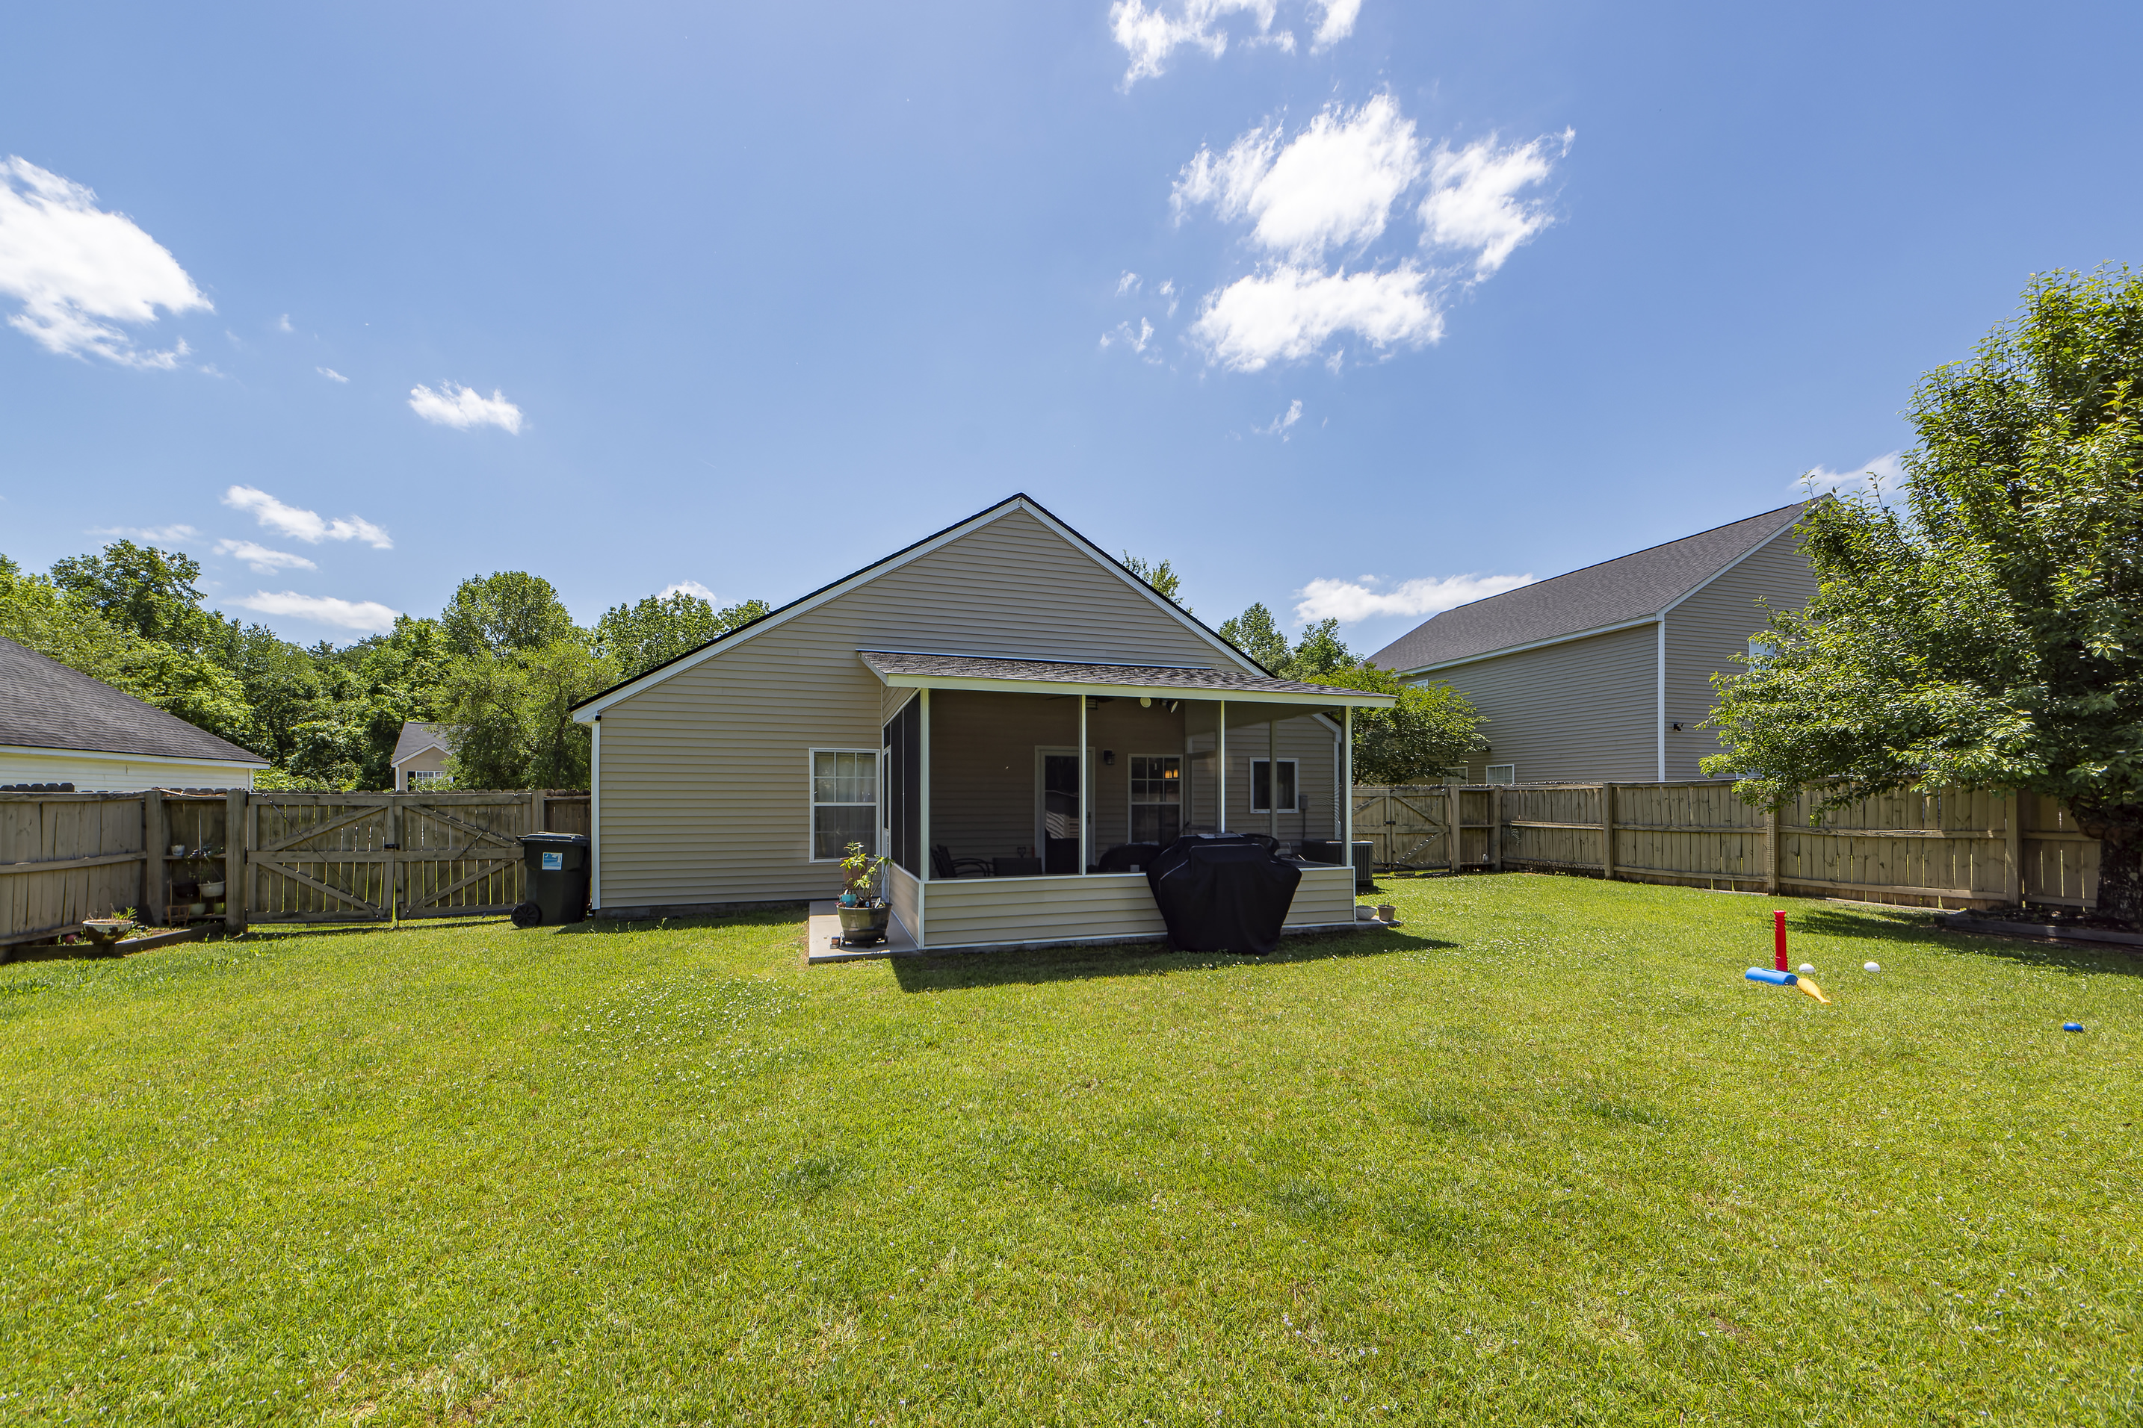

This is it!
3028 Maple Leaf Drive
Oak Hill Plantation | Moncks Corner, SC 29461 | MLS# 24011030 | $344,000
Don't miss this great home! Open design has a large great room & separate dining room. The great room has a gas log fireplace and the kitchen is large with plenty of cabinets, counters and a center island. Appliances are all updated and upgraded including a 3 door refrigerator. The unique master bedroom suite has two rooms that can be used as a PRIVATE SUITE AREA. Close one door to give you privacy to both areas. could be a 4th bedroom. Two other large bedrooms are at the front of the home. Both BATHROOMS HAVE BEEN REMODELED AND CUSTOMIZED. The master has a beautiful WALK IN CUSTOM TILE SHOWER and CUSTOM DOUBLE VANITIES. Hall bath has custom cabinets and vanity. Roof is 4 Years Old & HVAC is new 2023. Seller states attic has closed cell insulation saving on energy bills.
4 Bedroom
2 Bath
1,766 sf
Virtual Tour
Connie White, Broker
843-532-3356
connie@conniewhiteteam.com
conniewhiterealestate.com
Connie White Real Estate & Design, LLC
102 Six Point Court
Goose Creek, SC 29445

