Slide 1
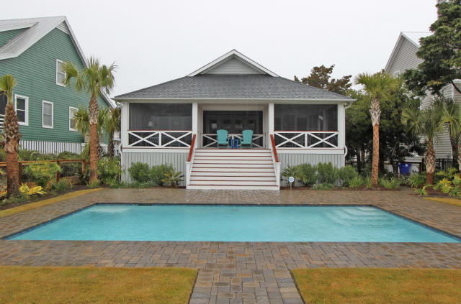
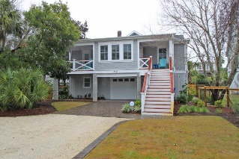
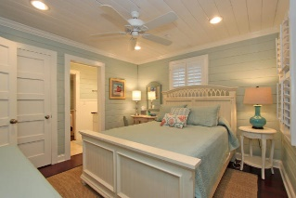
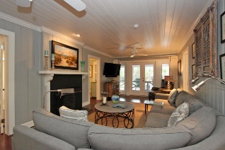
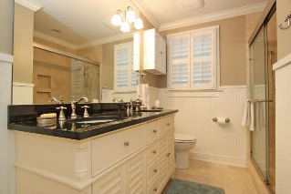
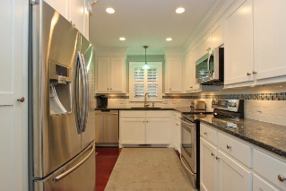
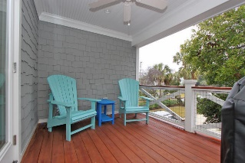
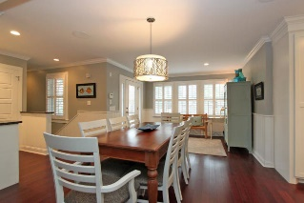
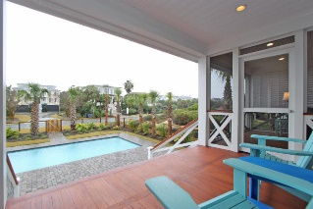
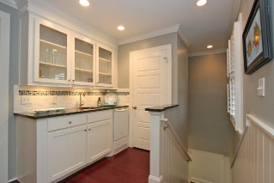
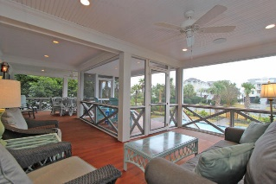


302 Charleston Boulevard Isle of Palms, SC 29451 MLS# 15008209 $1,549,900
Magnificent Beach Home with Salt Water Pool
New Price!
This sophisticated but charming beach home has been totally renovated with the finest materials. This street to street lot is 2nd row from Ocean Boulevard with convenient beach access. The complete transformation is truly spectacular, warm and inviting. From your walk through the main door you will see and feel the Classic Beach House touches, extensive crown moldings, gorgeous bamboo flooring, original wainscoting, travertine tile, surround sound, and a saltwater pool with picturesque landscaping. This 5 bedroom, 3 bath home (with a bedroom and full bath on the lower level) is great for entertaining friends and family in the spacious family room, dining room, one of the three covered porches or the screen porch overlooking the saltwater pool. The hurricane resistant doors and windows are a great addition and you will feel totally comfortable with the new heating a cooling system, ductwork copper connecting wiring system, WiFi home security system, and landscaping and construction guarantees. This home has been meticulously maintained and re-constructed with no detail overlooked.
Darlene Smith Office - (843) 886-8110
Mobile - (843) 696-7824
darlenesmith@carolinaone.com
DarleneSmithTeam.com
Carolina One Real Estate
1503 Palm Blvd Ste
Isle of Palms, SC 29451

