Slide 1
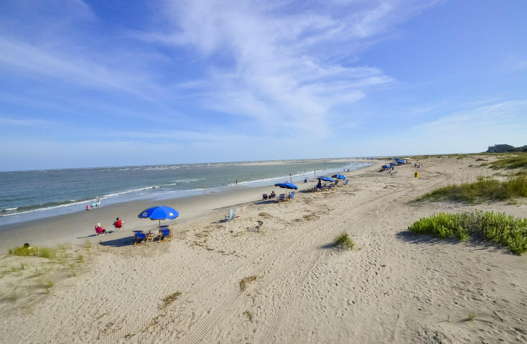
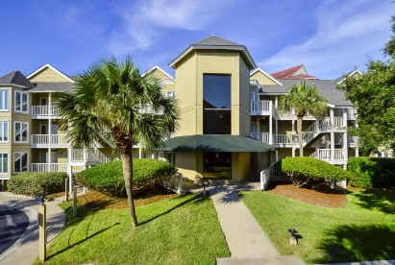
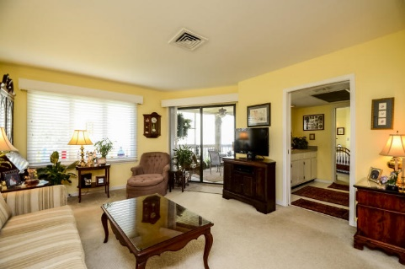
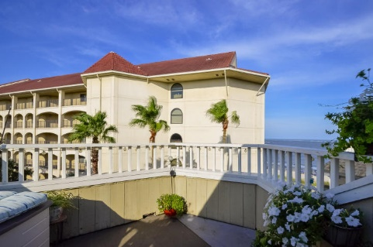
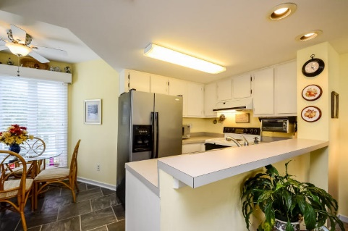
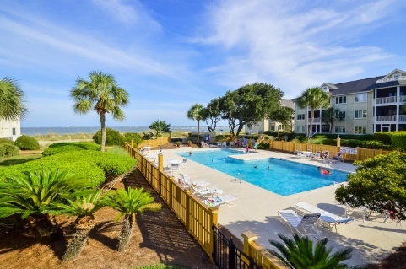
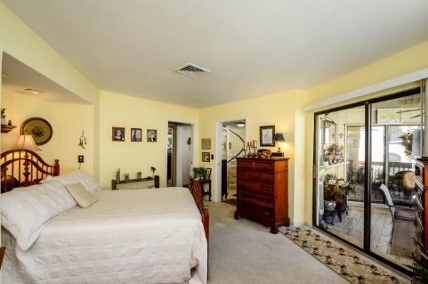
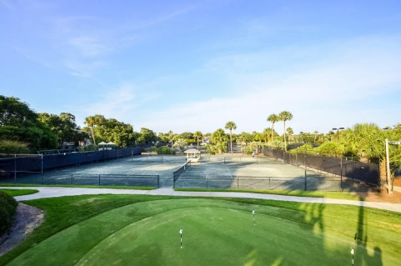
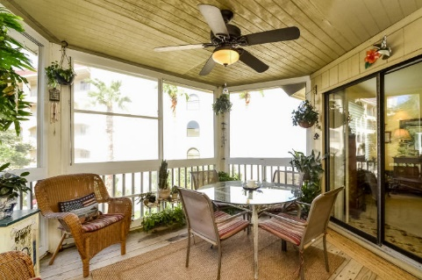
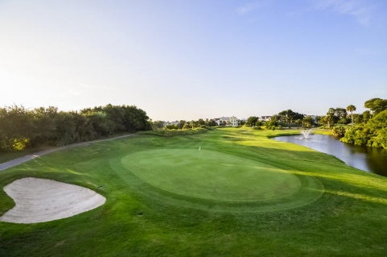
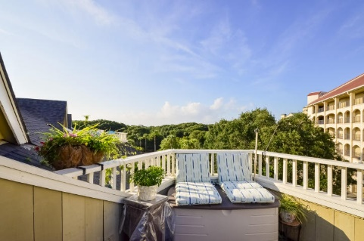
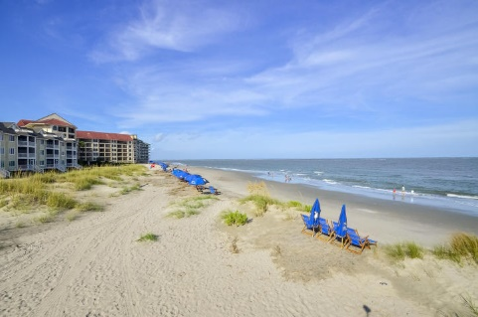

Stunning Ocean View Villa!
302 Port O' Call Drive G
Wild Dunes ~ Isle of Palms, SC 29451 ~ MLS# 15021030 ~ $385,900
This 1-bedroom, 1-bath villa, located in the beautiful Port O’Call condominium community, is only steps away from the beach!
The main level of the home is filled with natural light streaming from the oversized windows into the open living and kitchen area. The windows above the large wet bar open to the home’s private, winter porch, made complete with a ceiling fan and a spectacular view of the beautiful ocean.
Inside, a spiral staircase leads you up to the loft area for extra storage, which leads out onto the sundeck with an absolutely stunning view of the ocean, the perfect place to wind down after a hectic day. From the sun deck, enjoy cool ocean breezes, the sounds of crashing waves, and gorgeous sunrises.
Additional Features Include:
A spacious master suite with access to the closed-in porch
The community amenities include a clubhouse, resort-style pool area right off the beach, tennis courts, fitness center, dock facilities, and golf memberships are available.
A great rental opportunity
Available furnished
Book your showing today!
Nate Gainey nate@mattoneillteam.com 843-513-2038

