Slide 1
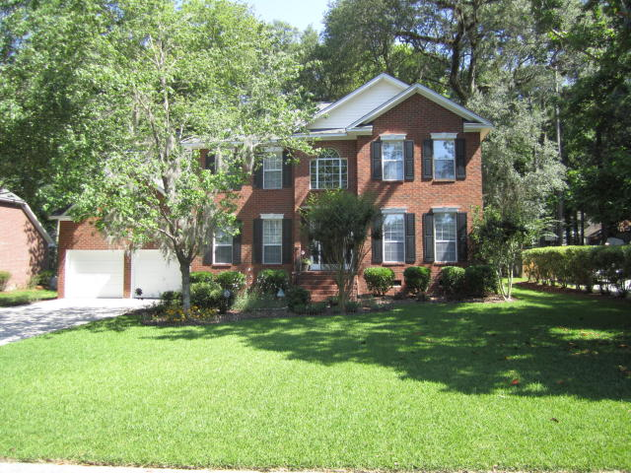
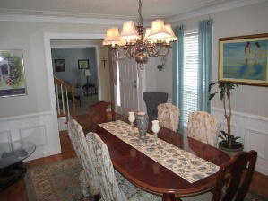
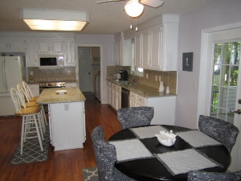
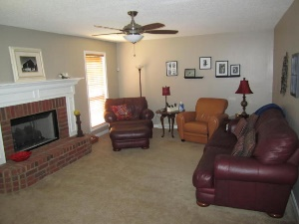
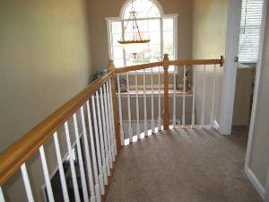
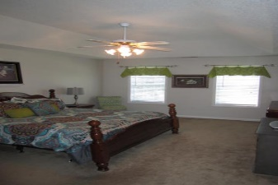
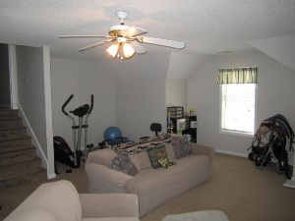
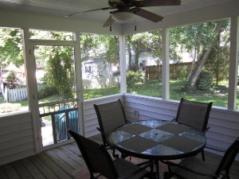
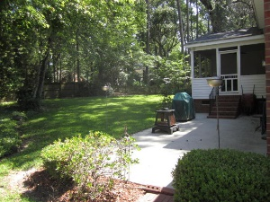
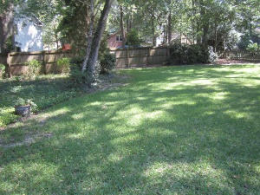

302 Kenilworth Road
Newington Plantation ~ Summerville
MLS# 16012631 ~ $339,900
Wonderful charming home sits on a quiet street in the well-established Newington Plantation neighborhood nestled amongst lovely mature trees, has been lovingly maintained and includes many nice upgrades. Located in the desirable Dorchester 2 School District, close to Historic Downtown Summerville, shopping, and dining. You'll be welcomed home by the beautiful landscaping and curb appeal. As you enter, you'll be greeted by a two story foyer and gorgeous hardwood flooring. The bright, spacious floor plan has a great flow for entertaining and everyday living. To your right is the formal living and to the left is the formal dining room. Located in the rear of this home is the eat-in-kitchen with hardwood floors, beautiful upgraded custom cabinets built with unique corner edges along with Granite counter tops, tile back splash, under cabinet lights and new stainless appliances. In addition, Kitchen has a center Island with seating for three as well as a work station. Off of the kitchen there is the family room equipped with gas log fireplace and a separate large home office space. You will also find a door that leads you to large screened in porch. Upstairs you will find the master bedroom that has a well-appointed master bathroom with double sink vanity, tiled flooring, a large jetted tub, and separate shower and an over-sized walk-in closet. There are also two other large bedrooms and a newly remodeled guest bath. The spacious FROG (considered 4th Bdr) is just down the hallway. A much appreciated feature of this home is the generous amount of storage for your seasonal items and other misc. items. This home also features an attached over-sized two car garage with garage door openers. Out back there is a large grilling patio adjacent to the screened in porch. This wonderful neighborhood is also adjacent to the Sawmill Branch trail for walking and biking. Newington Elementary School is located in the neighborhood, and students can walk or ride their bikes. This would be a great place to call home! Roof was replaced in 2014. Home is under termite bond. Owners are downsizing and moving to retirement community. Some furniture in the Living and Dining room will not be needed in their new home. One owner, pet and smoke free home!!! If square footage is important, measure.
John Chap
(843) 901-1174
jchap@beresfordrealty.com
www.jchap@beresfordrealty.com
Beresford Realty, LLC | 672 Marina Dr, S-206B | Charleston, SC 29492

