Slide 1
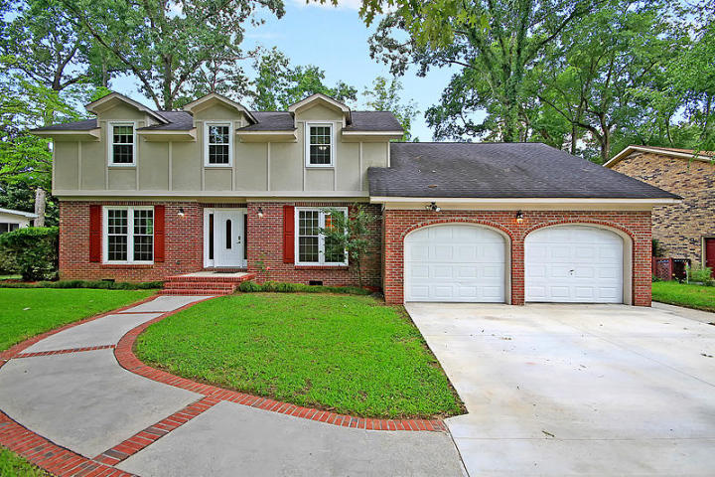
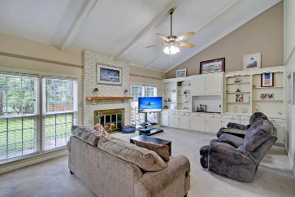
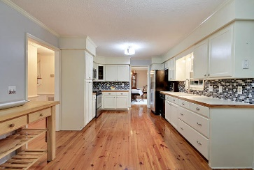
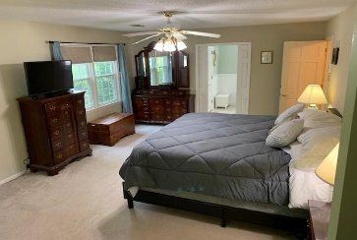
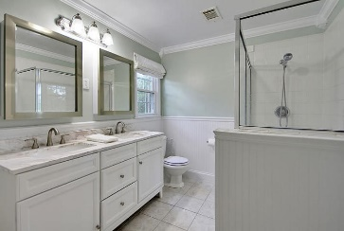
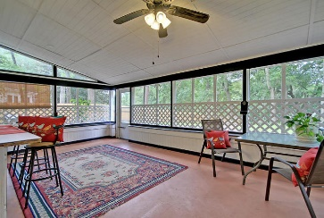
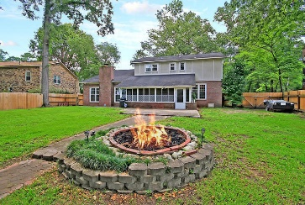
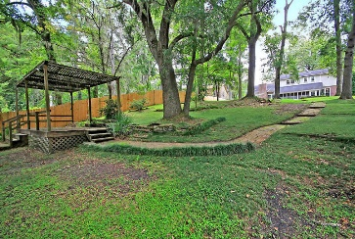
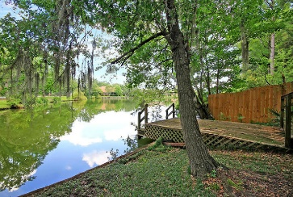

302 Lakeview Drive Summerville, SC 29485 · MLS# 19021032 · $$375,000
Ashborough on Lake w/Dock only $375,000
Ashborough on Lake w/Dock
LAKEFRONT w/ DOCK 5 bed, 3 bath home in desirable Ashborough. Awesome CURB APPEAL with established manicured yard. Upon entering this beautiful home you are greeted with gorgeous heart of pine wood floors, and an abundance of natural light. To the right is a bedroom/office with direct access to a full bath. To the left is the living/flex room, next is the large formal dining room w/ wainscoting and it is perfect for entertaining on holidays with family and friends. The gourmet eat-in kitchen has STAINLESS STEEL appliances, tiled backsplash, and pantry. The family room has a fireplace, built-in shelving, soaring ceilings, and stunning views of the lake. There are two staircases that lead to the second floor: one front one back. The second floor oversized master bedroom has his and hers walk-in closets and ensuite updated spa-like bath with a marble dual sink vanity, and relaxing large tiled shower. There are 3 additional bedrooms that share a full bath. The fourth upstairs bedroom is large and could be a media room/man cave/playroom as well. There is a HUGE screen porch for entertaining that leads to the OASIS of a massive backyard with lake views and PRIVATE DOCK that is ideal for fishing, or relaxing with a beverage enjoying the wildlife after a long days work. Ashborough in Summerville is a wonderfully landscaped community and is known for it's very strong community with many outdoors activities ongoing, they have 2 playgrounds, tennis courts , civic building , boat landing , baseball and volley ball field and a 25 meter / 6 lane size pool. Neighbor gatherings for holidays. All of this is part of the Ashborough amenities. The neighborhood also is close to local shopping and grocery stores and is a short drive to downtown Charleston with 5-star restaurants, world class shopping and iconic history as well as a short drive to the beaches, the airport, Boeing, Volvo, Mercedes, and Daniel Island. Come take a look because you will not find another home that offers as much as this one!
Seller will pay buyer's agent $5,000 at closing
with accepted offer by noon June 7, 2019!
Stan Huff
843-670-2835 stan.huff@agentowned.com
Jill Marcacci
843-297-5590 jill@agentowned.com
www.agentownedrealty.com
AgentOwned Realty Co. Preferred Group, Inc. | 824 Johnnie Dodds Blvd | Mt Pleasant, SC 29464

