Slide 1
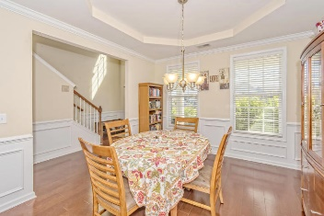
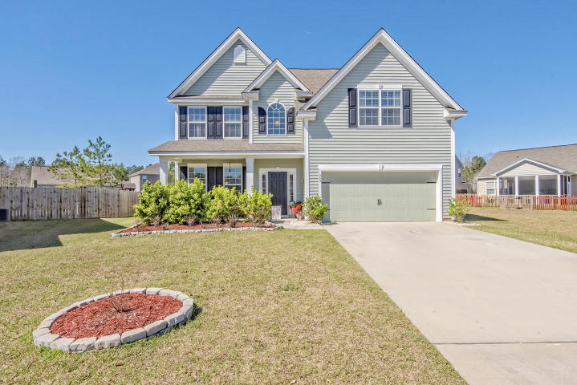
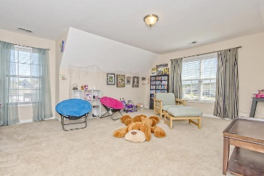
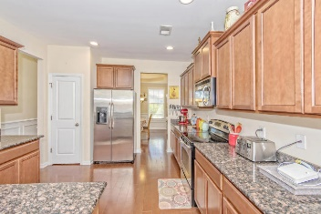
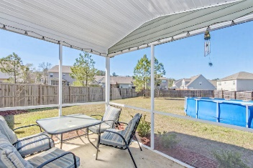
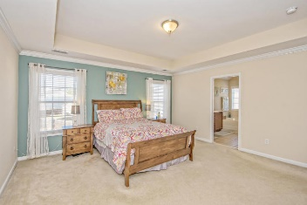
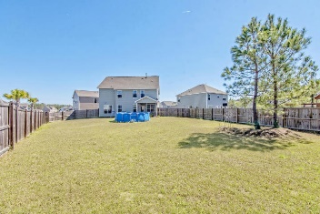


Don’t Miss Out On This Amazing Home!
302 Southern Sugar Avenue
Cypress Ridge · Moncks Corner · MLS# 17006137 · $245,000
Beautiful 5 Bedroom 3 Bathroom Home located in Moncks Corner. Come live in the cul-de-sac. Enter the home and to the left is the Formal Dining Room that flows into the kitchen and the open living room that boasts hardwood Floors throughout! The fifth bedroom with full bathroom is also located on the first floor. Walk into your very spacious master bedroom as you come up the stairs with the deluxe master bath! Three other large rooms are located upstairs as well. Come hangout in the screen in porch and look at largest backyard on the street. The yard is also fenced and the pool, washer, dryer and refrigerator also comes with this home!!!!!
Michael Waites
Mobile - (843) 637-1464 | mwaites@ergroupofsc.com
The Elite Realty Group of SC, LLC · 8310-A Rivers Ave · North Charleston, SC 29406

