Slide 1
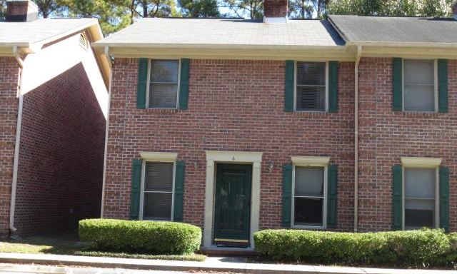
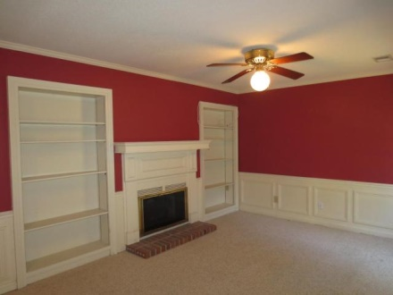
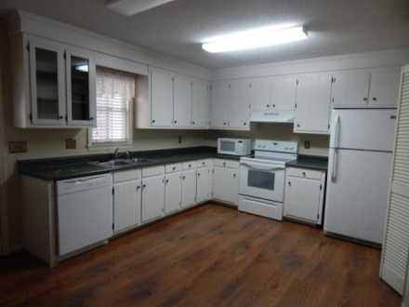
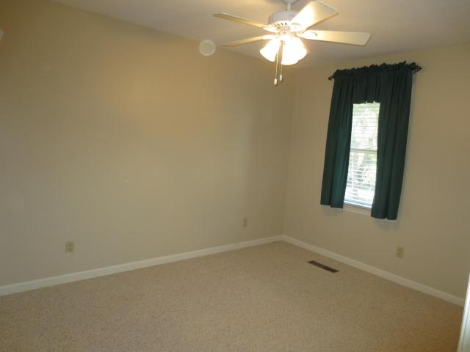
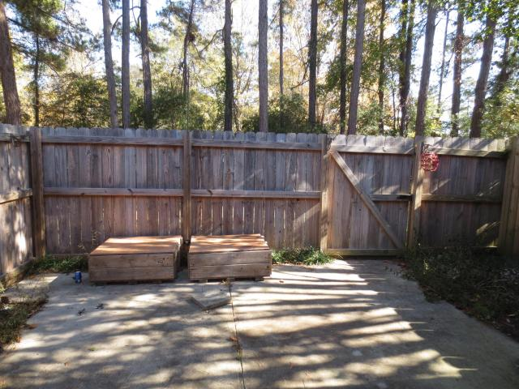
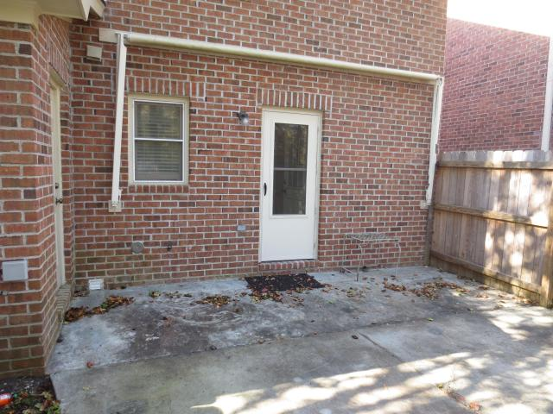
Unique Townhome Opportunity in Super Location!
302 Springview Ln
#4
Coventry Place
Summerville
MLS# 14030450
$110,000
Unique opportunity in super location! Just reduced almost $10,000, this charming traditional end unit 3-bedroom townhome is tucked away in very peaceful location that is super convenient to everything! Beautiful all brick construction, this townhome offers private patio area, completely enclosed by wood privacy fence off back, with awesome retractable awning for shaded comfort and tranquility. Inside finds large living/dining room combo with wood burning fireplace, surrounded by built-in bookshelves and pretty wainscoting. Huge eat-in kitchen has brand new smooth top range & vent hood, and newer refrigerator & dishwasher, Even counter microwave is included. The white kitchen cabinets have a glass front section to show off your best crystal! Large laundry room too off the kitchen, and a pantry. Upstairs finds 3 nice-sized bedrooms, including master with private bath. Both upstairs baths have ceramic tile floors. Window blinds on all windows are included, as are ceiling fans. Great value for this sized townhome in this location. Just needs your personal touches to make it your own.
Darlene Bollettino
Real Estate Agent
Miler Properties
Office: 843-821-1111
Cell: 843-209-8955
dbollo84@yahoo.com
www.milerproperties.com

