Slide 1
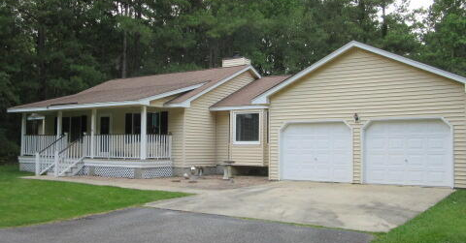
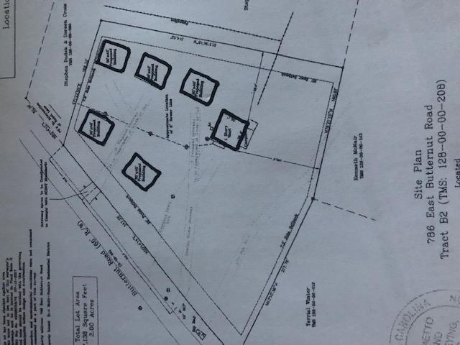
2.6 ACRES
100% USDA FINANCING
2ND HOME CAN BE ADDED TO PROPERTY (ADU)
$40,000
Price Reduction!
DRAFT
$455,000
302 Summerset Lane
MLS# 25010988
2 Blocks from The Crosstown
3 Blocks from The Citadel
6 Blocks from MUSC
This home is on 2.59 Acres of high land with the ability to build another home on the property (Accessory Dwelling Unit) and the house next to this is also for sale with 1.83 additional acres (298 Summerset). This property is just 15 minutes to downtown historic Summerville and also the I-26 at Jedburg Road. The home sits back off of the paved Road and you will feel like you are in a park-like setting This home has been updated and upgraded in every way and includes a brick wood burning fire place and even a whole house Generac generator The square footage includes a portion of the garage area that can be converted to finished heat and air interior square footage. Public sewer is avail + public water is close by.
Separate driveway can be added to the left side of the lot. Plat is under documents
2.5% Buyer’s Agent Commission
Rick Willis
843-327-3017 rwillisteam@gmail.com The Group, LLC

