Slide 1
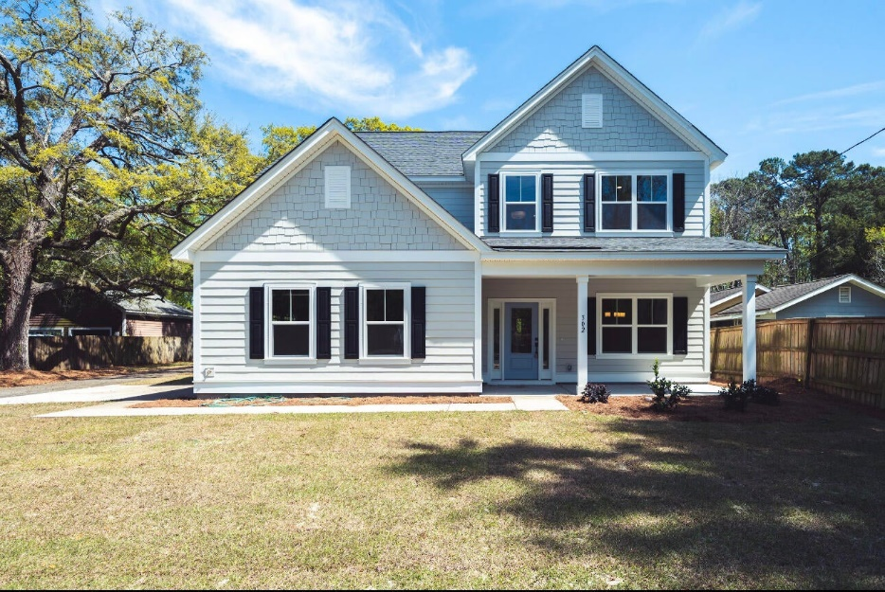
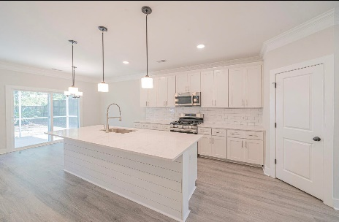
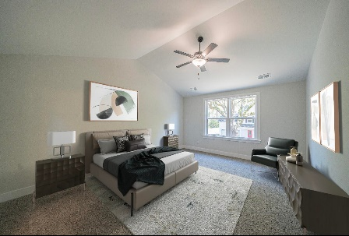

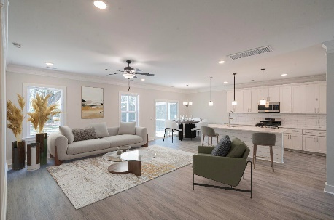
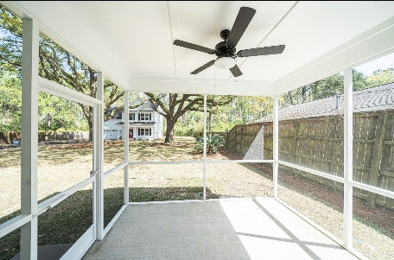






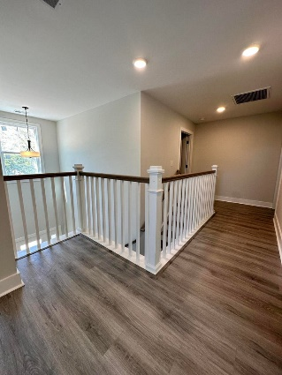
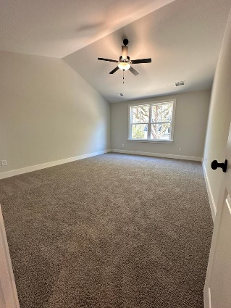
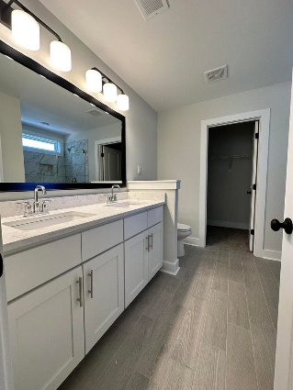
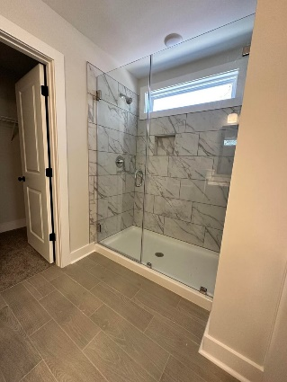
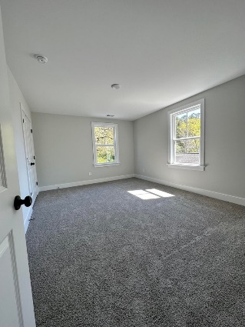
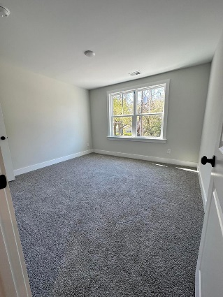
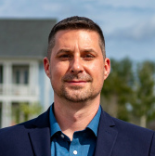
#23006232
Open House
302 Woodland Shores Road
Woodland Shores
Charleston, SC 29412
Saturday 12-2 & Sunday 2-4
Open House
Sat 10-12 & Sun 10-12
5 BED
3 BATH
2,416 SF
$739,000
Brand new construction in the heart of James Island only steps away from the Municipal Golf Course, Azul, The Pour House, Charleston Sports Pub, Terrace Theater, Maybank Public House, Millers All Day and more! This gorgeous home has **FIVE** bedrooms and **THREE** bathrooms! Every upgrade one could hope for is included with waterproof LVP flooring throughout the first floor, a designer craftsman style trim package with two-piece crown molding, chair rail and wainscoting, window casings, shiplap on the oversized kitchen island and more! You'll love the stunning 42'' white cabinets in the kitchen as well as the quartz countertops and custom backsplash! This home is equipped with gas cooking and gas heat as well! There's a large guest bedroom/office/playroom on the first floor accompanied by a full bathroom with tile flooring, a tiled shower and a raised vanity. The staircase is an open wood tread style with modern pickets leading up to the landing where the LVP continues to the bedrooms. The owners' suite is huge with vaulted ceilings and overlooks the twin hundred-year-old oak trees! The bathroom has a raised double vanity with white cabinets and upgraded tiling throughout plus an 80" frameless shower door for the ultimate custom look! There are three additional secondary bedrooms, all of which are enormous, plus another full bathroom! The screen porch takes advantage of the breathtaking views that this unique lot has to offer! It's also located in an X flood zone and the fiber cement siding is a natural insulator! There is a public boat landing across Maybank, just moments from this incredible home, and the County has committed to adding a sidewalk in front of the home that leads all the way from Maybank Highway down to Riverland Drive!
Meg H. Kandik
843-814-5137
Meg@HolyCityRE.com
www.holycityre.com
Brand Name Real Estate
4 Carriage Ln
Charleston 29407
Matt Kimes
843-860-1669 | mattkimeshomes@gmail.com
www.mattkimeshomes.com

