Slide 1
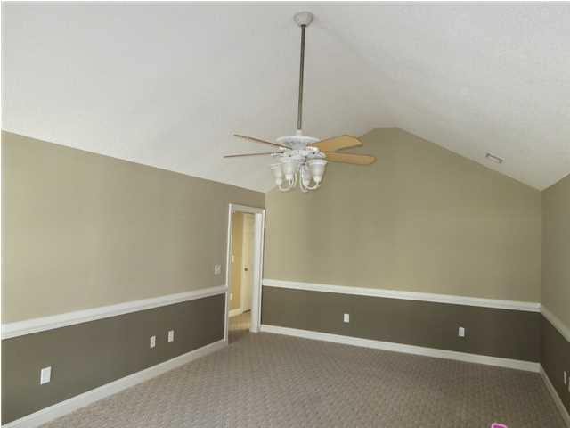
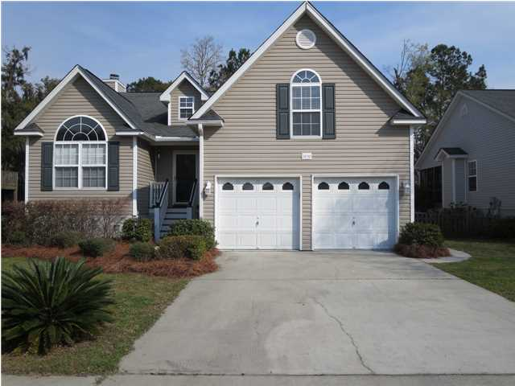
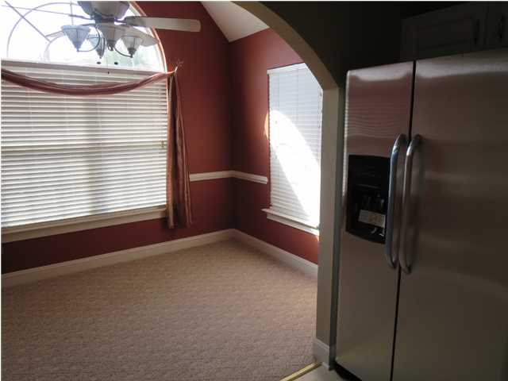
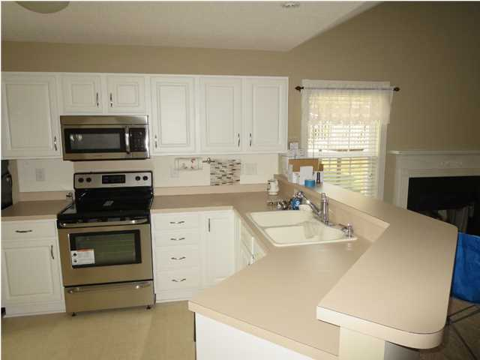
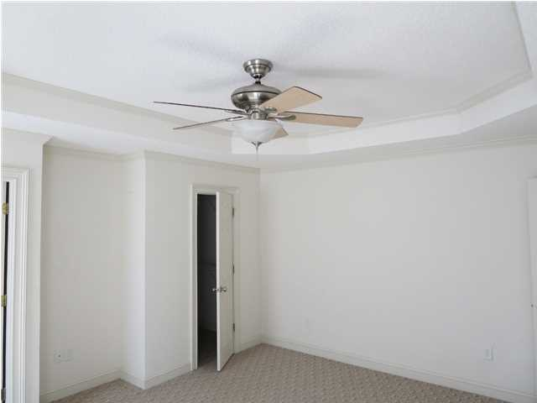
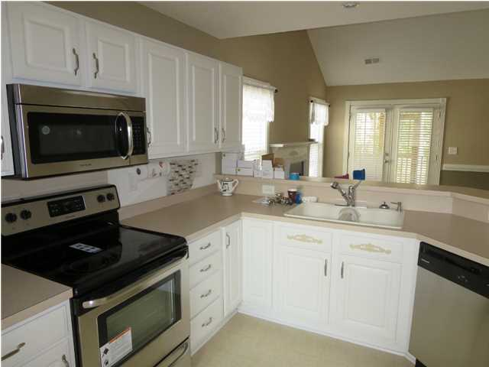
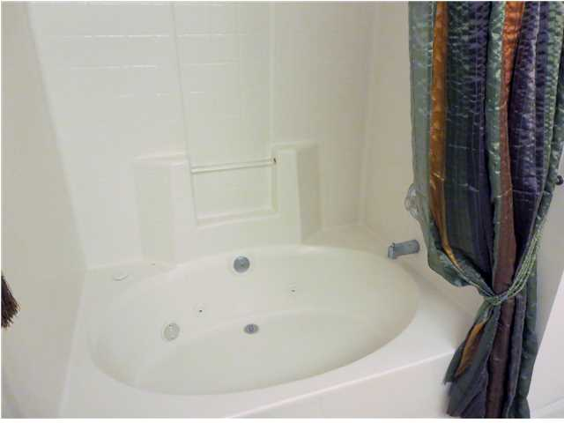
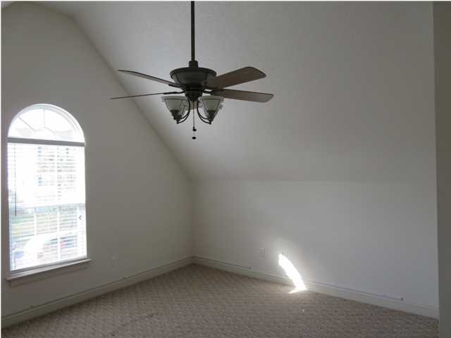
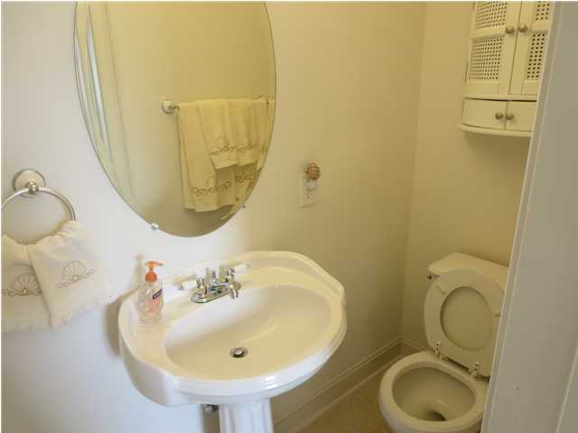
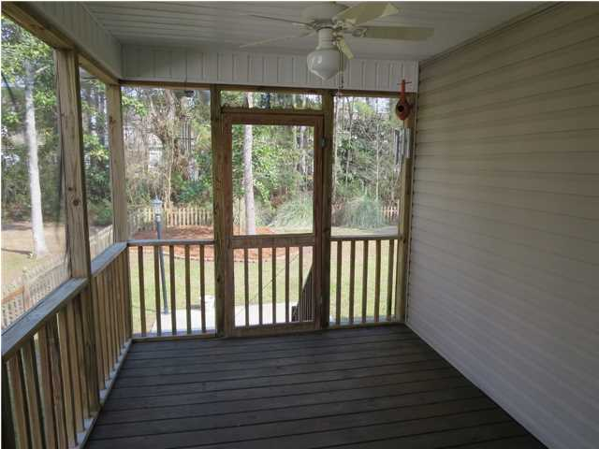
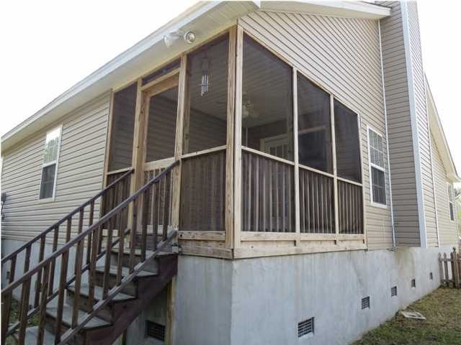
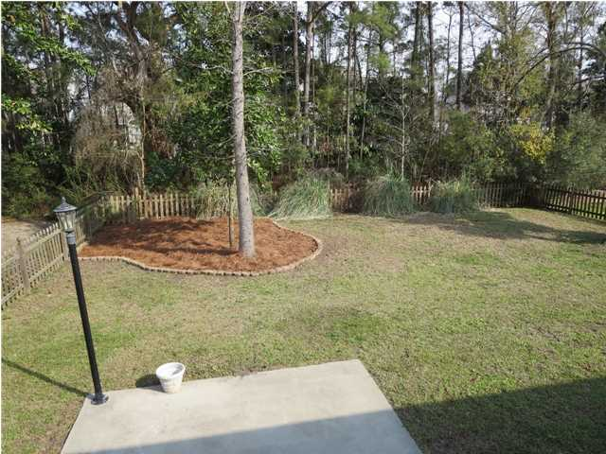
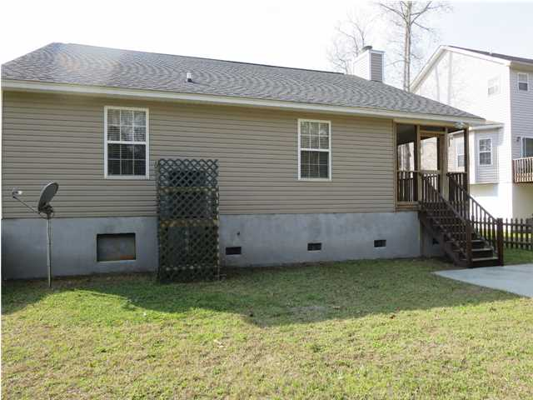


Open House Sunday 1-4
Price Reduced!
3030 Penny Ln
Johns Island – The Bend at River Road
MLS# 1424006 – $229,900
PRICED TO SELL. $135 PER SQUARE FOOT! SIMILAR HOME WITH SAME FLOOR PLAN AND NO BONUS ROOM (200 SQ/FT SMALLER) SOLD FOR $227k!!! THIS IS A GREAT DEAL. BRING YOUR BUYERS. BEAUTIFUL HOME!!!
Owner has replaced all appliances with new stainless steel, including double door refrigerator, new paint in all living areas (master, bonus and 1 guest room are left white for your colors!), new hardware on all doors. Owner upgraded original floor plan to include finished bonus room with full bath…could be used as 4th bedroom, but no closet.
Upgraded lighting and fans throughout. This is the only house in The Bend that has gas and natural burning fireplace. (Chimney). Gate on either side of house opens wide for your boat storage. Current HOA regulations allow for boat storage on your lot! Back yard is big, fenced in and private.
Randy Stuckey, Realtor
843-906-7997
randystuckey@msn.com
ERA Wilder Realty, 125-F Wappoo Creek Dr, Charleston, SC 29412

