Slide 1
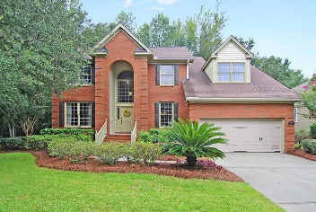
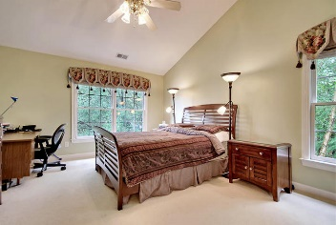
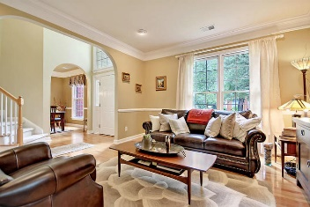
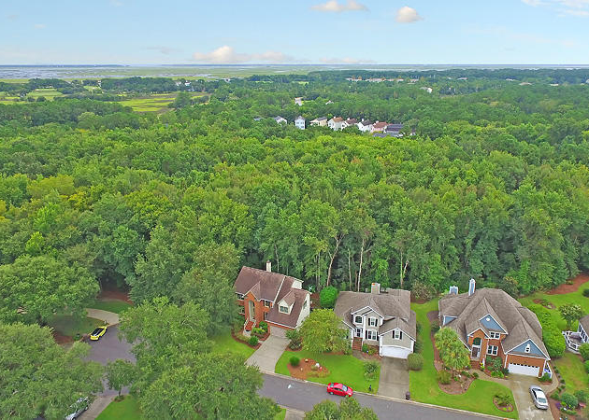
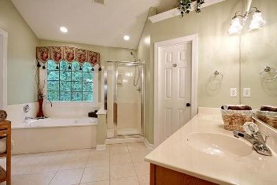
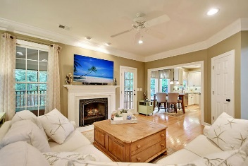
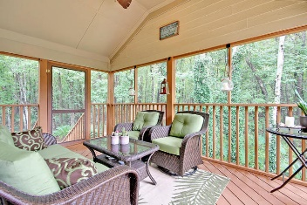
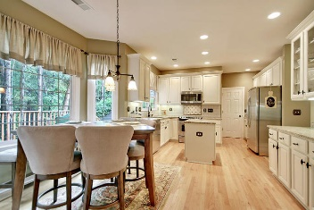
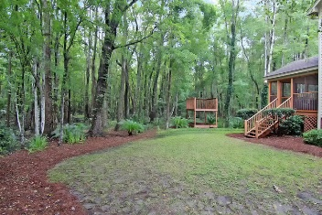

3031 Linksland Road Charleston National · Mount Pleasant, SC 29466 · MLS# 17025140 · $450,000
Upgraded Home ~ Private Lot
Great Price!
Gas Card Give Away
GORGEOUS meticulously maintained brick front/cement siding 4 bedroom 2.5 bath EXECUTIVE home that sits on one of the BEST LOTS in Charleston National. This home has a 2 story grand foyer with handsome hardwood floors, heavy molding throughout the main level, and an abundance of natural light. From the foyer is a separate dining room to the right and living room/office to the left. Continuing into the home is the large family room with fireplace that is open to the upgraded/updated gourmet chef's eat-in kitchen with granite counter tops, stainless steel appliances, 42 inch cabinets, butlers pantry area and tile backsplash that is perfect for entertaining family and friends. The first floor also has a beautifully updated guest bath and a laundry room. The master bedroom is on the second floor with his and hers walk-in closets, spa-like master bath with jetted soaking tub, separate shower, and dual vanities. Three additional bedrooms upstairs share a bath. The forth bedroom is the FROG and is large enough to be a bedroom, media room, or office. The screened porch and deck are perfect for having a morning cup of coffee or reading a good book in the afternoon and overlook the peaceful, wooded lot. Additional features include-professionally encapsulated crawlspace, extra garage storage space, garage utility sink, and a hurricane rated garage door. The private lot sits on a cul-de-sac and 2 sides back up to protective wetlands. Charleston National in Mount Pleasant is a wonderfully landscaped community with a golf course, club house, play park, tennis courts and community pool! The neighborhood has quick access to HWY 17 for an easy commute and is close to local shopping and grocery stores and is a short drive to downtown Charleston with 5-star restaurants, world class shopping and iconic history as well as a short drive to the beaches, the airport, Boeing and Daniel Island. Come take a look because you will not find another home that offers as much as this one: a chef's delight and entertainer's dream in a private oasis!
Stan Huff
843-670-2835 stan.huff@agentowned.com
Jill Marcacci
843-297-5590 jill@agentowned.com
www.agentownedrealty.com
AgentOwned Realty Co. Preferred Group, Inc. | 824 Johnnie Dodds Blvd | Mt Pleasant, SC 29464

