Slide 1
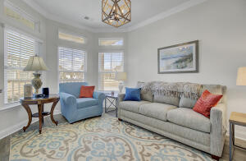
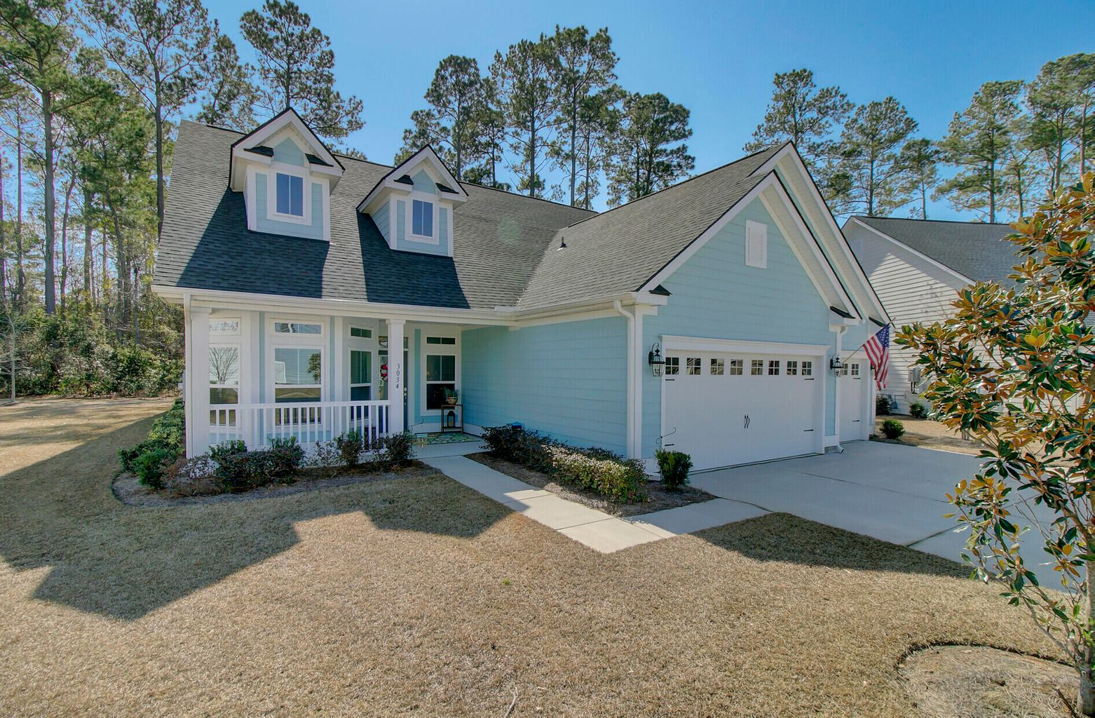
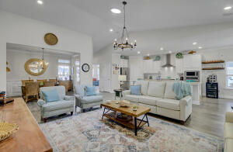
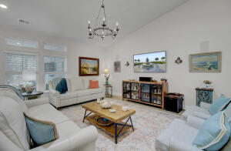
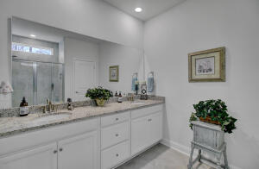
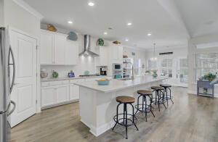
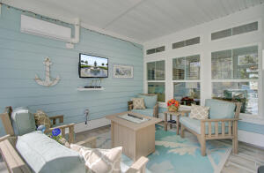


New Listing!
Liberty Cottages in Park West!
3034 Rice Field Lane
Park West
Mount Pleasant, SC 29466
MLS# 22004414 | $650,000
Is this a model home?
You will ask yourself this question when you enter this BETTER THAN NEW one story home in the coveted 55+ community, Liberty Cottages in Park West!
3 Bedrooms, two baths and 2274 sf. Tasteful finishes are found throughout - no carpet, quartz counters in the bright white kitchen with gas cooking and stainless steel appliances, and designer light fixtures throughout.
A sunroom, heated and cooled, was created as an additional living area.
A three car garage is an added benefit.
Do NOT delay in scheduling your appointment!
Showings begin Wednesday and Open Houses are scheduled Saturday and Sunday from 12-3.
Take a video tour!
Ellen O'Neil
Broker/Owner, ABR, e-PRO, CNE
Charleston Realtor of Distinction
(843) 300-8530
www.EllenONeilProperties.com

