Slide 1
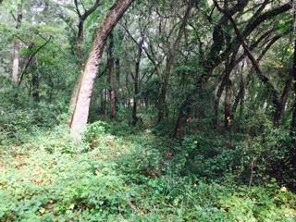
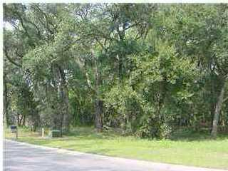
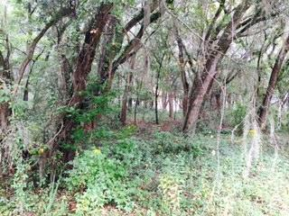
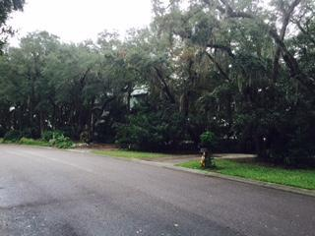
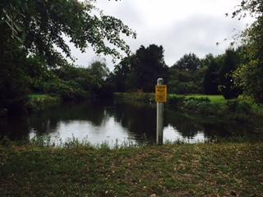
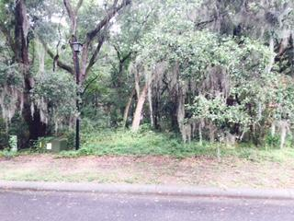
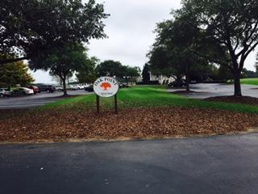
Come build your dream home!
3035 Maritime Forest Drive
Kiawah River Estates ~ Johns Island, SC 29455
MLS# 15011785 ~ $70,000
Property is behind the second gate and features mature vegetation including live oaks, located across the street from million dollar homes on the banks of Haulover Creek.
Community offers pool, tennis courts, crabbing dock and a special golf membership package for residents.
Fresh Fields shopping center, Bohicket Marina and area beaches are only minutes away.
Mike Goldston, Realtor
mikesellscharleston@gmail.com | 843-343-7026 | www.cometocharlestonsc.com
Brand Name Real Estate | 4 Carriage Lane, Suite 106 | Charleston, SC 29407

