Slide 1
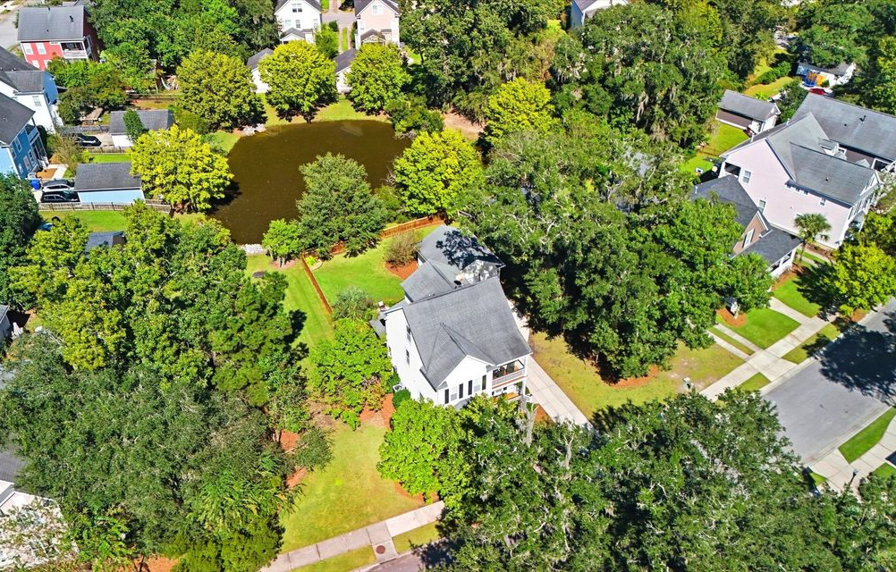
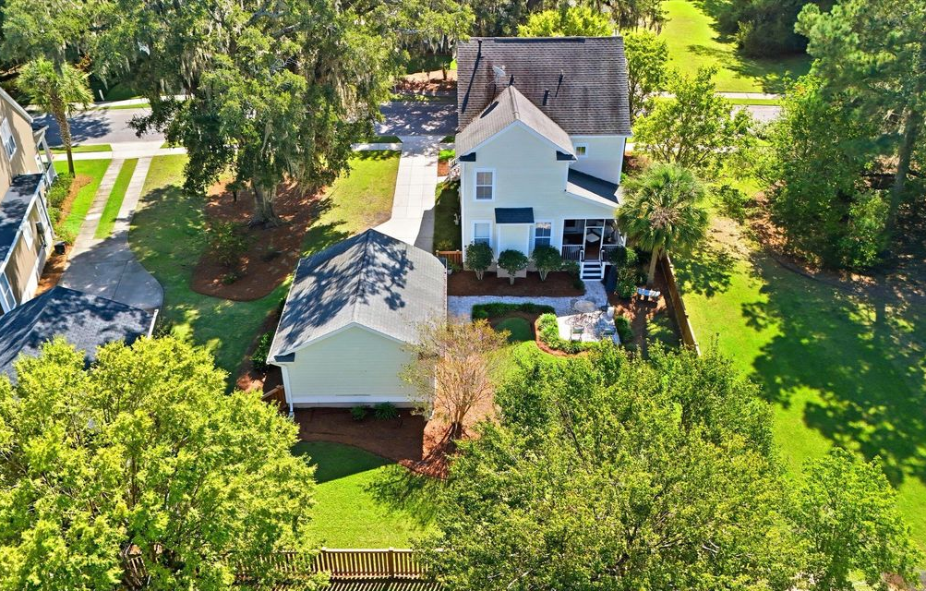





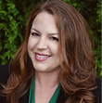

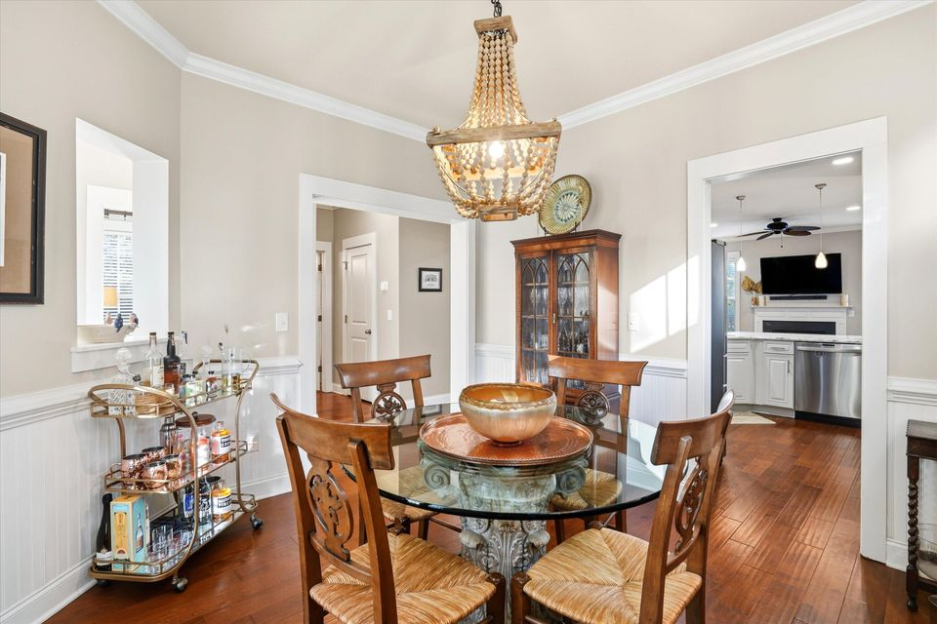
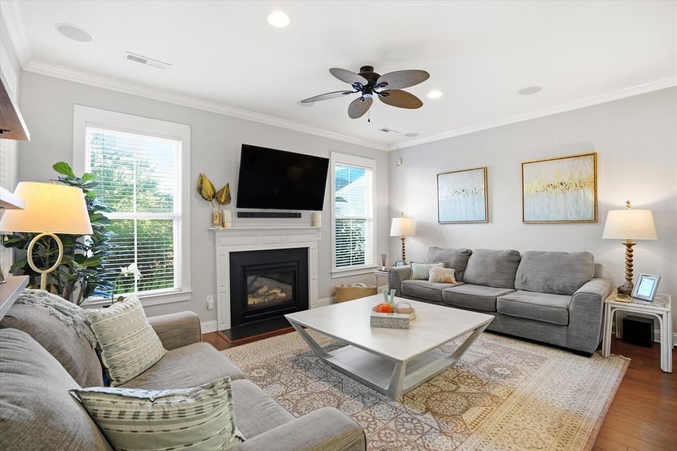
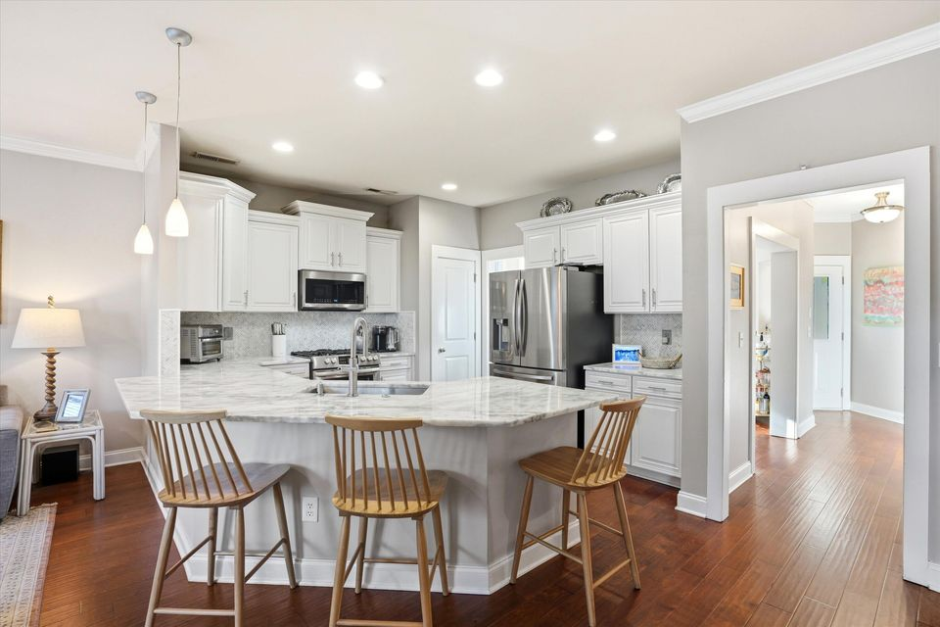
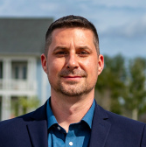
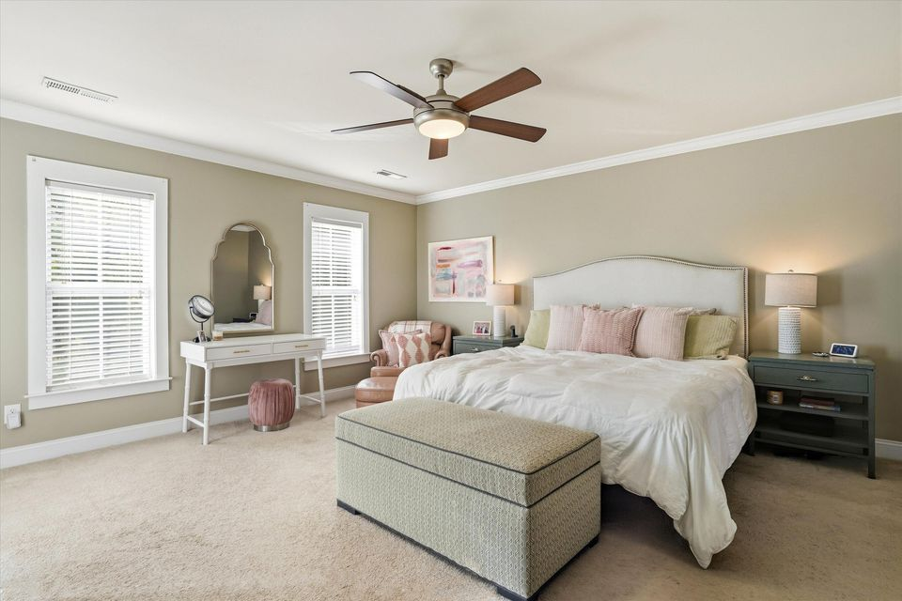
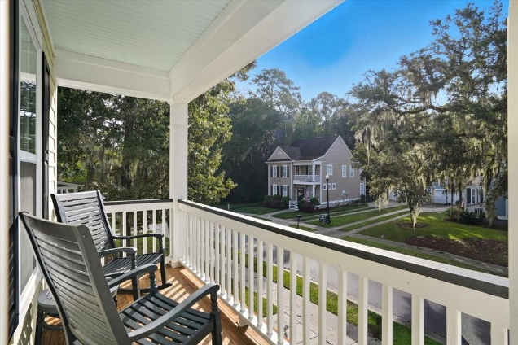
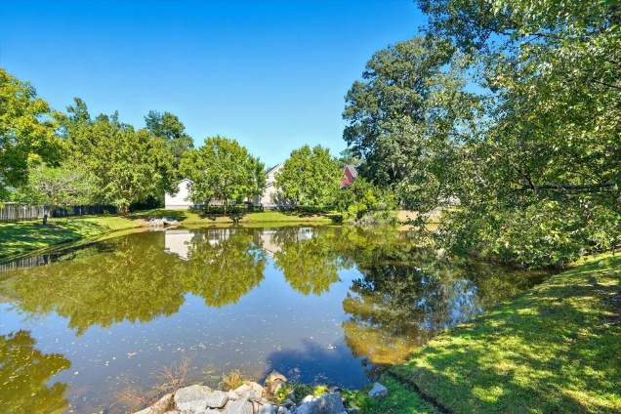
#25028243
Private Pond Homesite
8 Miles to Downtown Charleston
3036 Hatchers Run Drive
Carolina Bay
Charleston, SC 29414
Open House
Sat 10-12 & Sun 10-12
5 BED
3 BATH
2,460 SF
$699,999
This stunning home is located in Carolina Bay's Most Sought-After Section: Salt Grass! Welcome to Salt Grass, the original and most desirable subsection of Carolina Bay, where homes are thoughtfully spaced apart and framed by moss-draped ancient oaks. There's truly nothing else like it in the neighborhood. This oversized homesite is perched on the pond and surrounded b, fully fenced, and offers rare privacy. The quintessential Charleston Single-style home exudes Lowcountry charm, complete with a fabulous detached two-car garage. Inside, you'll find thoughtful design and recent updates throughout: First-Floor Mother-in-Law Suite - perfect for guests or extended family. Newly Renovated Kitchen - featuring stunning quartz countertops, a custom coordinating backsplash, and gas cooking that any chef will love.
Spacious Owner's Suite - located upstairs, with a private balcony overlooking majestic oak trees, a large walk-in closet, double vanities, and separate tub & shower. Additional Bedrooms - two secondary bedrooms plus a generous laundry room on the second floor. Third-Floor Bonus Room/5th Bedroom - enormous and versatile, ideal for a playroom, media space, or home office.
Enjoy Charleston's outdoor living at its finest with a screened porch overlooking the private fenced backyard and pond views.
Meg H. Kandik
843-814-5137
Meg@HolyCityRE.com
www.holycityre.com
Brand Name Real Estate
4 Carriage Ln
Charleston 29407
Matt Kimes
843-860-1669 | mattkimeshomes@gmail.com
www.mattkimeshomes.com

