Slide 1
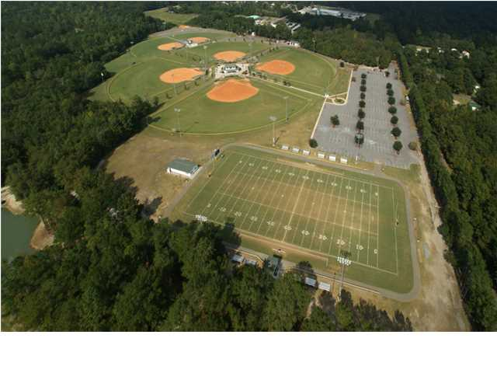
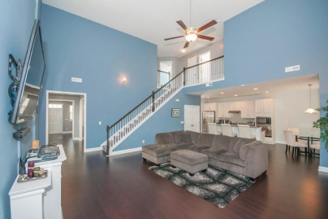
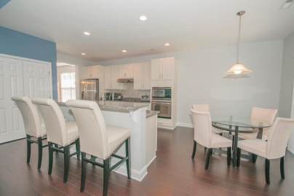
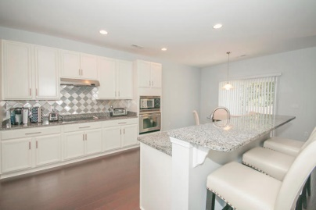
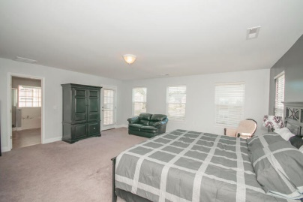
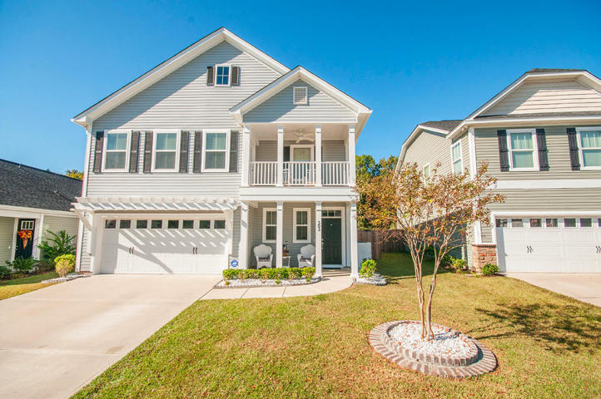
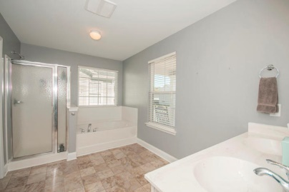
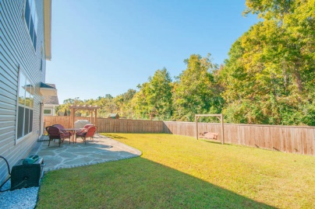
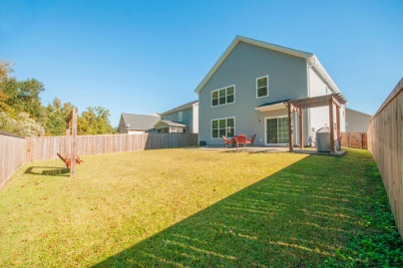


303 Foster Greens Court
Brickhope Greens | Goose Creek | MLS# 14028732 | $245,000
New Price! Reduced Almost $10,000!
This has the ''WOW'' factor you are looking for. You will love the spaciousness and modern feel of this gorgeous home from the moment you walk through the front door. Loaded with upgrades and extras, this 4BR/2.5BA home offers a chef's kitchen with S/S appliances, beautiful granite countertops, an abundance of cabinet space and an oversized walk-in double-door pantry. For more casual dining there is a large eat-in kitchen or center island. For more formal gatherings you have a wonderful space right off of the kitchen that flows into the formal living room. Also off of the kitchen is the huge great room with 2-story soaring ceilings and lots of natural light. Beautiful dark flooring with a hand-scraped look runs throughout the entire first floor. Beautiful paint colors compliment the floors on both levels. A half bath as well as a mudroom are also located on the first level. As you make your way upstairs notice the wood stained bannister and white wood spindles that add to the open feel. The silver gray carpet compliments the cool paint colors throughout the home. Upstairs you will find a large Master Suite with a double vanity, separate garden tub/shower with a cultured marble backsplash. You will love the large custom designed walk-in closet as well as a covered porch off of the bedroom roomy enough for two rocking chairs and a table. The secondary bedrooms are generously sized and the laundry room is conveniently located on the second floor as well. Enjoy outdoor living in your own private backyard oasis. A beautiful flagstone and brick patio awaits you as you dine under the charming pergola. There is a full privacy fence with the woods directly behind you. The current owner has taken great care by adding landscape rock running the full length of the home on both sides as well as installing a French drain to pull any rain water away from the home. Conveniently located to Boeing, Naval Weapons Station, Downtown Charleston as well as the Beaches and Interstate.
Beth Mandell
M 843-900-1296 | O 843-871-2121
bmandell@century21properties.com
www.bestcarolinahomedeals.com
Century 21 Properties Plus of Summerville | 118 W Richardson Ave | Summerville, SC 29483

