Slide 1
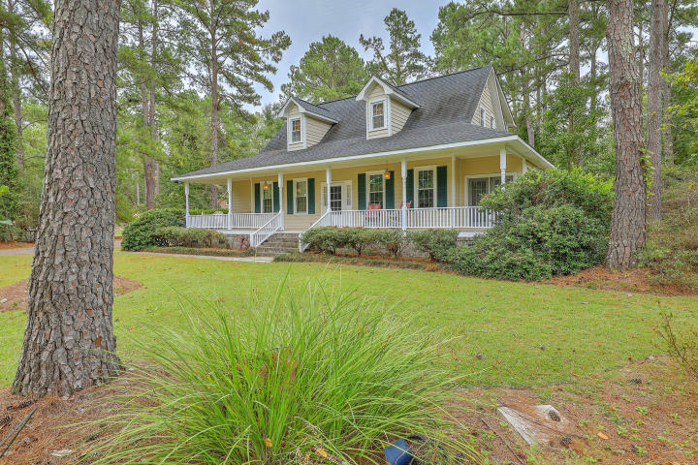
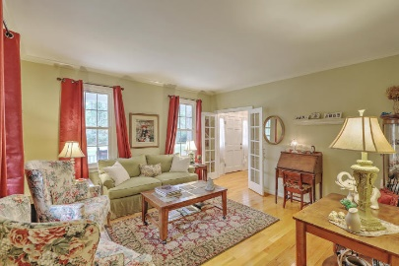
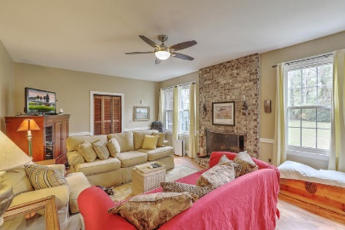
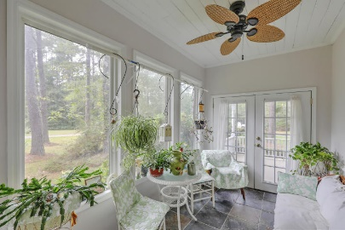
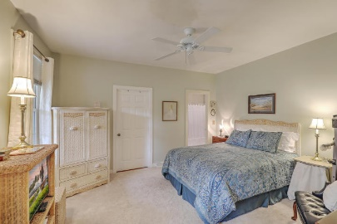
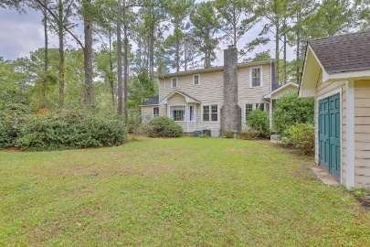
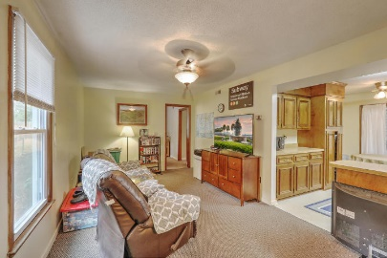
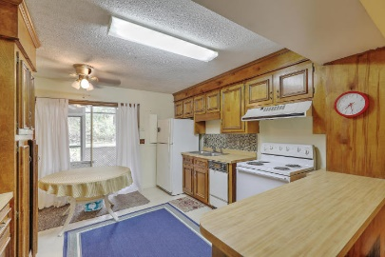


303 Huntington Road
Sweetbriar | Summerville, SC 29483 | MLS# 17027455 | $354,900
Huge Price Reduction!
1+ Acre Lot
Detached Cottage
With rates on the rise, now is the time to buy!
Perfect opportunity for a Multi-Generational Family with space for everyone! This lovely home and Detached Cottage, situated on over an acre lot, offers Gracious Southern Living in the highly desirable Sweetbriar neighborhood within walking distance to Pinewood Prep School. Inviting Wrap-Around Front Porch welcomes you in to the Main house which offers Dual Masters, Formal LR, DR and Great Room w/FP, Sunroom with French Doors and Slate Tile Floor. Eat-in Kitchen w/Bay Window, SS Appliances, Quartz Counters and Breakfast Bar. 3 large BR's upstairs. Cozy Screen Porch off of Family Room. Crown Molding in Foyer, LR, DR and Kitchen. The 2-Story Cottage offers a spacious Living Room, Full Eat-in Kitchen with sliding glass doors to a Screened Porch, Bonus Room and 1BR with a Private Bathroom. Second floor has plumbing, electrical and HVAC and is currently being used as storage. There is also an attached storage building on the main level as well as a detached building for extra storage. Square footage for home is 2600 and 1200 for cottage. Home and Cottage are on separate septic systems. Seller is offering a 1-year home warranty through AHS. So much potential to make this your own private oasis!
Beth Mandell
M 843-900-1296 | O 843-871-2121
bmandell@century21properties.com
www.bestcarolinahomedeals.com
Century 21 Properties Plus of Summerville | 118 W Richardson Ave | Summerville, SC 29483

