Slide 1
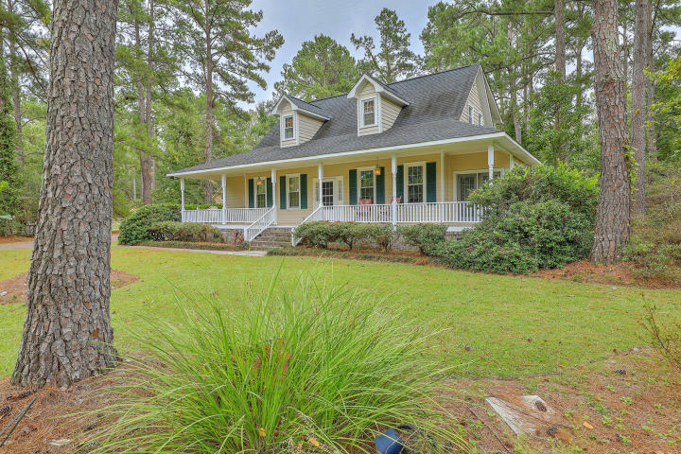
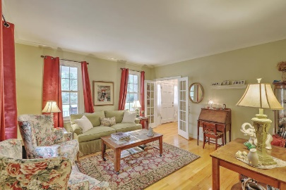
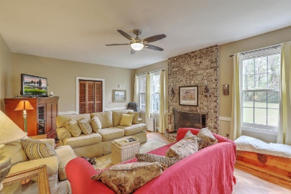
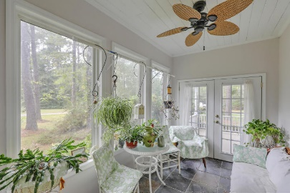
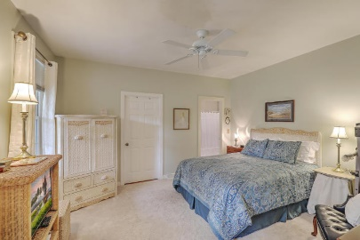
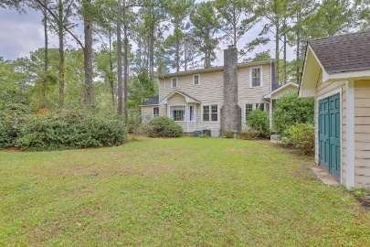
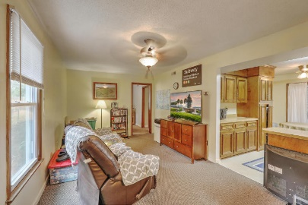
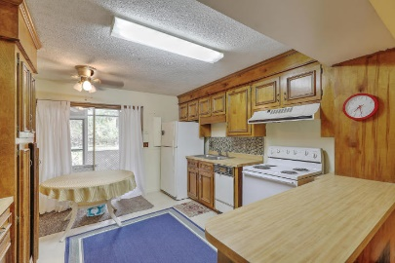


303 Huntington Road
Sweetbriar | Summerville, SC 29483 | MLS# 17027455 | $424,900
Just Listed!
1+ Acre Lot
Gracious Southern living in the highly desirable Sweetbriar neighborhood within walking distance to Pinewood Preparatory School. Main house offers dual masters, formal LR, DR and Great Room w/FP. Sunroom with French doors and slate tile floor. Eat-in kitchen w/bay window, SS appliances, quartz counters and breakfast bar. 3 large BR's upstairs. Small screen porch off of laundry room. Detached Cottage offers over 1200 sq. ft. In this 1BR/1BA , LR, full kitchen, bonus room and large screen porch. Attached storage plus second story with small sink. Currently used for storage. Extra shed in the private backyard. So much potential to make this your own private oasis. Home and cottage on separate septic systems. Seller offering one year home warranty through AHS and transferable termite bond.
Beth Mandell
M 843-900-1296 | O 843-871-2121
bmandell@century21properties.com
www.bestcarolinahomedeals.com
Century 21 Properties Plus of Summerville | 118 W Richardson Ave | Summerville, SC 29483

