Slide 1
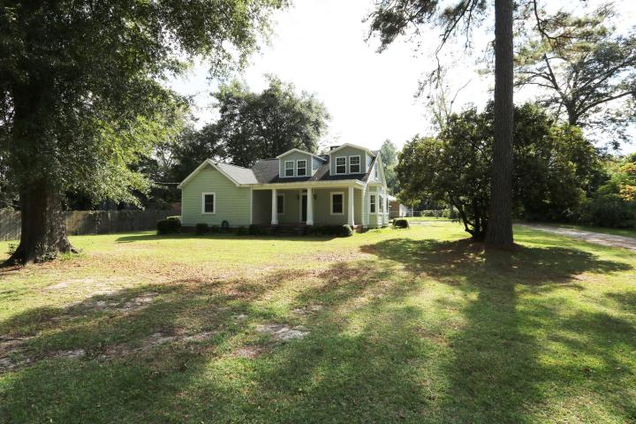
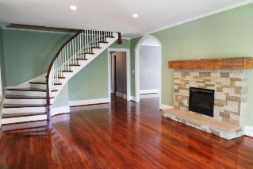
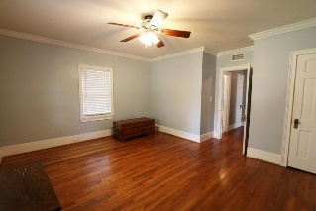
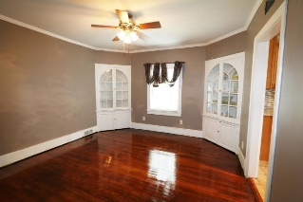
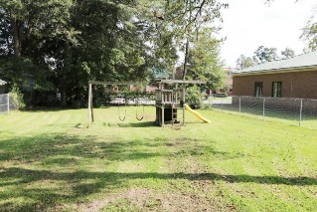
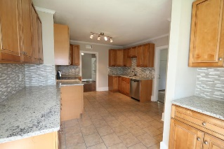
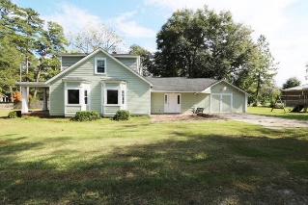


Open House Saturday & Sunday
303 Johnston St
Saint George, SC 29477 | MLS# 18028306 | $235,000
Motivated Sellers!!! Bring all offers. Don't be shy.
Rare opportunity to own this beautiful historic early 1900's home located in the desirable town of St. George. Easy walking distance to shops gas station and more. It has been extensively renovated while keeping its historic charm intact. Updates include resurfaced hardwood floors original to the house, a brand new kitchen, fresh paint, hvac and roof was replace just a few years ago just to name a few. You will find 2 bedrooms including the master downstairs and the other 2 bedrooms are upstairs. The kitchen has new cabinets with granite counter tops, stainless steel appliances, and tiled floors and back splash. Off the kitchen you will find a large laundry/mug room that is adjacent to the 2 car garage. This property is a whopping 1/2 acres for you to watch your children or grandchildren run and play or entertain family and friend with an outdoor party or barbecue.
Come see for yourself.
Carmilla Brown, REALTOR
Mobile - (843) 926-2007
crbrownrealestate@gmail.com
www.yourcharlestonnewhome.com
Keller Williams Realty 496 Bramson Ct Ste 200
Mt. Pleasant, SC 29464

