Slide 1
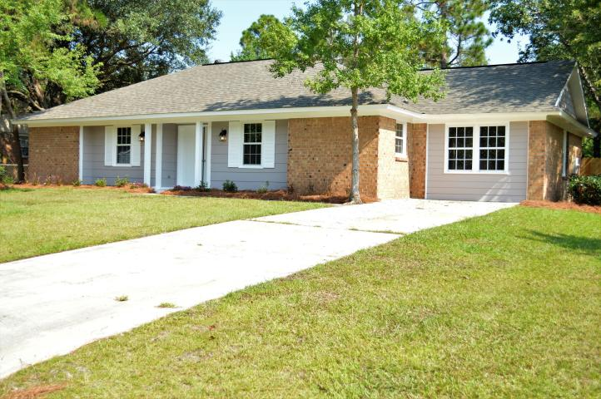

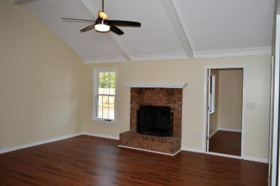
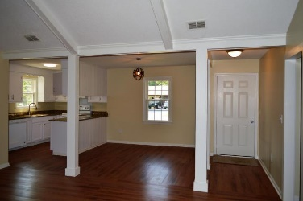
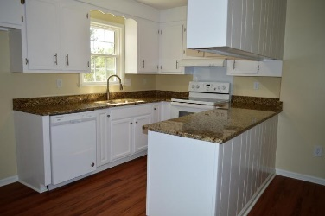
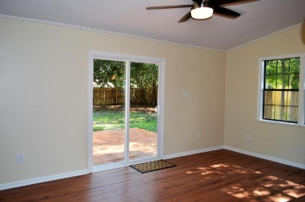
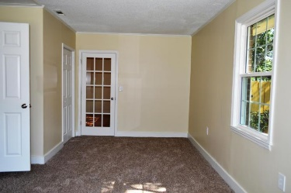
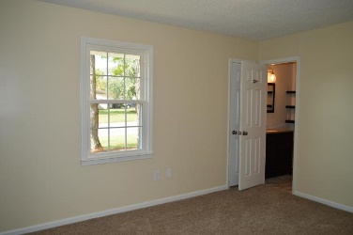
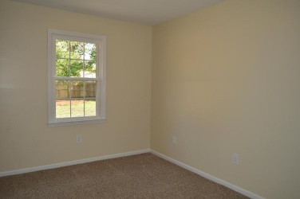
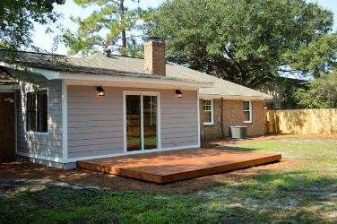
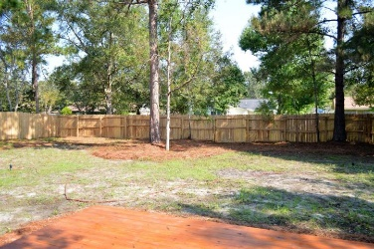
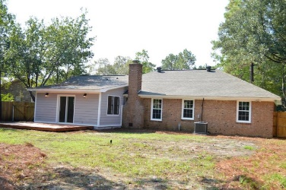



Sangaree Full Renovation
303 Longleaf Road
Sangaree
Summerville, SC 29486
MLS# 17025942
$199,000
1,800 SF
4 Bedrooms :: 2 Bath
Beautiful Renovation!!
This spacious home has a nice open floor plan. The kitchen has granite counter tops, new appliances and a large walk-in pantry. A nice cozy living room with large wood burning fireplace. There is a bright and sunny, fully enclosed sun room that opens up to a huge back yard with privacy fence. The master bedroom is airy and bright. Master bath has large stand up shower and new granite topped vanity. Just down the hall from the master are 2 guests bedrooms and a full bath with tub/shower and granite topped vanity.
The converted garage is the fourth bedroom. The Roof and the HVAC are BRAND NEW! This is a TRUE TURN-KEY home and won't last long. Schedule a showing and start packing your bags because your new home is waiting.
Lizzie H Ray
(843) 452-9298
lizzieray1122@gmail.com
Eric Draper
(843) 442-7118
eric.draper@gmail.com
www.charlestonrealestategroup.com
Charleston Real Estate Group | 792 Folly Rd. C1 | Charleston, SC 29412

