Slide 1
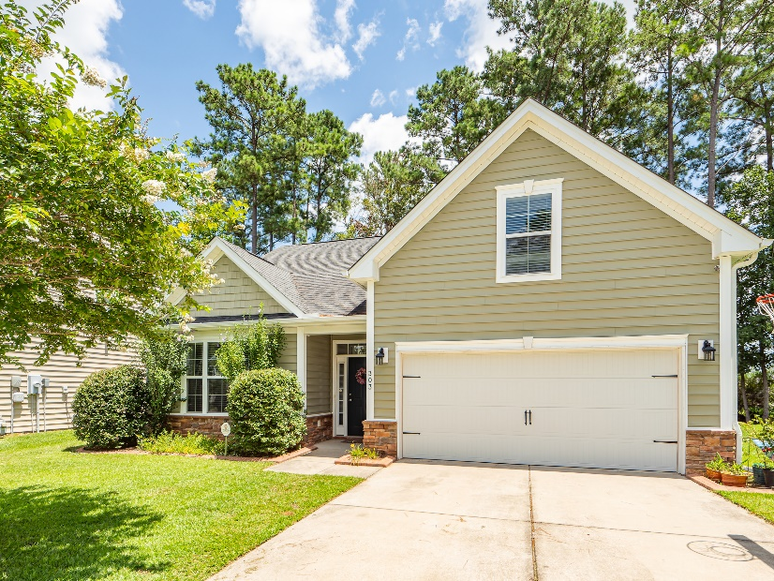
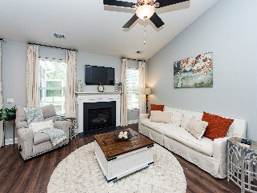
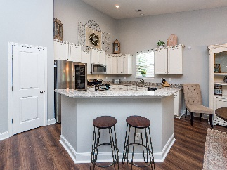
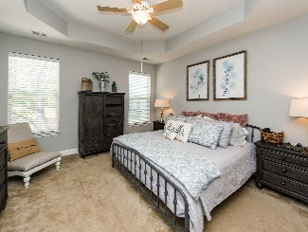
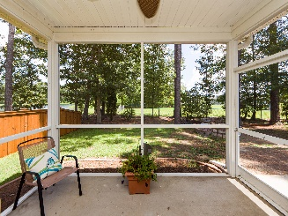
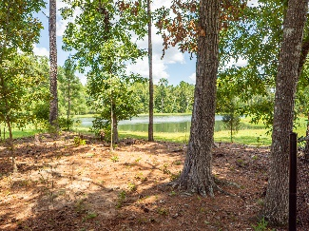


$5,000 Toward Closing Costs Or Rate Buy Down
$15,000 Agent Bonus
with ratified contract by 4/15/18
303 Freeland Way
Foxbank Plantation
Moncks Corner, SC 29461
MLS# 22021977
$359,000
** Act Fast - Seller is offering $5,000 toward Buyer Closing Costs or Interest Rate Buy Down ** Beautiful, 1 story home in Foxbank Plantation with bonus room and bath upstairs. Quiet cul de sac location. Screened porch with views to picturesque HOA maintained pond. This home features an open concept floor plan with high vaulted ceilings. New laminate flooring throughout the living areas. Split bedroom floor plan – 2 secondary bedrooms with a shared bath located at the front of the home, with the master bedroom set in the rear opposite corner for privacy and backyard views. Master bedroom includes a tray ceiling, walk in closet, and lovely private bath suite with relaxing soaking tub and separate shower. You'll love the volume of the high vaulted ceilings throughout the living area and kitchen. Recessed lighting, upgraded designer light fixtures and ceiling fan, and gas fireplace. The kitchen is a gourmet's dream, with solid counter tops, staggered cabinetry, pantry storage, abundant counter space and a prep island with bar top. Stainless appliance package includes a gas range, dishwasher and microwave. Bonus (4th bedroom) upstairs with private bath will delight any teenager or is the perfect guest suite for overnight visitors. Walking distance to Foxbank Elementary School. Foxbank Plantation offers excellent amenities including a neighborhood lake, swimming pool, dog park and more. Conveniently located off Highway 52 near dining, shopping, employment and recreation.
Come see 303 Freeland Way today!
Mason Thurber
(843) 709-5109 – C (843) 576-2699 – O
mason@theeverettgroup.net
RE/MAX Pro Realty, 9209 University Blvd, Charleston, SC 29406

