Slide 1
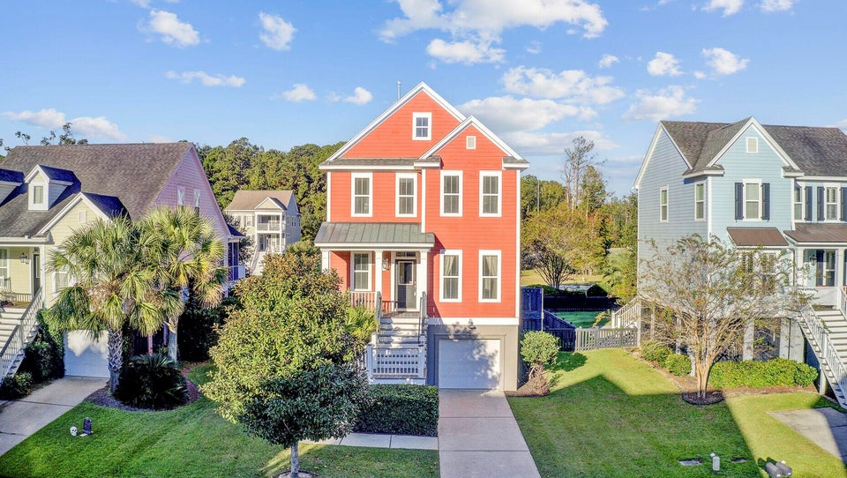
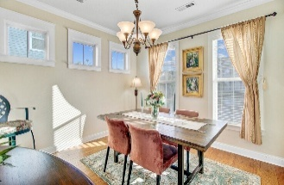
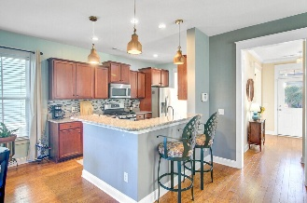
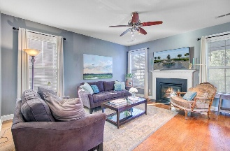
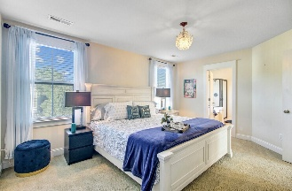
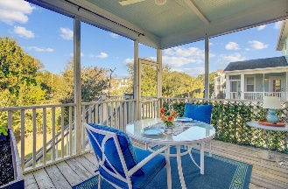
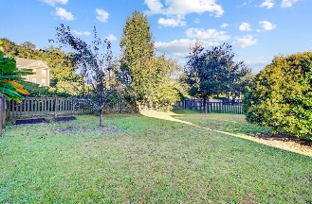


Don’t miss this one!
Beautiful elevated residence nestled in Shellring at St. Thomas Island
303 Megans Bay Lane
Wando, SC 29492 | MLS# 25028967 | $795,000
From the moment you arrive, you'll be drawn to the expansive front porch—perfect for morning coffee or evening relaxation while enjoying views of the charming neighborhood. Step inside to a thoughtfully designed first floor featuring an open dining area, kitchen, and inviting living space, complete with a convenient half bath. The kitchen offers a raised bar and a cozy breakfast area, seamlessly connecting to a screened-in porch that overlooks a beautifully fenced backyard—ideal for entertaining, play, or peaceful outdoor living.
Upstairs, retreat to the spacious primary suite with a private en suite bath boasting a luxurious soaking tub and walk-in shower. Two additional bedrooms and a full bathroom are located just down the hall, offering comfortable accommodations for family or guests. The upstairs laundry room adds everyday convenience and ease. When you descend to the ground level, the garage holds 2-cars plus extra space. This home is close to all the luxuries of Daniel Island. Daniel Island has numerous restaurants, a recreation center for kids and adults, numerous entertainments and a water taxi that can take you into Charleston without having to worry about driving or parking in the city. This home blends comfort, functionality, and Lowcountry charm in a location you'll love...don't miss the opportunity to see it in person!
Renee Szczepanski
843-830-4889
renee.resc@gmail.com
www.truecarolinarealty.com
True Carolina Realty
7410 Northside Drive, Ste 150
N Charleston, SC 29420

