Slide 1
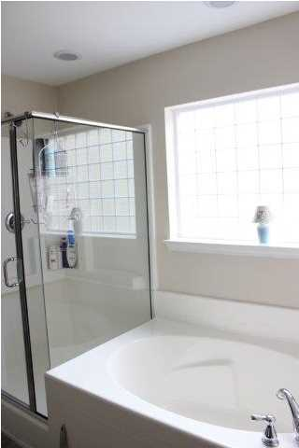
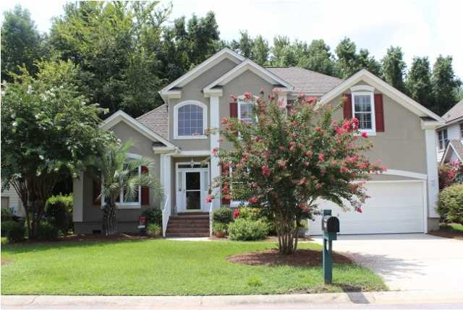
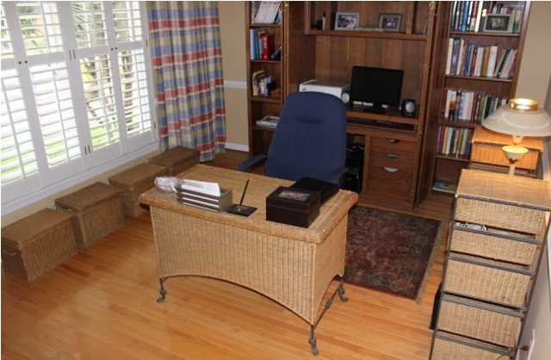
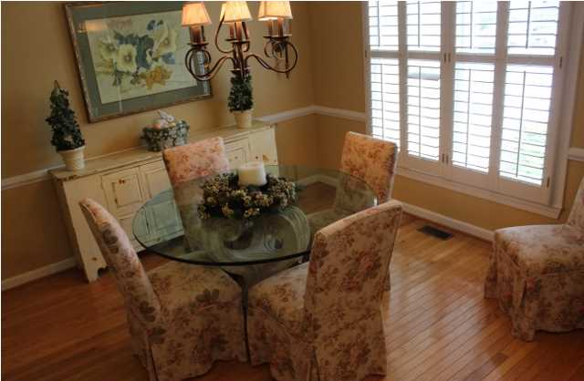
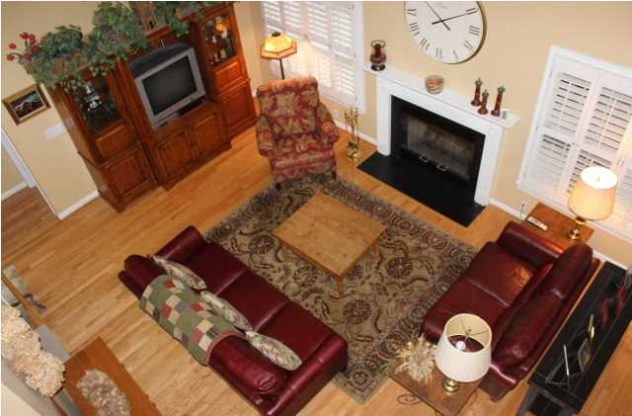
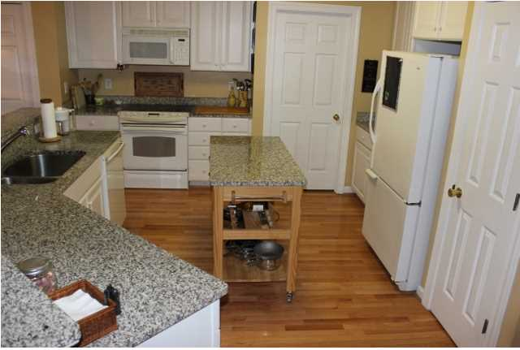
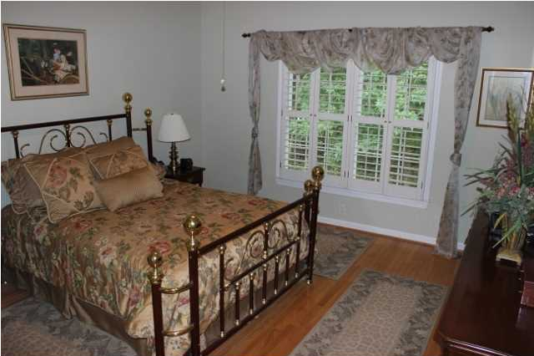
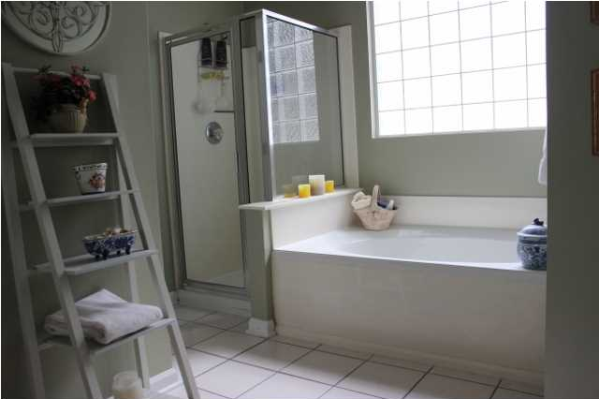
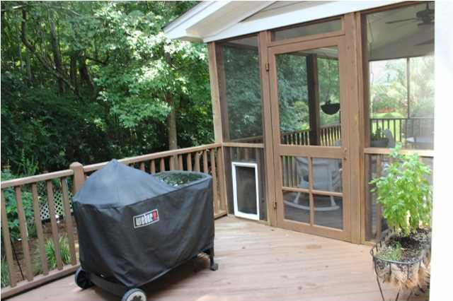
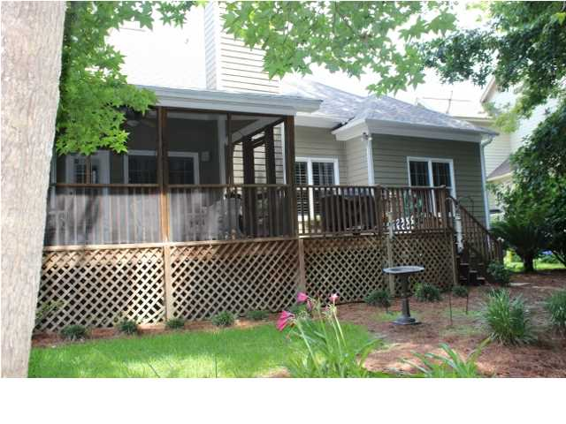


Priced to SELL in Mount Pleasant!!
3041 Linksland Dr
Charleston National ~ MLS# 1420306 ~ $390,000
“Home is where the heart is” should be engraved above the fireplace at this inviting home. Family life is given top priority in this home with its open floor plan. For the buyer, 3041 Linksland is in move-in condition with hardwood flooring throughout the first floor. The foyer leads through to the Family Room which is the center of the home and is fully open to the Breakfast Room and Kitchen which has granite counter tops. There is a charming Dining Room that shines with natural light at the entrance to the home. On the opposite side of the foyer is the Study or Home Office which can be converted to a Living Room or a Rec Room. The large Master Bedroom is towards the rear of the first floor offering a view of the back yard and the woods. Adjoining the Master Bedroom is a spacious and tiled (12x12) Master Bath. The tiled Laundry Room has a door which offers privacy and is sound retardant. The Screen Porch and large grilling Deck overlook the back yard and the wooded buffer. The additional two Bedrooms are upstairs along with the Bonus Room which is set up as a bedroom. A benefit to the buyer is the home warranty that is included in the purchase. Upgrades and maintenance include: Exterior wood siding and trim painted in May 2014, HVAC 2012, Roof 2012, Hot Water Heater 2011, Hardwood floors 2003, Ceramic 12’x12’ tile 2003, Original stucco removed around 2000 and fully acceptable standard stucco installed. Preventative maintenance with gutters and piping to drain to the rear of the yard, vapor barrier, good air flow in front of the crawl space vents. Current termite bond with Lightening Termite for $190/year. Flood insurance is not mandatory for financing. Additional upgrades and features of the home: In the Kitchen, granite counter tops including on the island, a pantry, 42” cabinets, Bosch (quiet) dishwasher, built-in microwave. Master Bath with a separate water closet, linen closet, shower, soaking tub, double vanity sinks. Wood Burning Fireplace in the Family Room. Upgraded light fixtures in the Dining Room and Foyer. Numerous ceiling fans. 3” plantation shutters throughout the home. Abundant storage including under the eaves and under the staircases as well as in the attic. Pull down attic stairs. Upstairs Hall Bath has a linen closet. Shelf system in the clean garage. TV satellite in use and to be left in “as is” condition. Additional information: HOA $370/year plus $43.50/mo. for 3 pools, tennis courts and playground at Charleston National Country Club. Security system is $216/year with Carolina Custom Security. Nearby: Neighborhood pool, golf course, tennis courts, club house, play park, Mount Pleasant Recreation Center with baseball, soccer, lacrosse, football fields, basketball gym, pool, tennis courts. Francis Marion Forest within 5-10 miles including Seewee Visitor’s Center. Access to Bulls Island National Refuge Ferry. Schools are Laurel Hill Primary, Charles Pinkney Elementary, Cario Middle, Wando High.
Kay Kennerty MBA, ABR, CRS, GRI
843-345-5011
Kay@agentownedrealty.com
www.KayKennertyHomes.com
The AgentOwned Realty Company
824 Johnnie Dodds Blvd
Mt. Pleasant, SC 29464

