Slide 1
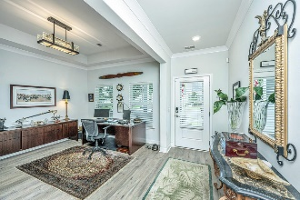
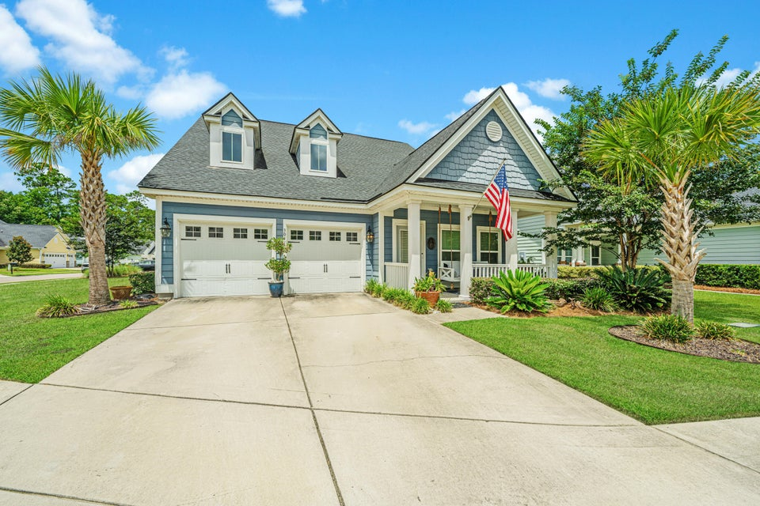
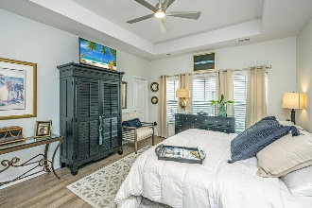
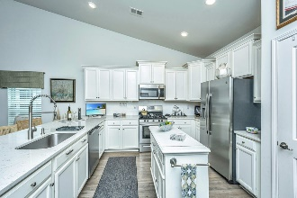
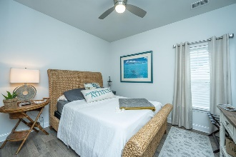
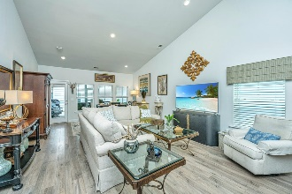
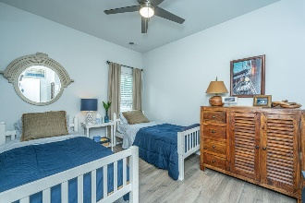
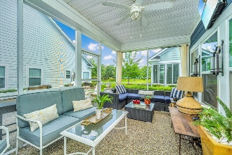
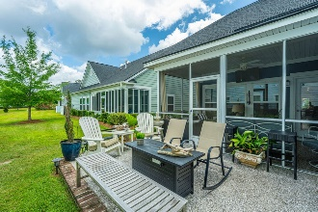
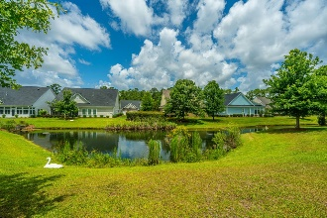
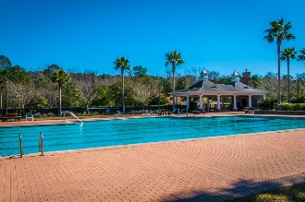
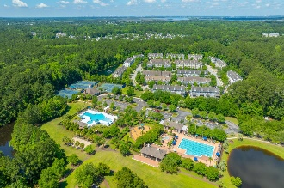


Price Reduction! 55+ Mt. Pleasant Community
3041 Rice Field Lane
Park West | Mount Pleasant, SC 29466 | MLS# 24015811 | $730,000
Welcome to this charming single-story cottage located in the desirable 55+ gated community of Park West in Mt. Pleasant. This home offers a spacious and inviting layout, starting with a welcoming foyer that leads into a versatile study or dining room. The heart of the home is the open floor plan that includes a gourmet kitchen with quartz countertops, a custom backsplash, and high-end stainless steel appliances. The family room features a vaulted ceiling and opens onto a fabulous screened-in porch and oyster shell tabby patio, ideal for entertaining. The primary bedroom is a serene retreat with a tray ceiling and direct access to the screened porch. The en-suite bathroom is equipped with dual sinks, an upgraded walk-in shower, and a soaking tub.
A $TBD* Lender Credit is available and will be applied towards the buyer's closing costs and pre-paids if the buyer chooses to use the seller's preferred lender. This credit is in addition to any negotiated seller concessions.
Designed for a stress-free lifestyle, this home includes monthly regime services such as lawn maintenance and window cleaning, allowing you more time to enjoy the beach, golf, and all that Charleston has to offer. Don't miss out on this exceptional opportunity to live in comfort and style!
Debbie Rogers (843) 990-2915
deborah.rogers@carolinaone.com
www.DebbieRogersSellsCharleston.com
Carolina One Real Estate | 2713 Highway 17 North | Mt. Pleasant, SC 29466

